Slide 1
Welcome back!
2023/24

Slide 2
What’s new for 2023-24?
We have been busy over the Summer Holidays making sure that each and every child in KS2 (so that’s Y3 to Y6) has their own device. So children in Y3 and Y4 will have a Samsung Tablet and children in Y5 and Y6 will have an iPad. This will form a huge part of your learning in school and it is yours to look after – so take care of it!
And children in Y1 and Y2 will have a device 1:2 – so a big change with technology for everyone!

Slide 3
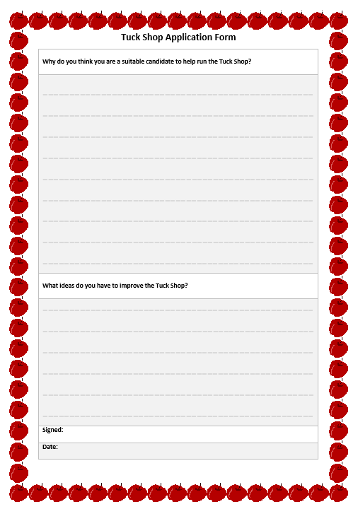
What’s new for 2023-24?
PE Kits. For the time being, all children in school will be bringing their PE Kit to school and getting changed at school. We will see how this goes – but this is how it always used to be!
Outdoor area near the bike shed – this will be a chill-out zone!
Tuck Shop – new recruits needed! Please come to my office for an application form.

Slide 4

Your wellbeing @ Markeaton

