Slide 1
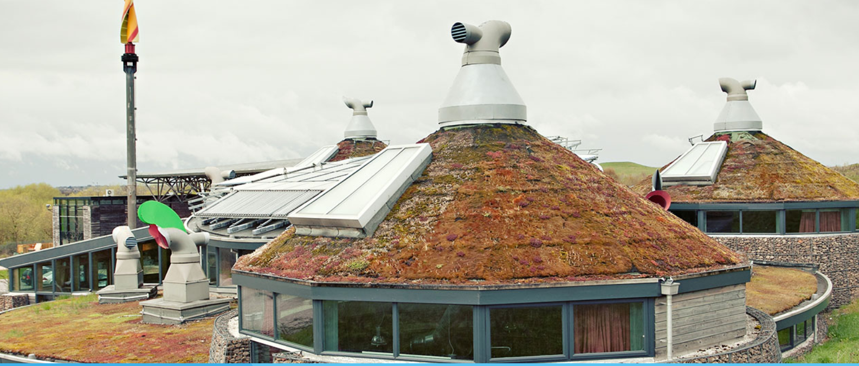
Kingswood Activity Centre
Dearne Valley
Doncaster
Wednesday 28th June – Friday 30th June

Slide 2
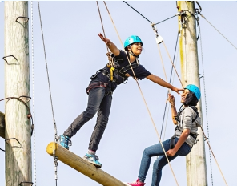
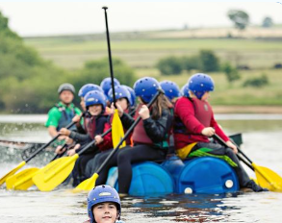
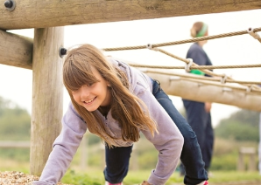
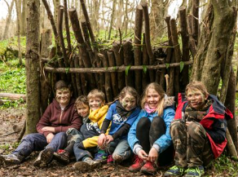
Formerly the Earth Centre, one of the millennium commission projects, Dearne Valley was transformed into a state-of-the-art activity centre in 2012. Dearne Valley is our most environmentally sustainable centre, complete with one of Europe’s largest solar panels and an on-site water treatment plant.
With fantastic indoor and outdoor activity facilities surrounded by the beautiful countryside of South Yorkshire, a purpose-built water sports lake and access to the adjacent River Don, Dearne Valley offers something for everyone.
Why are we going here?

Slide 3
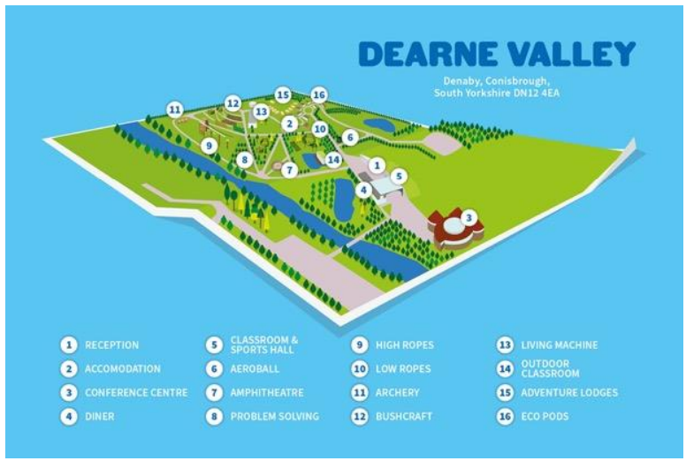

Slide 4
Which staff members are going?
Mr Holmes
Miss Herriman
Miss Hall
Miss Hawley
Mr Campbell
Ms Morrison
Mrs Outten-Mann

Slide 5
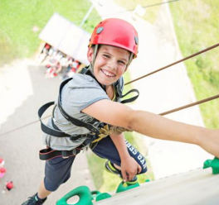
What activities are we doing?
We will be doing a range of activities over the 3 days. Activities will involve wearing a harness and climbing, working together to create, sports/games ( but not as you know it) and a water-based activity.
All children will have the opportunity to take part in the same activities.
While they will be encourage and supported, no child will be forced to do an activity that they do not want to. The emphasis will be on supporting each other and giving it a go.

Slide 6
Who will my child be with?
For the activities, the children will be split into 4 groups. Children will have their say about who they want to be with and we will try to ensure everyone is happy.
In between activities, during meal times and free times and in the evening we will all be together.
Bedrooms: the bedrooms range in size from 4 bed to 10 bed rooms. Children will select who they would like to be with and we will try to ensure that everyone is happy.

Slide 7
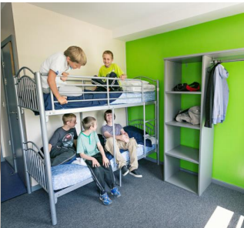
Accommodation / night times
We have our own accommodation block split over 2 floors that is fully secure. The children sleep in shared bedrooms that each has its own bathroom.
Boys and girls sleep in separate zones and adult rooms are spread throughout both floors.
All bedding is provided.
Children do not go into each others rooms.

Slide 8

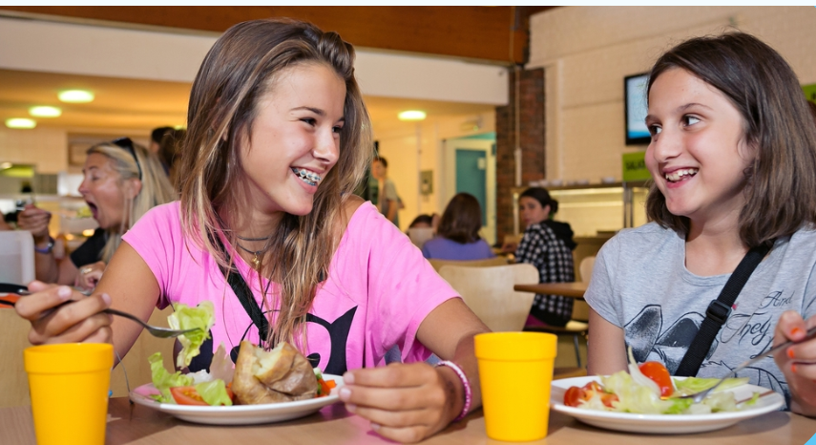
We can cater for dietary requirements. You need to let us know on the medical and permission forms that were sent out on Monday.
There is water and juices available throughout the day and snacks and drinks are available to buy from the shop.
Children will need a packed lunch on the first day.

Slide 9




Slide 10

Kit List
Socks and underwear
T-shirts/shirts ( at least 1 long sleeved)*
Jumpers/hoodie
Trousers/jeans/ tracksuit bottoms
Trainers – at least 2 pairs
Set of clothes and shoes that can get wet
Plastic bags for wet/dirty clothes
Bath towel
Toiletries Bag (toothbrush, toothpaste, soap, hairbrush etc)
Night clothes
Waterproof jacket
Sun hat/ sunscreen
Waterbottle
*Please note most activities require long sleeves

Slide 11
Kit List
Bring plenty of clothes – pack in one big bag.
Pocket money – recommended up to £10 to spend on snacks and souvenirs at the on-site gift shop.
Phones / electronic devices – no thank you. Any phones brought are to be handed in on the morning of the trip and will be returned when we return to school. Kingswood do not allow electronic equipment in the rooms so please do not bring any.
Label everything!

Slide 12
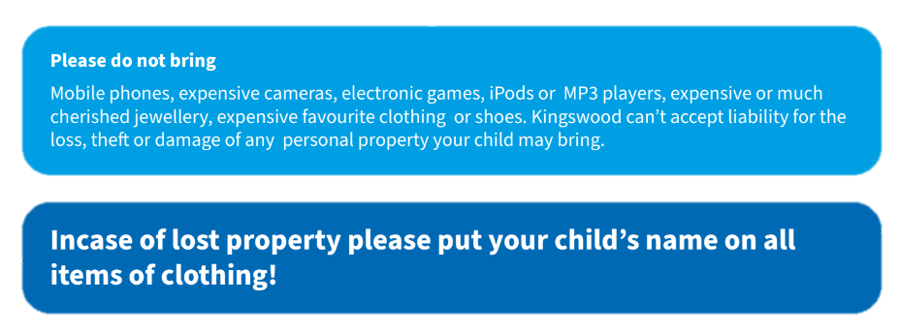
Kit List

Slide 13

Timings
Children are to arrive at the normal time on Wednesday 28th June. Bring medication, packed lunch and suitcase.
We will complete an activity in school and depart school around 11.00am to arrive around 12.30. We will have a picnic lunch before meeting our course leader, sorting out bedrooms and the off to complete the first activity.
On Friday, we will depart Kingswood around 2.00pm to be back in school ready for the end of the day.

Slide 14

Any Questions?
https://www.kingswood.co.uk/hub/faqs

