Slide 1
Whole School Assembly
8.3.2022

Slide 2
Democracy
Rule of law
Individual liberty
Mutual respect
Tolerance
What are these?

Slide 4
Why Are Rules Important?
1
If we didn’t have rules and everyone could do whatever they wanted, there would be chaos.
To keep people safe.
2
To help people learn.
3
To help us understand the difference between right and wrong.
4
To give everyone a chance to join in.
5
To help us show respect for each other.
6
To give everyone a chance to be heard.

Slide 5
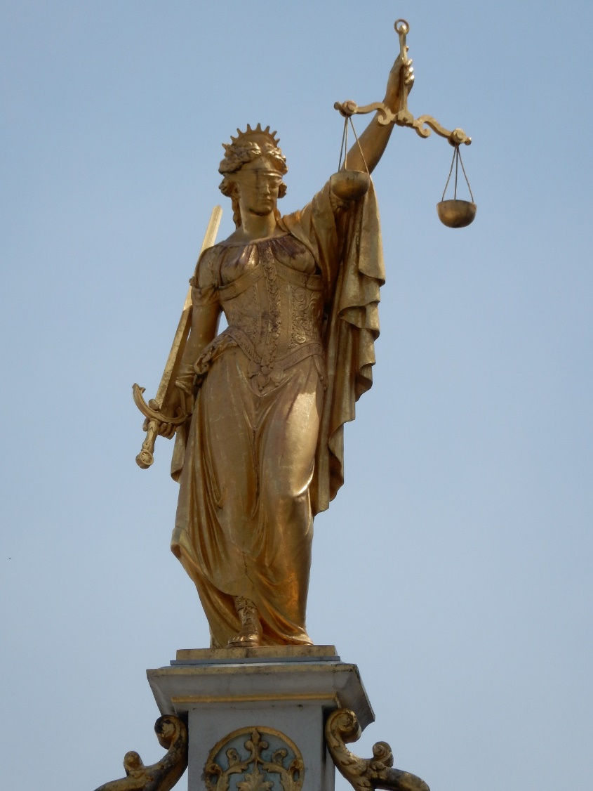
Lady J…..?
Who is this?
Originally known as the goddess Themis, she represents f…?
In Greek, Themis means o…?

Slide 6
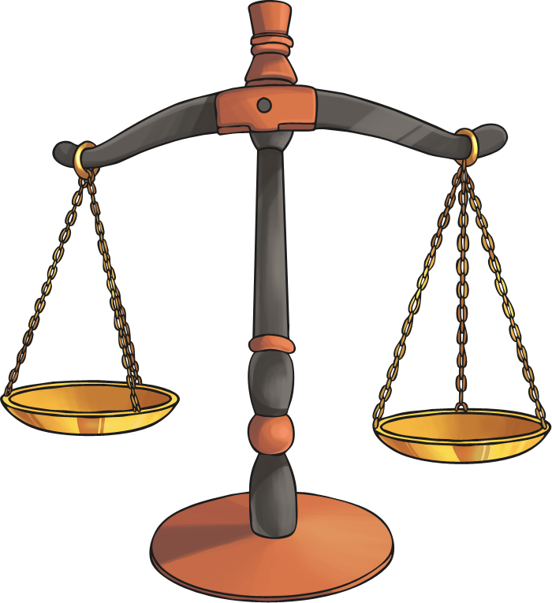
Why does Britain have a legal system with laws and rules?
Here are just a few:
To prevent unacceptable behaviour
To keep an eye on businesses and how they spend their money
To identify who should own houses ands buildings
To help families with their relationships
To help people solve arguments between one another

Slide 7
Civil Law
Civil law is all about people dealing with other people:
Civil law covers activities such as:
Lending and borrowing…..?
Entering into contracts
Disputes with…..?
Getting…..?
Inheritances and wills
Challenge:
Can you think of any more civil law activities?

Slide 8
Criminal Law
Criminal offences are regarded as offences against society. It includes the punishment of people who break these laws.
It deals with matters such as:
Crimes against people:
Crimes against property and buildings

Slide 9
The Old B…..?
“The Old Bailey” by [It's No Game] is licensed under CC BY 2.0
The Central Criminal Court of England and Wales, commonly known as the Old Bailey from the street on which it stands, is a court in London, and one of a number of buildings housing the Crown Court.

Slide 10
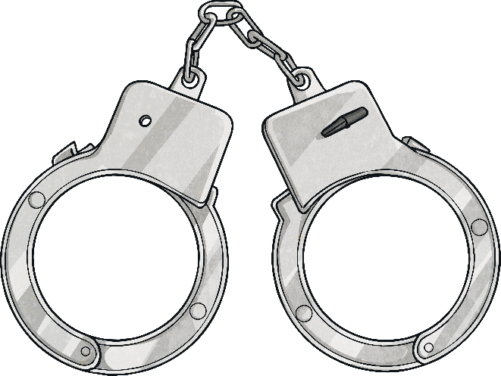
Compensation or Punishment?
In civil law, the courts award compensation (usually money) when someone can prove the other person is in the wrong.
In criminal courts, the aim is to punish wrongdoers and impose a sentence which prevents them from reoffending.
Compensation
This refers to the act of providing a person with money or other things of value in order to provide for the costs of injuries that they have incurred.
Sentence
This can generally involve imprisonment, a fine and/or other punishments against a defendant convicted of a crime.

