Slide 1
Recycling Assembly
Sept 2021
What do we know?

Slide 2
Quick quiz
https://www.theguardian.com/environment/2018/jul/01/think-you-know-how-to-recycle-take-the-quiz

Slide 3
Challenge
At Markeaton, we are now a recognised collection point for crisp packets.
What do you think could be made from a crisp packet? 3 volunteers…
Now let’s see what the professionals say:
https://www.bing.com/videos/search?q=walkers+crisp+recycle&&view=detail&mid=7BE9150DA3D8DFEB72817BE9150DA3D8DFEB7281&&FORM=VRDGAR

Slide 4
Serious question…
Where do you think the crisp recycling bins should go in school?
What should be the roles of an eco council?

Slide 5
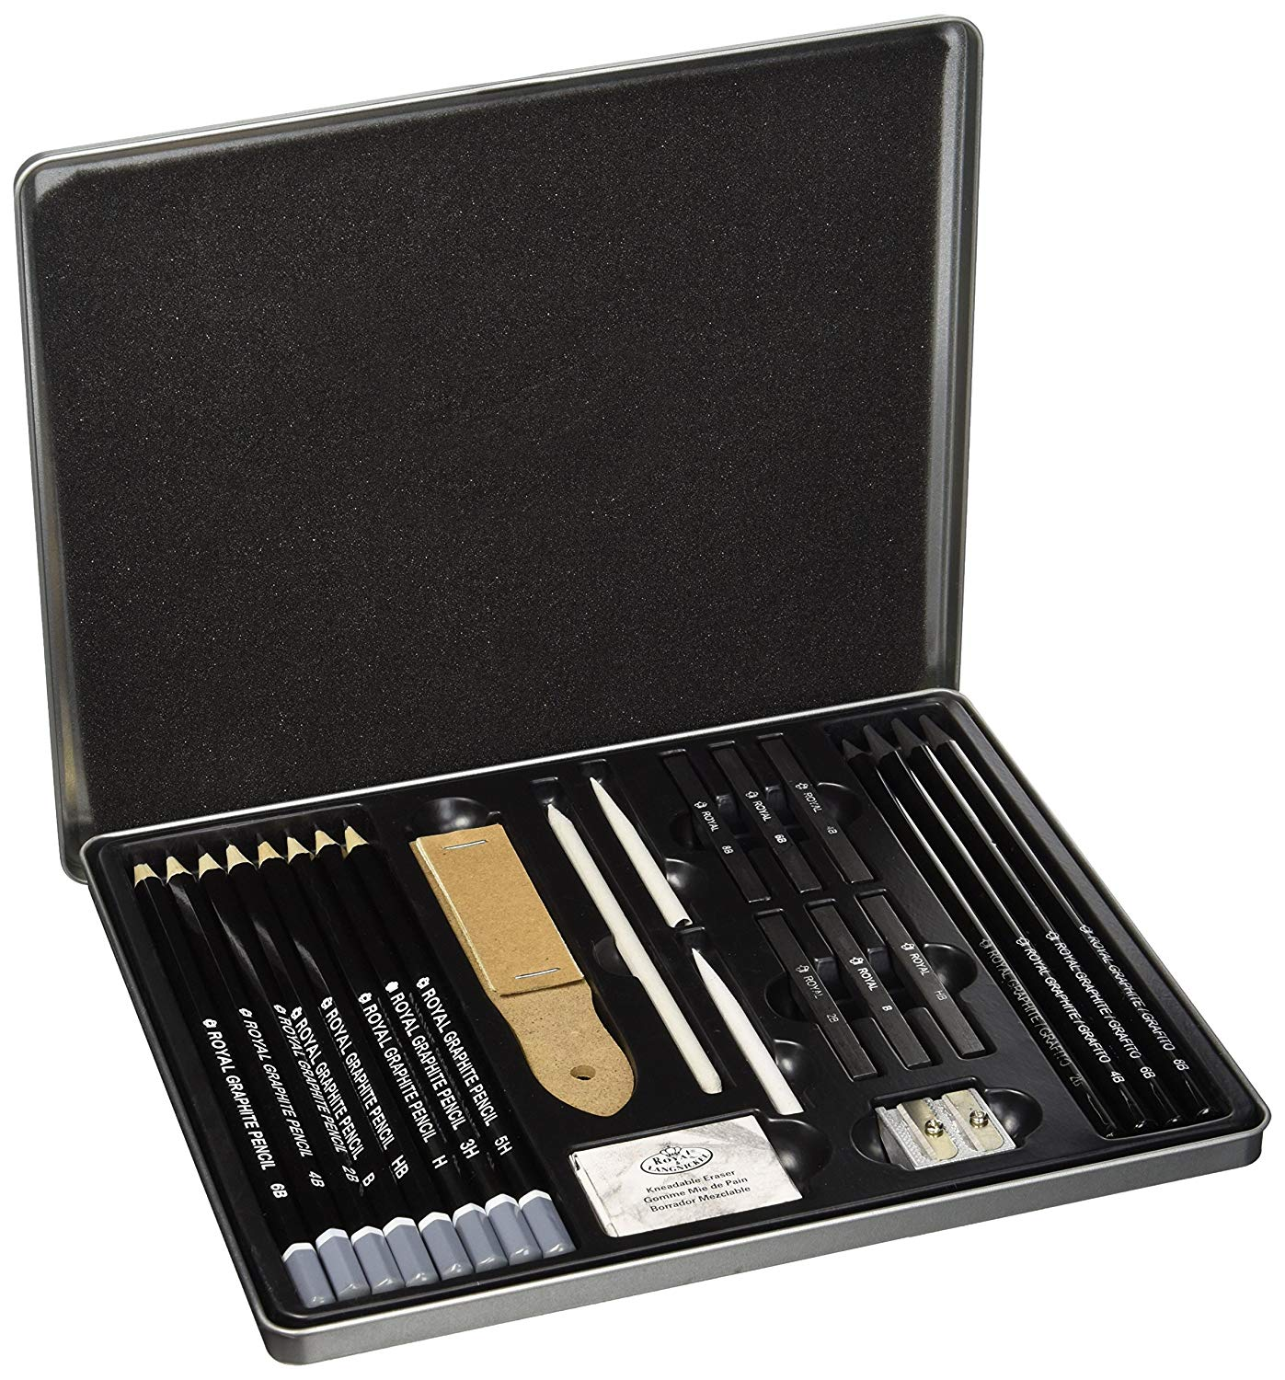
Competition
Design a logo for Markeaton’s Eco Council. Come and collect an entry form from my office.
The winning design will be put on the school website and the winner will receive a Graphic Art Set to help them with future designs!

Slide 6
And finally…
https://www.youtube.com/watch?v=07d2dXHYb94

