Slide 2
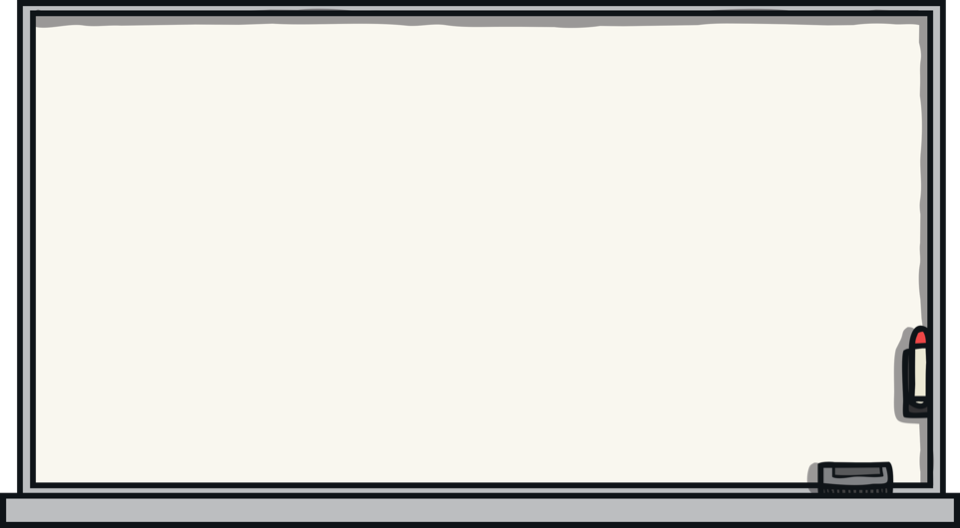
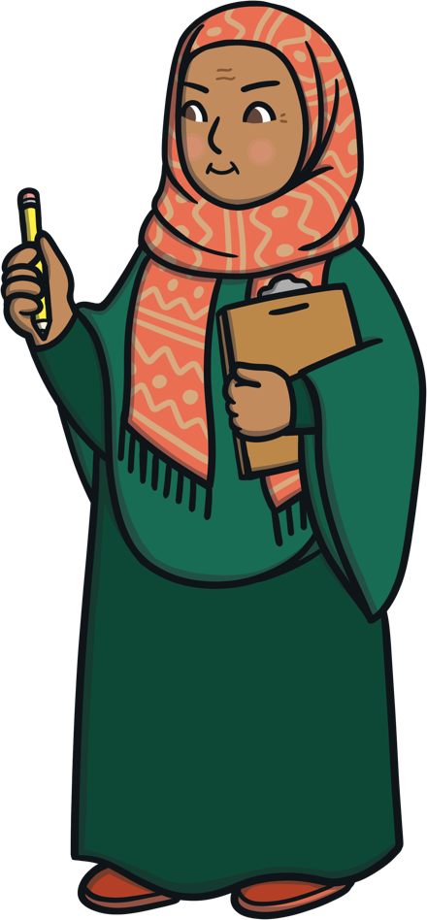
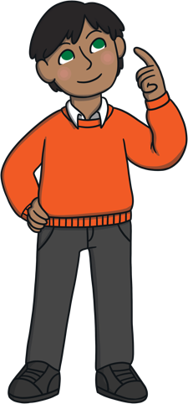
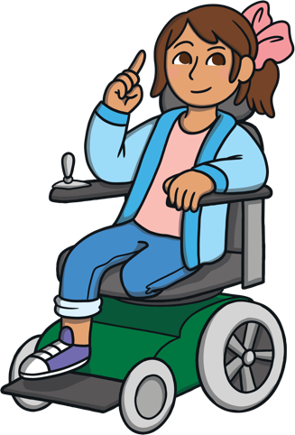
What Is Ramadan?
Think-Pair-Share.
Think about these questions and discuss your answers with a partner.
What is fasting?
What is Ramadan?
Why Ramadan is so special?

Slide 3

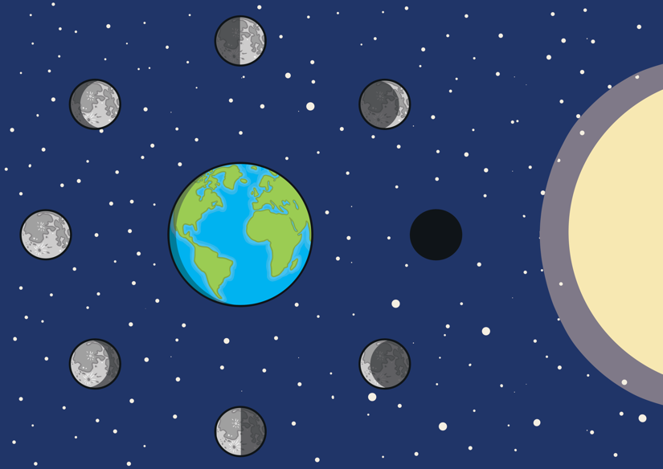
What Is Ramadan?
Ramadan is the ninth month of the Islamic calendar.
9
The Islamic calendar is lunar. This means that the calendar follows the patterns of the moon, not the sun.
Ramadan begins when we see a new moon in a crescent shape in the sky.

Slide 4
…began Saturday, 2 April ends Sunday, 1 May…

Slide 5
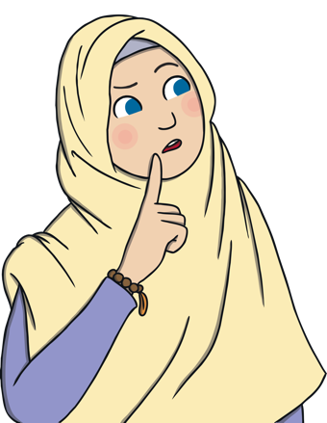
How Many Months in the Islamic Calendar?
There are twelve months in the Islamic calendar, just like in the Gregorian calendar.
What Islamic month are we in right now?

Slide 6
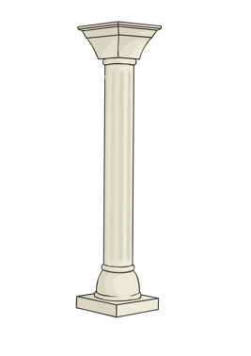
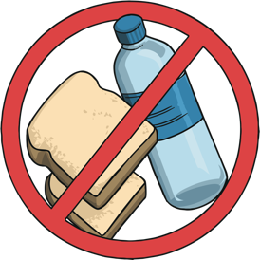
What Is Fasting?
Ramadan is also the month of fasting. Siyam means fasting in Arabic.
Fasting in Ramadan is one of the five pillars of Islam.
Fasting
4
Fasting is when we do not eat or drink from Fajr/dawn until Maghrib/sunset.
Healthy adult Muslims should fast during Ramadan.
Fasting is a way of worshiping Allah by not eating or drinking. We also stay away from bad deeds when we are fasting and we do extra good deeds.

Slide 7

Why Do We Fast?
Fasting teaches us to be patient, self-disciplined and to be grateful for Allah’s blessings.
When we fast and we can control ourselves from eating or drinking, this will help to train us to control any bad habits or bad deeds. It will help us to become better Muslims.
Can you think of any examples of giving up bad habits or bad deeds?

Slide 8
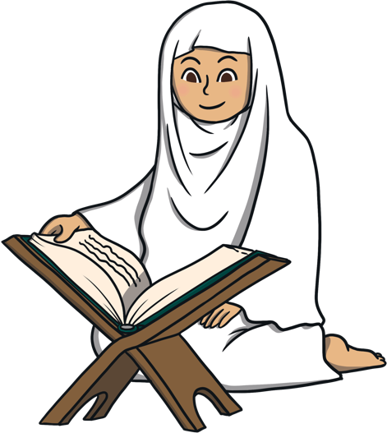
Why Ramadan Is So Special?
During the month of Ramadan, we have the chance to gain a lot of rewards when we do good deeds.
If we do a good deed in Ramadan, the rewards will be multiplied compared to doing the same good deed in a normal month. Allah will also wipe away our sins.
During a normal month.
During Ramadan.
Rewards x1
Rewards x7

Slide 9
Winners of Big Walk and Wheel
Winning Class…?
The winning class gets a 15 minute lunch voucher, so when you want, you can have an extra 15 minutes of playtime at lunch!
1st Prize…?
2nd Prize…?
3rd Prize…?

Slide 10
Readathon
Well done to everyone that took part in this year’s Readathon – you helped the school to raise nearly £400 for new books!
And our winners for each year groups are…

