Slide 1
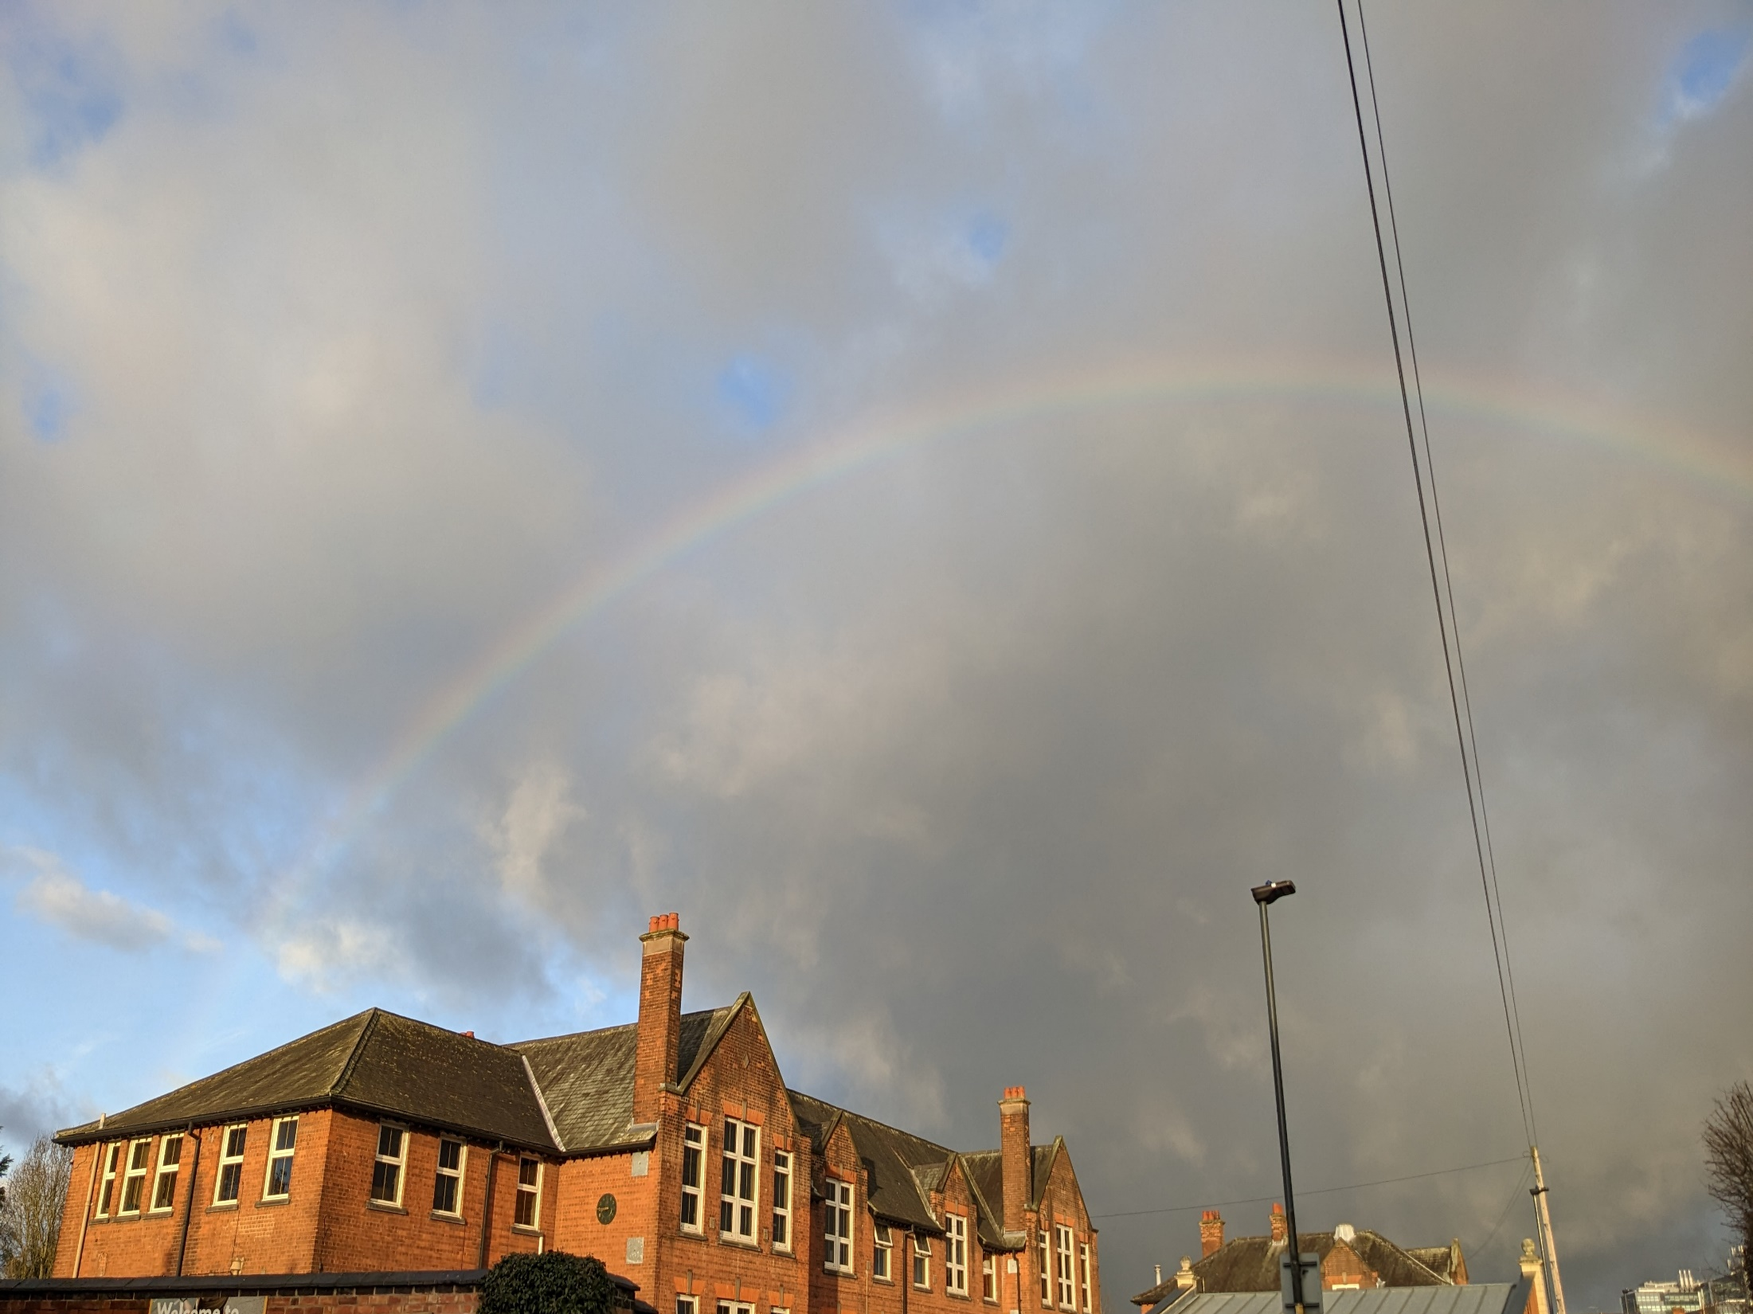
When you see a rainbow, what does it make you think of?

Slide 2
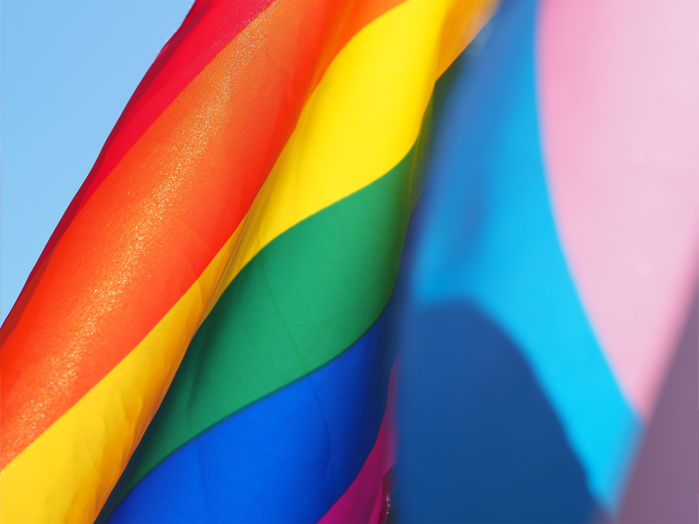
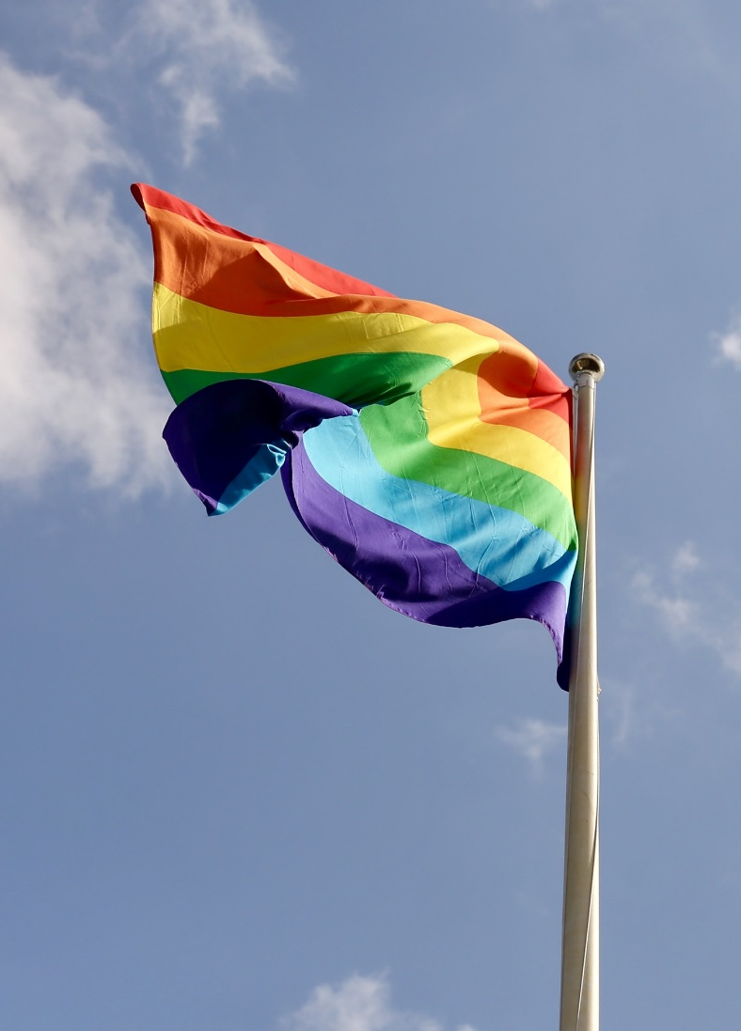
Why is a rainbow flag used to symbolise inclusion?
Rainbow flags have been used in many places over the centuries. They tend to be used as a sign of new eras, hope or social changes.
Today, the flag is flown as a sign of inclusion and welcome.
What does inclusion mean?
The flag’s six colours represent different things, but the rainbow also means freedom to express yourself and be who you want to be.

Slide 3
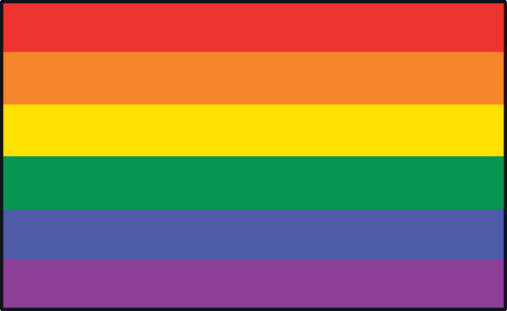
The different colours, can you guess which one is which (answers on the right)?
The colours represent:
Life
Sunlight
Healing
Nature
Spirit
Harmony/Peace
Life
Healing
Sunlight
Nature
Harmony/Peace
Spirit
Did You Know?
The 1978 flag originally had eight colours, but has undergone changes over the years, partly due to the availability of fabric colours.

Slide 4
Do you think you could design a new flag for Markeaton?

