Slide 1
Parent/Carer Questionnaire Results
Summer 2021
Based on 196 responses

Slide 2
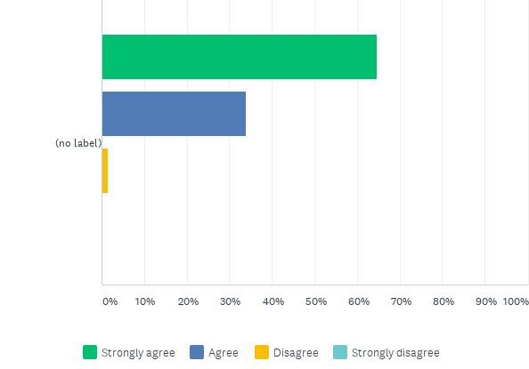
Q1: My child is happy at school.
Answered: 195 Skipped: 1

Slide 3
Q1: My child is happy at school.
Answered: 195 Skipped: 1

Slide 4
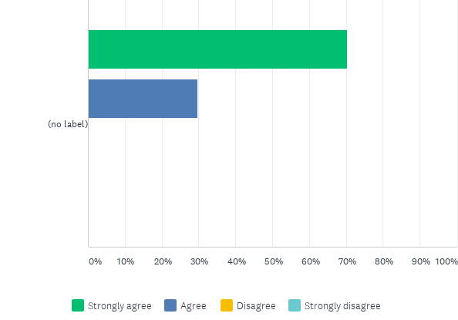
Q2: My child feels safe at school
Answered: 195 Skipped: 1

Slide 5
Q2: My child feels safe at school
Answered: 195 Skipped: 1

Slide 6
Q3: There is a positive atmosphere at Markeaton Primary School.
Answered: 194 Skipped: 2

Slide 7
Q3: There is a positive atmosphere at Markeaton Primary School.
Answered: 194 Skipped: 2

Slide 8
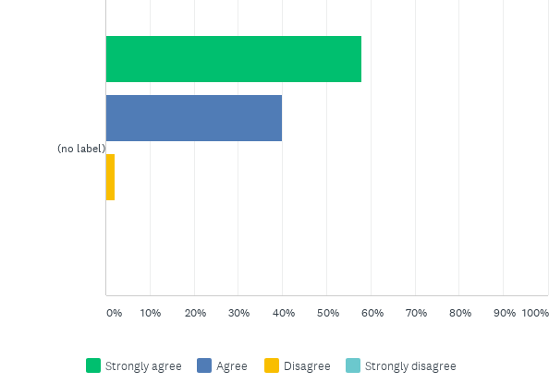
Q4: The outdoor environment is effective at supporting creativity and learning.This has formed a large part of the Recovery Curriculum since September so we would appreciate any further feedback on this in the comments box below.
Answered: 193 Skipped: 3

Slide 9
Q4: The outdoor environment is effective at supporting creativity and learning.This has formed a large part of the Recovery Curriculum since September so we would appreciate any further feedback on this in the comments box below.
Answered: 193 Skipped: 3

Slide 10
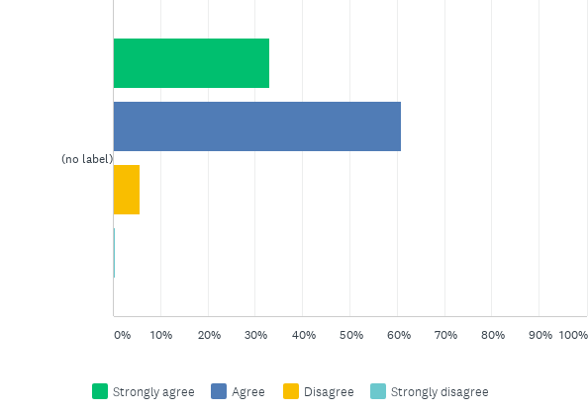
Q5: I am kept well informed about what my child is learning at school e.g. class Twitter pages, Curriculum Newsletters, 'All you need to know' booklets etc. Click on the links to visit Y1 as an example but all other year groups are on the same page down the left hand side.
Answered: 194 Skipped: 2

Slide 11
Q5: I am kept well informed about what my child is learning at school e.g. class Twitter pages, Curriculum Newsletters, 'All you need to know' booklets etc. Click on the links to visit Y1 as an example but all other year groups are on the same page down the left hand side.
Answered: 194 Skipped: 2

Slide 12
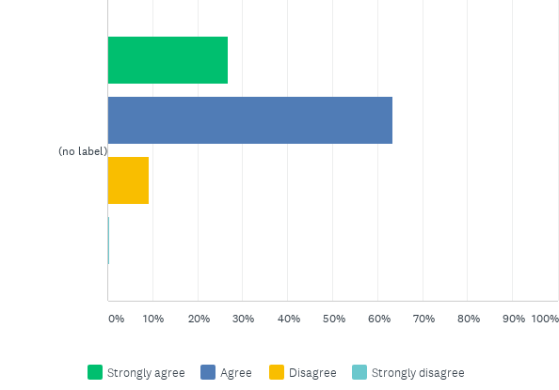
Q6: I am kept well informed about how my child is progressing.
Answered: 194 Skipped: 2

Slide 13
Q6: I am kept well informed about how my child is progressing.
Answered: 194 Skipped: 2

Slide 14
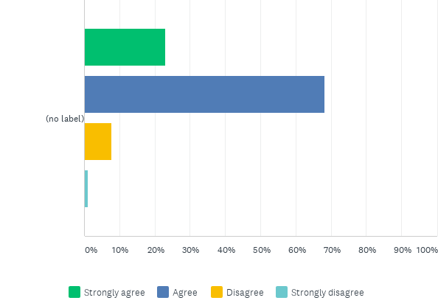
Q7: I think my child gets an appropriate amount of homework.
Answered: 195 Skipped: 1

Slide 15
Q7: I think my child gets an appropriate amount of homework.
Answered: 195 Skipped: 1

Slide 16
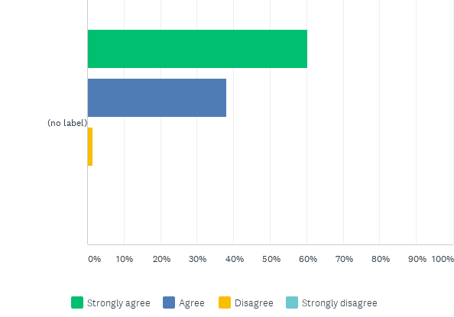
Q8: I think my child is taught well.
Answered: 194 Skipped: 2

Slide 17
Q8: I think my child is taught well.
Answered: 194 Skipped: 2

Slide 18
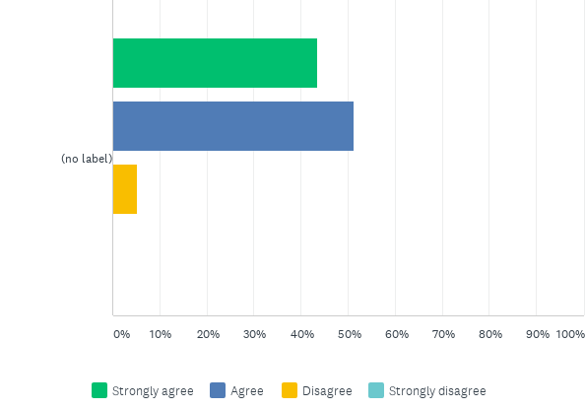
Q9: Markeaton Primary School has high expectations for my child.
Answered: 193 Skipped: 3

Slide 19
Q9: Markeaton Primary School has high expectations for my child.
Answered: 193 Skipped: 3

Slide 20
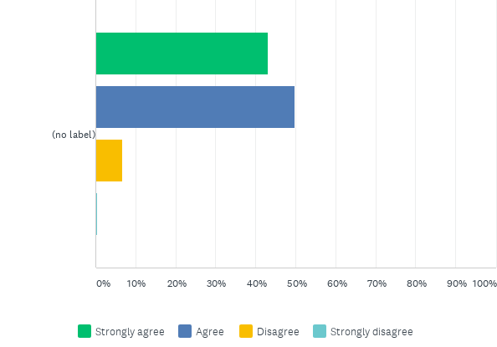
Q10: Markeaton Primary School ensures that my child is able to explore their potential.
Answered: 193 Skipped: 3

Slide 21
Q10: Markeaton Primary School ensures that my child is able to explore their potential.
Answered: 193 Skipped: 3

Slide 22
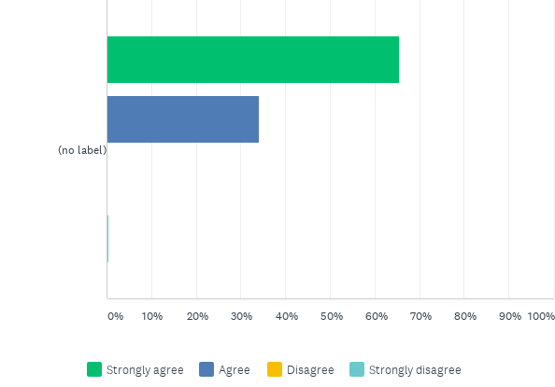
Q11: The school is led and managed effectively.
Answered: 194 Skipped: 2

Slide 23
Q11: The school is led and managed effectively.
Answered: 194 Skipped: 2

Slide 24
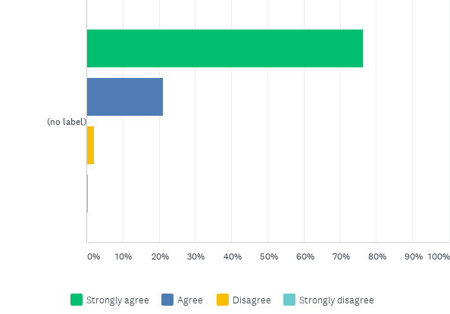
Q12: I would recommend Markeaton Primary School to another family.
Answered: 195 Skipped: 1

Slide 25
Q12: I would recommend Markeaton Primary School to another family.
Answered: 195 Skipped: 1

Slide 26
Q13: Markeaton Primary School has a good reputation.
Answered: 196 Skipped: 0

Slide 27
Q13: Markeaton Primary School has a good reputation.
Answered: 196 Skipped: 0

Slide 28
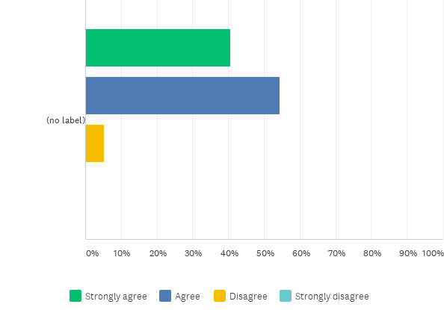
Q14: I understand how my child is assessed at Markeaton Primary and the language that is used.
Answered: 195 Skipped: 1

Slide 29
Q14: I understand how my child is assessed at Markeaton Primary and the language that is used.
Answered: 195 Skipped: 1

Slide 30
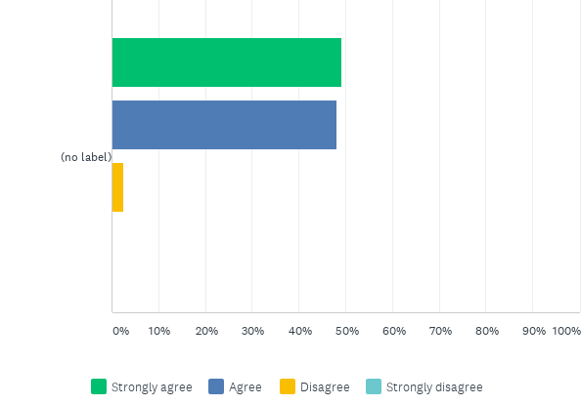
Q15: The school’s vision and values have a positive impact on my child.
Answered: 195 Skipped: 1

Slide 31
Q15: The school’s vision and values have a positive impact on my child.
Answered: 195 Skipped: 1

Slide 32
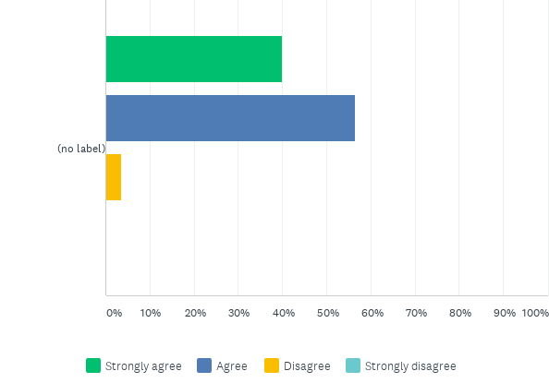
Q16: I think behaviour is good at Markeaton Primary School.
Answered: 195 Skipped: 1

Slide 33
Q16: I think behaviour is good at Markeaton Primary School.
Answered: 195 Skipped: 1

Slide 34
Q17: I think the school deals with any incidents of bullying effectively.
Answered: 191 Skipped: 5

Slide 35
Q17: I think the school deals with any incidents of bullying effectively.
Answered: 191 Skipped: 5

Slide 36
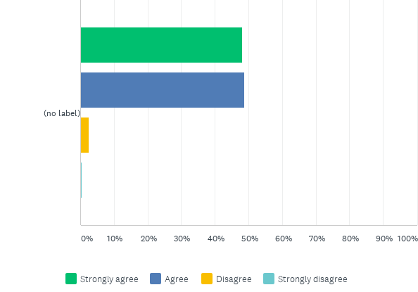
Q18: The school treats my child fairly.
Answered: 195 Skipped: 1

Slide 37
Q18: The school treats my child fairly.
Answered: 195 Skipped: 1

Slide 38
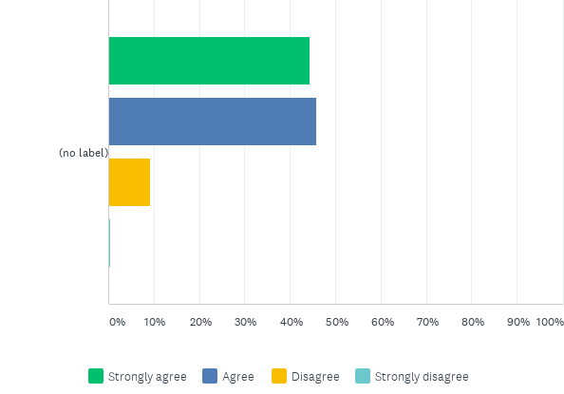
Q19: My child is confident that, should they have a problem, there is someone they can go to in school who will listen to them.
Answered: 194 Skipped: 2

Slide 39
Q19: My child is confident that, should they have a problem, there is someone they can go to in school who will listen to them.
Answered: 194 Skipped: 2

Slide 40
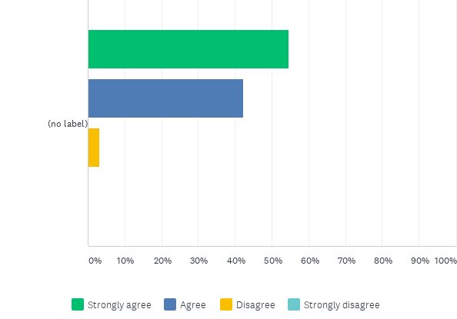
Q20: My child enjoys playtimes and lunchtimes.
Answered: 196 Skipped: 0

Slide 41
Q20: My child enjoys playtimes and lunchtimes.
Answered: 196 Skipped: 0

Slide 42
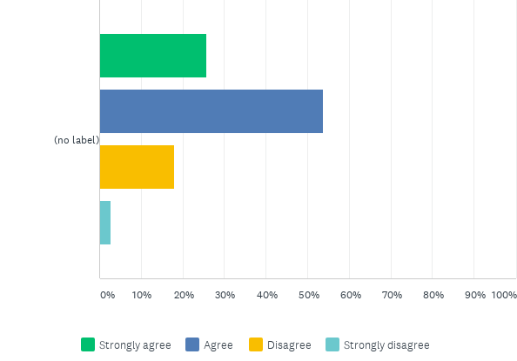
Q21: My child finds school meals enjoyable.
Answered: 190 Skipped: 6

Slide 43
Q21: My child finds school meals enjoyable.
Answered: 190 Skipped: 6

Slide 44
Q22: I think members of staff at Markeaton Primary School are approachable.We appreciate that this has been more difficult due to Covid Restrictions throughout the year.
Answered: 195 Skipped: 1

Slide 45
Q22: I think members of staff at Markeaton Primary School are approachable.We appreciate that this has been more difficult due to Covid Restrictions throughout the year.
Answered: 195 Skipped: 1

Slide 46
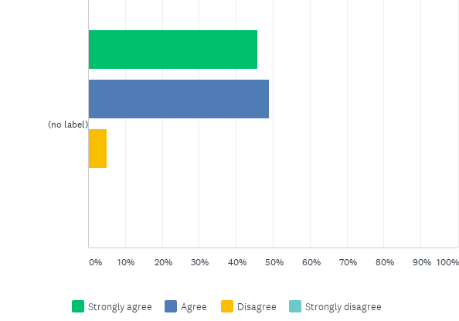
Q23: Parent/Carer Consultation Evenings provide me with the information I require about my child’s progress and achievement. *These have been held over the phone this year due to restrictions*
Answered: 196 Skipped: 0

Slide 47
Q23: Parent/Carer Consultation Evenings provide me with the information I require about my child’s progress and achievement. *These have been held over the phone this year due to restrictions*
Answered: 196 Skipped: 0

Slide 48
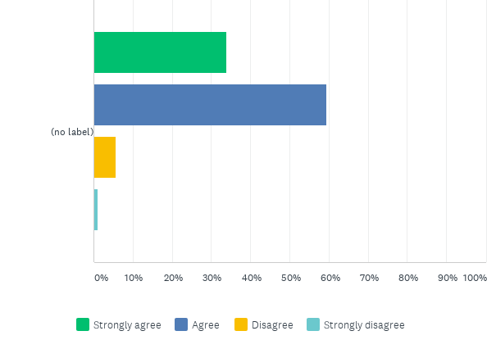
Q24: I think the school seeks my views and listens to my concerns.
Answered: 195 Skipped: 1

Slide 49
Q24: I think the school seeks my views and listens to my concerns.
Answered: 195 Skipped: 1

Slide 50
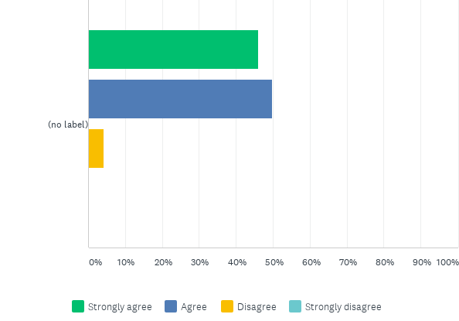
Q25: I feel my child's mental health/well-being is well supported at Markeaton.Supporting children's mental health and wellbeing has also played a strong role in our Recovery Curriculum.
Answered: 191 Skipped: 5

Slide 51
Q25: I feel my child's mental health/well-being is well supported at Markeaton.Supporting children's mental health and wellbeing has also played a strong role in our Recovery Curriculum.
Answered: 191 Skipped: 5

Slide 52
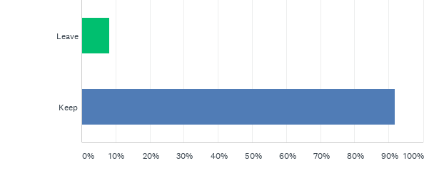
Q26: *Leavers and Keepers* Children coming into school in their PE Kits?
Answered: 194 Skipped: 2

Slide 53
Q26: *Leavers and Keepers* Children coming into school in their PE Kits?
Answered: 194 Skipped: 2

Slide 54
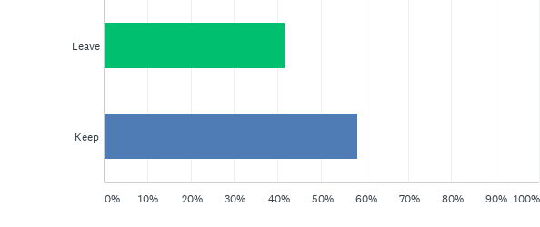
Q27: *Leavers and Keepers* Homework via Microsoft Teams?
Answered: 192 Skipped: 4

Slide 55
Q27: *Leavers and Keepers* Homework via Microsoft Teams?
Answered: 192 Skipped: 4

Slide 56
Q28: *Leavers and Keepers* Staggered start and end times?
Answered: 193 Skipped: 3

Slide 57
Q28: *Leavers and Keepers* Staggered start and end times?
Answered: 193 Skipped: 3

Slide 58
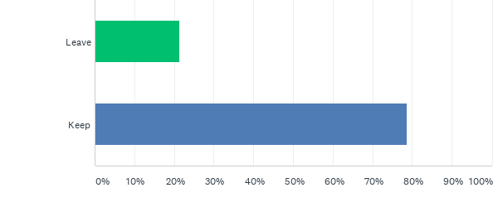
Q29: *Leavers and Keepers* Parents/carers dropping off at the gate(s) rather than on the playground?We have seen a hugely positive impact on the children's levels of independence and overall calmness coming into the classroom with the current system but we understand this doesn't always work for everyone.
Answered: 192 Skipped: 4

Slide 59
Q29: *Leavers and Keepers* Parents/carers dropping off at the gate(s) rather than on the playground?We have seen a hugely positive impact on the children's levels of independence and overall calmness coming into the classroom with the current system but we understand this doesn't always work for everyone.
Answered: 192 Skipped: 4

Slide 60
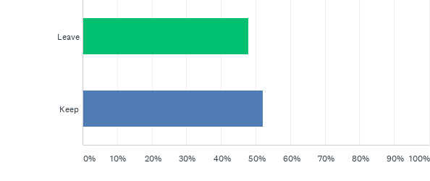
Q30: *Leavers and Keepers* Online or over the phone Parent/Carer meetings?From a school perspective this has worked well in that general uptake in all year groups has been higher. Following the feedback you provide us, we may well look at some being in school (so you can see your child's work) and some being done remotely.
Answered: 192 Skipped: 4

Slide 61
Q30: *Leavers and Keepers* Online or over the phone Parent/Carer meetings?From a school perspective this has worked well in that general uptake in all year groups has been higher. Following the feedback you provide us, we may well look at some being in school (so you can see your child's work) and some being done remotely.
Answered: 192 Skipped: 4

Slide 62
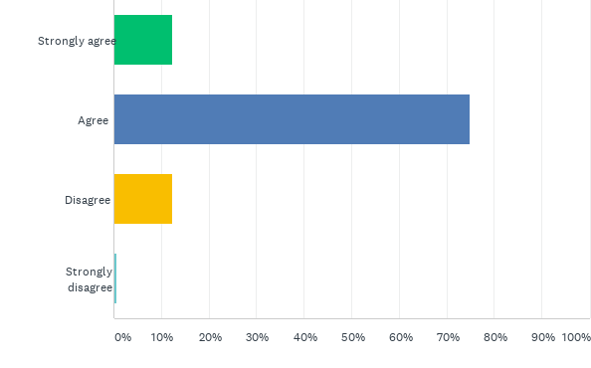
Q33: RSE (Relationships and Sex Education) has been taught effectively this year.
Answered: 147 Skipped: 49

Slide 63
Q33: RSE (Relationships and Sex Education) has been taught effectively this year.
Answered: 147 Skipped: 49

Slide 64
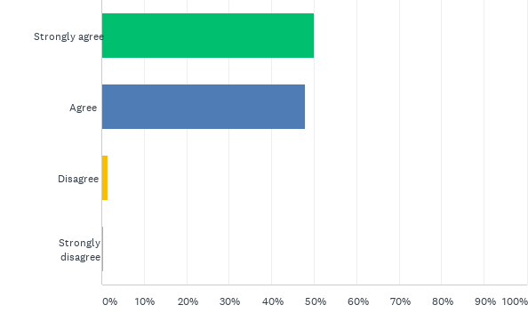
Q34: Markeaton has a strong and positive commitment towards equality.
Answered: 192 Skipped: 4

Slide 65
Q34: Markeaton has a strong and positive commitment towards equality.
Answered: 192 Skipped: 4

Slide 66
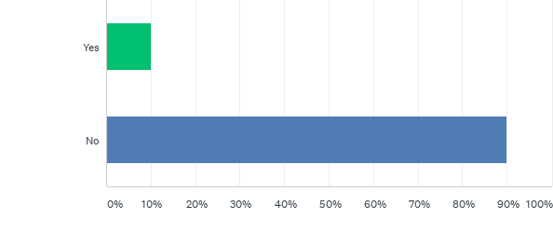
Q37: I would be happy to volunteer and help with some general manual tasks/DIY in school on Monday 26th July, Tuesday 27th July or Wednesday 28th July 2021.In advance - thank you, thank you, thank you!!!
Answered: 179 Skipped: 17

Slide 67
Q37: I would be happy to volunteer and help with some general manual tasks/DIY in school on Monday 26th July, Tuesday 27th July or Wednesday 28th July 2021.In advance - thank you, thank you, thank you!!!
Answered: 179 Skipped: 17

