Slide 1
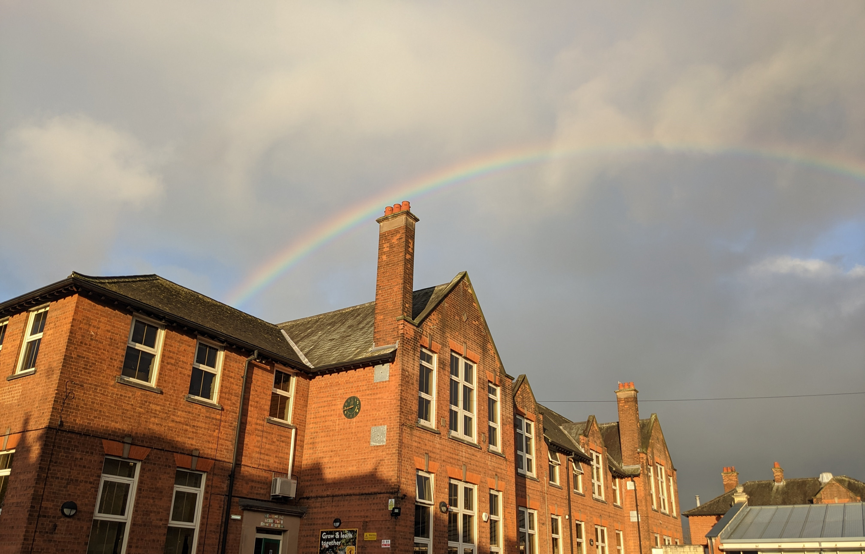
Thank you for all your feedback ☺ We had nearly 200 responses in total! Any responses which provide a score between 3.0 (agree) and 4.0 (strongly agree) is viewed as a positive response, so lots to celebrate overall and other areas/individual responses for us to consider. See previous years on the website for a comparison. Thanks again!

Slide 2
Q1: My child is happy at school:
Answered: 189 Skipped: 2

Slide 3
Q1: My child is happy at school:
Answered: 189 Skipped: 2
 | STRONGLY AGREE | AGREE | DISAGREE | STRONGLY DISAGREE | TOTAL | WEIGHTED AVERAGE
 | 61.90% 117 | 37.04% 70 | 0.53% 1 | 0.53% 1 | 189 | 3.60

Slide 4
Q2: My child feels safe at school:
Answered: 191 Skipped: 0

Slide 5
Q2: My child feels safe at school:
Answered: 191 Skipped: 0
 | STRONGLY AGREE | AGREE | DISAGREE | STRONGLY DISAGREE | TOTAL | WEIGHTED AVERAGE
 | 69.11% 132 | 30.37% 58 | 0% 0 | 0.52% 1 | 191 | 3.68

Slide 6
Q3: My child experiences outdoor learning on a regular basis (this could be any type of learning that takes place outside!):
Answered: 191 Skipped: 0

Slide 7
Q3: My child experiences outdoor learning on a regular basis (this could be any type of learning that takes place outside!):
Answered: 191 Skipped: 0
 | STRONGLY AGREE | AGREE | DISAGREE | STRONGLY DISAGREE | TOTAL | WEIGHTED AVERAGE
 | 41.36% 79 | 52.36% 100 | 5.24% 10 | 1.05% 2 | 191 | 3.34

Slide 8
Q4: I am kept well informed about what my child is learning at school e.g. class Twitter pages, Curriculum Newsletters, Weekly Words, 'All you need to know' booklets etc. Click on the links to visit Y1 as an example but all other year groups are on the same page down the left hand side:
Answered: 191 Skipped: 0

Slide 9
Q4: I am kept well informed about what my child is learning at school e.g. class Twitter pages, Curriculum Newsletters, Weekly Words, 'All you need to know' booklets etc. Click on the links to visit Y1 as an example but all other year groups are on the same page down the left hand side:
Answered: 191 Skipped: 0
 | STRONGLY AGREE | AGREE | DISAGREE | STRONGLY DISAGREE | TOTAL | WEIGHTED AVERAGE
 | 42.93% 82 | 49.74% 95 | 5.24% 10 | 2.09% 4 | 191 | 3.34

Slide 10
Q5: I am kept informed about how my child is progressing e.g. Parent/Carer consultations with your child's teacher, Parent/Carer pop-ins (where you can come into school and look at your child's work):
Answered: 191 Skipped: 0

Slide 11
Q5: I am kept informed about how my child is progressing e.g. Parent/Carer consultations with your child's teacher, Parent/Carer pop-ins (where you can come into school and look at your child's work):
Answered: 191 Skipped: 0
 | STRONGLY AGREE | AGREE | DISAGREE | STRONGLY DISAGREE | TOTAL | WEIGHTED AVERAGE
 | 42.41% 81 | 46.60% 89 | 8.90% 17 | 2.09% 4 | 191 | 3.29

Slide 12
Q6: I think my child is taught well:
Answered: 191 Skipped: 0

Slide 13
Q6: I think my child is taught well:
Answered: 191 Skipped: 0
 | STRONGLY AGREE | AGREE | DISAGREE | STRONGLY DISAGREE | TOTAL | WEIGHTED AVERAGE
 | 57.07% 109 | 40.31% 77 | 1.57% 3 | 1.05% 2 | 191 | 3.53

Slide 14
Q7: Markeaton Primary School is led and managed effectively:
Answered: 190 Skipped: 1

Slide 15
Q7: Markeaton Primary School is led and managed effectively:
Answered: 190 Skipped: 1
 | STRONGLY AGREE | AGREE | DISAGREE | STRONGLY DISAGREE | TOTAL | WEIGHTED AVERAGE
 | 65.79% 125 | 33.68% 64 | 0% 0 | 0.53% 1 | 190 | 3.65

Slide 16
Q8: I would recommend Markeaton Primary School to another family:
Answered: 191 Skipped: 0

Slide 17
Q8: I would recommend Markeaton Primary School to another family:
Answered: 191 Skipped: 0
 | STRONGLY AGREE | AGREE | DISAGREE | STRONGLY DISAGREE | TOTAL | WEIGHTED AVERAGE
 | 75.92% 145 | 23.04% 44 | 0.52% 1 | 0.52% 1 | 191 | 3.74

Slide 18
Q9: I understand how my child is assessed at Markeaton Primary and the language that is used:
Answered: 191 Skipped: 0

Slide 19
Q9: I understand how my child is assessed at Markeaton Primary and the language that is used:
Answered: 191 Skipped: 0
 | STRONGLY AGREE | AGREE | DISAGREE | STRONGLY DISAGREE | TOTAL | WEIGHTED AVERAGE
 | 43.46% 83 | 48.69% 93 | 6.81% 13 | 1.05% 2 | 191 | 3.35

Slide 20
Q10: My child knows our new school values: Care, Curiosity and Determination:
Answered: 190 Skipped: 1

Slide 21
Q10: My child knows our new school values: Care, Curiosity and Determination:
Answered: 190 Skipped: 1
 | STRONGLY AGREE | AGREE | DISAGREE | STRONGLY DISAGREE | TOTAL | WEIGHTED AVERAGE
 | 32.11% 61 | 58.95% 112 | 7.89% 15 | 1.05% 2 | 190 | 3.22

Slide 22
Q11: Markeaton Primary School works to ensure that children demonstrate positive behaviour with other children and adults:
Answered: 191 Skipped: 0

Slide 23
Q11: Markeaton Primary School works to ensure that children demonstrate positive behaviour with other children and adults:
Answered: 191 Skipped: 0
 | STRONGLY AGREE | AGREE | DISAGREE | STRONGLY DISAGREE | TOTAL | WEIGHTED AVERAGE
 | 51.83% 99 | 47.12% 90 | 0.52% 1 | 0.52% 1 | 191 | 3.50

Slide 24
Q12: When I have raised concerns with the school they have been dealt with effectively:
Answered: 189 Skipped: 2

Slide 25
Q12: When I have raised concerns with the school they have been dealt with effectively:
Answered: 189 Skipped: 2
 | STRONGLY AGREE | AGREE | DISAGREE | STRONGLY DISAGREE | TOTAL | WEIGHTED AVERAGE
 | 44.44% 84 | 48.15% 91 | 6.35% 12 | 1.06% 2 | 189 | 3.36

Slide 26
Q13: The school treats my child fairly:
Answered: 190 Skipped: 1

Slide 27
Q13: The school treats my child fairly:
Answered: 190 Skipped: 1
 | STRONGLY AGREE | AGREE | DISAGREE | STRONGLY DISAGREE | TOTAL | WEIGHTED AVERAGE
 | 60.53% 115 | 36.32% 69 | 2.11% 4 | 1.05% 2 | 190 | 3.56

Slide 28
Q14: My child is confident that, should they have a problem, there is someone they can go to in school who will listen to them:
Answered: 191 Skipped: 0

Slide 29
Q14: My child is confident that, should they have a problem, there is someone they can go to in school who will listen to them:
Answered: 191 Skipped: 0
 | STRONGLY AGREE | AGREE | DISAGREE | STRONGLY DISAGREE | TOTAL | WEIGHTED AVERAGE
 | 53.93% 103 | 42.41% 81 | 2.62% 5 | 1.05% 2 | 191 | 3.49

Slide 30
Q15: My child enjoys playtimes and lunchtimes:
Answered: 190 Skipped: 1

Slide 31
Q15: My child enjoys playtimes and lunchtimes:
Answered: 190 Skipped: 1
 | STRONGLY AGREE | AGREE | DISAGREE | STRONGLY DISAGREE | TOTAL | WEIGHTED AVERAGE
 | 58.95% 112 | 39.47% 75 | 1.05% 2 | 0.53% 1 | 190 | 3.57

Slide 32
Q16: My child finds school meals enjoyable:
Answered: 186 Skipped: 5

Slide 33
Q16: My child finds school meals enjoyable:
Answered: 186 Skipped: 5
 | STRONGLY AGREE | AGREE | DISAGREE | STRONGLY DISAGREE | TOTAL | WEIGHTED AVERAGE
 | 27.96% 52 | 54.30% 101 | 13.98% 26 | 3.76% 7 | 186 | 3.06

Slide 34
Q17: I think members of staff at Markeaton Primary School are approachable:
Answered: 191 Skipped: 0

Slide 35
Q17: I think members of staff at Markeaton Primary School are approachable:
Answered: 191 Skipped: 0
 | STRONGLY AGREE | AGREE | DISAGREE | STRONGLY DISAGREE | TOTAL | WEIGHTED AVERAGE
 | 57.07% 109 | 39.27% 75 | 2.09% 4 | 1.57% 3 | 191 | 3.52

Slide 36
Q18: My child has Special Educational Needs and they are well supported in school:
Answered: 190 Skipped: 1

Slide 37
Q18: My child has Special Educational Needs and they are well supported in school:
Answered: 190 Skipped: 1
ANSWER CHOICES | RESPONSES
Strongly agree | 14.74% | 28
Agree | 11.05% | 21
Disagree | 1.05% | 2
Strongly disagree | 0.53% | 1
Not applicable | 72.63% | 138
TOTAL |  | 190

Slide 38
Q19: I feel my child's mental health/well-being is supported at Markeaton:
Answered: 187 Skipped: 4

Slide 39
Q19: I feel my child's mental health/well-being is supported at Markeaton:
Answered: 187 Skipped: 4
 | STRONGLY AGREE | AGREE | DISAGREE | STRONGLY DISAGREE | TOTAL | WEIGHTED AVERAGE
 | 48.13% 90 | 50.27% 94 | 1.60% 3 | 0% 0 | 187 | 3.47

Slide 40
Q20: Markeaton has a strong and positive commitment towards equality.
Answered: 189 Skipped: 2

Slide 41
Q20: Markeaton has a strong and positive commitment towards equality.
Answered: 189 Skipped: 2
ANSWER CHOICES | RESPONSES
Strongly agree | 49.21% | 93
Agree | 48.68% | 92
Disagree | 2.12% | 4
Strongly disagree | 0% | 0
TOTAL |  | 189

Slide 42
Q21: My child can explain what Markeaton MINDS is (feel free to test them on what is written below!).M = More than just meI = I can do itN = Now whatD = Doing it myselfS = Solving problems
Answered: 188 Skipped: 3

Slide 43
Q21: My child can explain what Markeaton MINDS is (feel free to test them on what is written below!).M = More than just meI = I can do itN = Now whatD = Doing it myselfS = Solving problems
Answered: 188 Skipped: 3
ANSWER CHOICES | RESPONSES
Strongly agree | 38.83% | 73
Agree | 46.81% | 88
Disagree | 13.30% | 25
Strongly disagree | 1.06% | 2
TOTAL |  | 188

Slide 44
Q22: I regularly engage with the school website and Twitter feed for photos, videos and updates about life at Markeaton.
Answered: 191 Skipped: 0

Slide 45
Q22: I regularly engage with the school website and Twitter feed for photos, videos and updates about life at Markeaton.
Answered: 191 Skipped: 0
ANSWER CHOICES | RESPONSES
Strongly agree | 25.13% | 48
Agree | 45.55% | 87
Disagree | 23.04% | 44
Strongly disagree | 6.28% | 12
TOTAL |  | 191

Slide 46
Q23: My child goes to an extra curricular/after school club:
Answered: 190 Skipped: 1

Slide 47
Q23: My child goes to an extra curricular/after school club:
Answered: 190 Skipped: 1
ANSWER CHOICES | RESPONSES
Yes | 49.74% | 95
No | 49.74% | 95
TOTAL |  | 190

Slide 48
Q24: Is there anything we can do to support you or someone you know at school with the cost of living e.g. uniform, trips etc.
Answered: 188 Skipped: 3

Slide 49
Q24: Is there anything we can do to support you or someone you know at school with the cost of living e.g. uniform, trips etc.
Answered: 188 Skipped: 3
ANSWER CHOICES | RESPONSES
Yes | 10.99% | 21
No | 87.43% | 167
TOTAL |  | 188

Slide 50
Q28: I would be happy to be part of the PTFA for 23/24In advance - thank you, thank you, thank you!!!
Answered: 178 Skipped: 13

Slide 51
Q28: I would be happy to be part of the PTFA for 23/24In advance - thank you, thank you, thank you!!!
Answered: 178 Skipped: 13
ANSWER CHOICES | RESPONSES
Yes | 11.11% | 20
No | 88.33% | 159
TOTAL |  | 179

