Slide 1
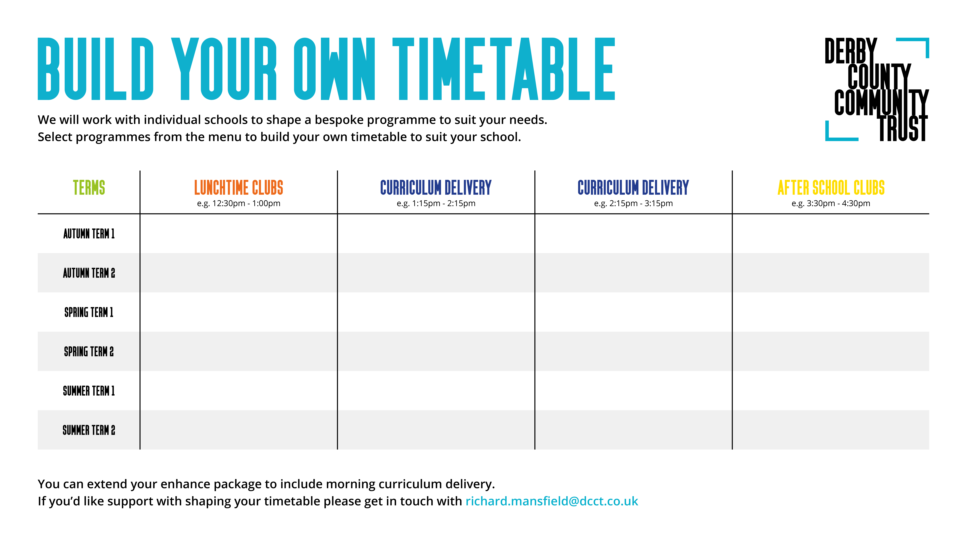
Times below
1:30pm – 2:25pm
2:30pm – 3:25pm
3:30pm – 4:30pm
Y1 Multi Sports up to 16 children
(12:30pm – 1:00pm)
Y5 – Matchday Maths
(run as an intervention up to 6 pupils)
Same as previous column but children from other class
Y4 - Dodgeball
Y1 Multi Sports up to 16 children
(12:30pm – 1:00pm)
Y5 – Matchday Maths
(run as an intervention up to 6 pupils)
Y4 - Dodgeball
Y2 Multi Sports up to 16 children
(12:30pm – 1:00pm)
Y4 – Reading Stars
(run as an intervention up to 6 pupils)
Y5 - TBC
Y2 Multi Sports up to 16 children
(12:30pm – 1:00pm)
Y4 – Reading Stars
(run as an intervention up to 6 pupils)
Y5 - TBC
Y3 Multi Sports up to 16 children
(12:20pm – 12:50pm)
Y3 – Reading Stars
(run as an intervention up to 6 pupils)
Y6 - TBC
Y3 Multi Sports up to 16 children
(12:20pm – 12:50pm)
Y3 – Reading Stars
(run as an intervention up to 6 pupils)
Y6 - TBC

