Slide 2
Learning outcomes
I will be able to:
describe the difference between banter and bullying
identify when and how banter can become bullying
explain what I can do to speak up against bullying and to make sure banter never becomes bullying.

Slide 3
Session overview
Activity summary
Pupils will learn the difference between banter and bullying, how to prevent banter from becoming bullying, and how to speak up when bullying takes place.
Pupils will make a commitment to preventing bullying in their school.
Age group
7 to 11 (Key Stage 2).
Time required
Approx. 45–60 mins.
Additional comments
You do not need subject knowledge in football to use this resource.
Using this presentation
The slides and slide notes include the vocabulary and subject knowledge you’ll need to teach this topic with confidence.
Slides 3–5: Overview for teachers.
Hidden slides will not display in presentation mode.
Slides 1, 2, 6–21: Slides to use with pupils.
Slide notes contain further guidance.
Developed with teachers
This resource has been developed in partnership with practising teachers.
Developed with experts
This resource has been created in partnership with the Anti-Bullying Alliance.
Notes:
Anti-Bullying Alliance: https://anti-bullyingalliance.org.uk/

Slide 4
Teacher support notes
PSHE best practice:
PSHE education covers many complex or sensitive issues, and any area of the subject has the potential to be sensitive for some pupils. That’s why it’s so important to create and maintain a safe and inclusive learning environment for all lessons.
A safe and inclusive learning environment helps pupils share feelings, explore values and attitudes, express opinions and consider those of others without attracting negative feedback.
Here are some ways that you can create a safe and inclusive learning environment:
Work with pupils to establish ground rules about how they will behave towards each other.
Make boxes available in classrooms which pupils can place anonymous questions or concerns.
Link PSHE education into the whole-school approach to supporting pupil wellbeing.
Make pupils aware of reliable sources of support, both inside and outside the school.
Distance the learning so that pupils do not feel pressured to share personal experiences.
Notes:
To provide guidance for teachers on PSHE Best practice and how to navigate questions and statements about bullying within the resources.

Slide 5
Curriculum links
England​​ | PSHE (Key Stage 2)​
 | Friendships​ What constitutes a positive, healthy friendship (e.g. mutual respect, sharing interests and experiences).​ That healthy friendships make people feel included; recognise when others may feel lonely or excluded; strategies for how to include them.​ Recognising and managing peer influence and a desire for peer approval in friendships. | Managing hurtful behaviour and bullying The impact of bullying, including face-to-face and online, and the consequences of hurtful behaviour. Strategies to respond to hurtful behaviour experienced or witnessed, face-to-face and online (including teasing, name–calling, bullying, trolling, harassment or the deliberate excluding of others). How to report concerns and get support.
Wales​​ | Health and Well-being (Progression Step 3)​​ I can ask for help when I need it from people I trust. I can reflect on the characteristics of safe relationships and I can seek support when needed. I can communicate my needs and feelings, and respond to those of others. I can reflect on the characteristics of safe relationships and I can seek support when needed.

Slide 6
Anti-Bullying Week 2023 Make a noise about bullying
Be Ambitious
Work hard and never give up on your goals
Be Inspiring
Set a great example to others
Be Connected
Work well with others and in a team
Be Fair
Treat people equally and think of others
Notes:
Make a noise about bullying | 1 minute | Aim: To launch the Premier League Primary Stars resources in school.
Explain that the school has teamed up with the Premier League to help support football in school, to teach us how to speak out against bullying and that anyone can play football, regardless of who they are!
Monday 13th – Friday 17th November 2023 is Anti-Bullying Week and this year's topic for the week is 'Make a noise about bullying’.
Share the Premier League values and/or your school values with your pupils and ask pupils what these values mean to them, what they might look, sound or feel like and which values align with the topic of the lesson.
Premier League values:
Be ambitious – work hard and never give up on their goals.
Be inspiring – set a great example to others.
Be connected – work well with others and in a team.
Be fair – treat people equally and think of others.

Slide 7
Word bank
Acceptance
Being liked, or thought well of, by an individual or a group of people.
Banter
The playful and friendly exchange of teasing remarks – joking about.
Bullying
The repetitive, intentional hurting of one person or group by another person or group.
Exchange
To give and receive – swapping.
Intentional
Done on purpose – deliberate.
Notes:
Make a noise about bullying | Word bank to support learning
Use this slide to include all pupils in your discussions, particularly when delivering slides that define and contrast joking about with bullying.
These are our own definitions. Feel free to adapt the word bank to suit the needs of your pupils.
Optional activity:
In small groups or pairs, have pupils discuss what these words mean to them.

Slide 8
Word bank
Power
The ability to influence how someone feels or behaves.
Physical
To do with the body e.g. kicking a ball.
Psychological
To do with thoughts and feelings e.g. making someone feel happy.
Repetitive
Saying or doing the same thing many times.
Verbal
To do with words e.g. saying kind things to someone.
Notes:
Make a noise about bullying | Word bank to support learning
Use this slide to include all pupils in your discussions, particularly when delivering slides that define and contrast joking about with bullying.
These are our own definitions. Feel free to adapt the word bank to suit the needs of your pupils.
Optional activity:
In small groups or pairs, have pupils discuss what these words mean to them.

Slide 9
Anti-Bullying Week 2023 – Make a noise about bullying
People are often silent when we see bullying take place, silent about the hurt bullying causes, and silent when we hear bullying dismissed as ‘just joking about’.
This Anti-Bullying Week, let’s come together to explore what bullying means to us, how joking about can turn into something more hurtful, and what we can do to stop bullying.
There are things we can do to stop bullying!
Notes:
Starter activity | 10 minutes | Slide 1 of 5 | Aim: To highlight the differences between friendly joking about and hurtful bullying.
Read the slide to introduce the theme to your pupils.
A key challenge with bullying is that people can be unsure or unwilling to respond when they see or hear it happening, or unclear about the dividing line between playful joking about and hurtful bullying. But when we understand the hurt that bullying can cause, know how it differs from joking about and know positive ways to respond, we are all better equipped to help stop bullying.

Slide 10
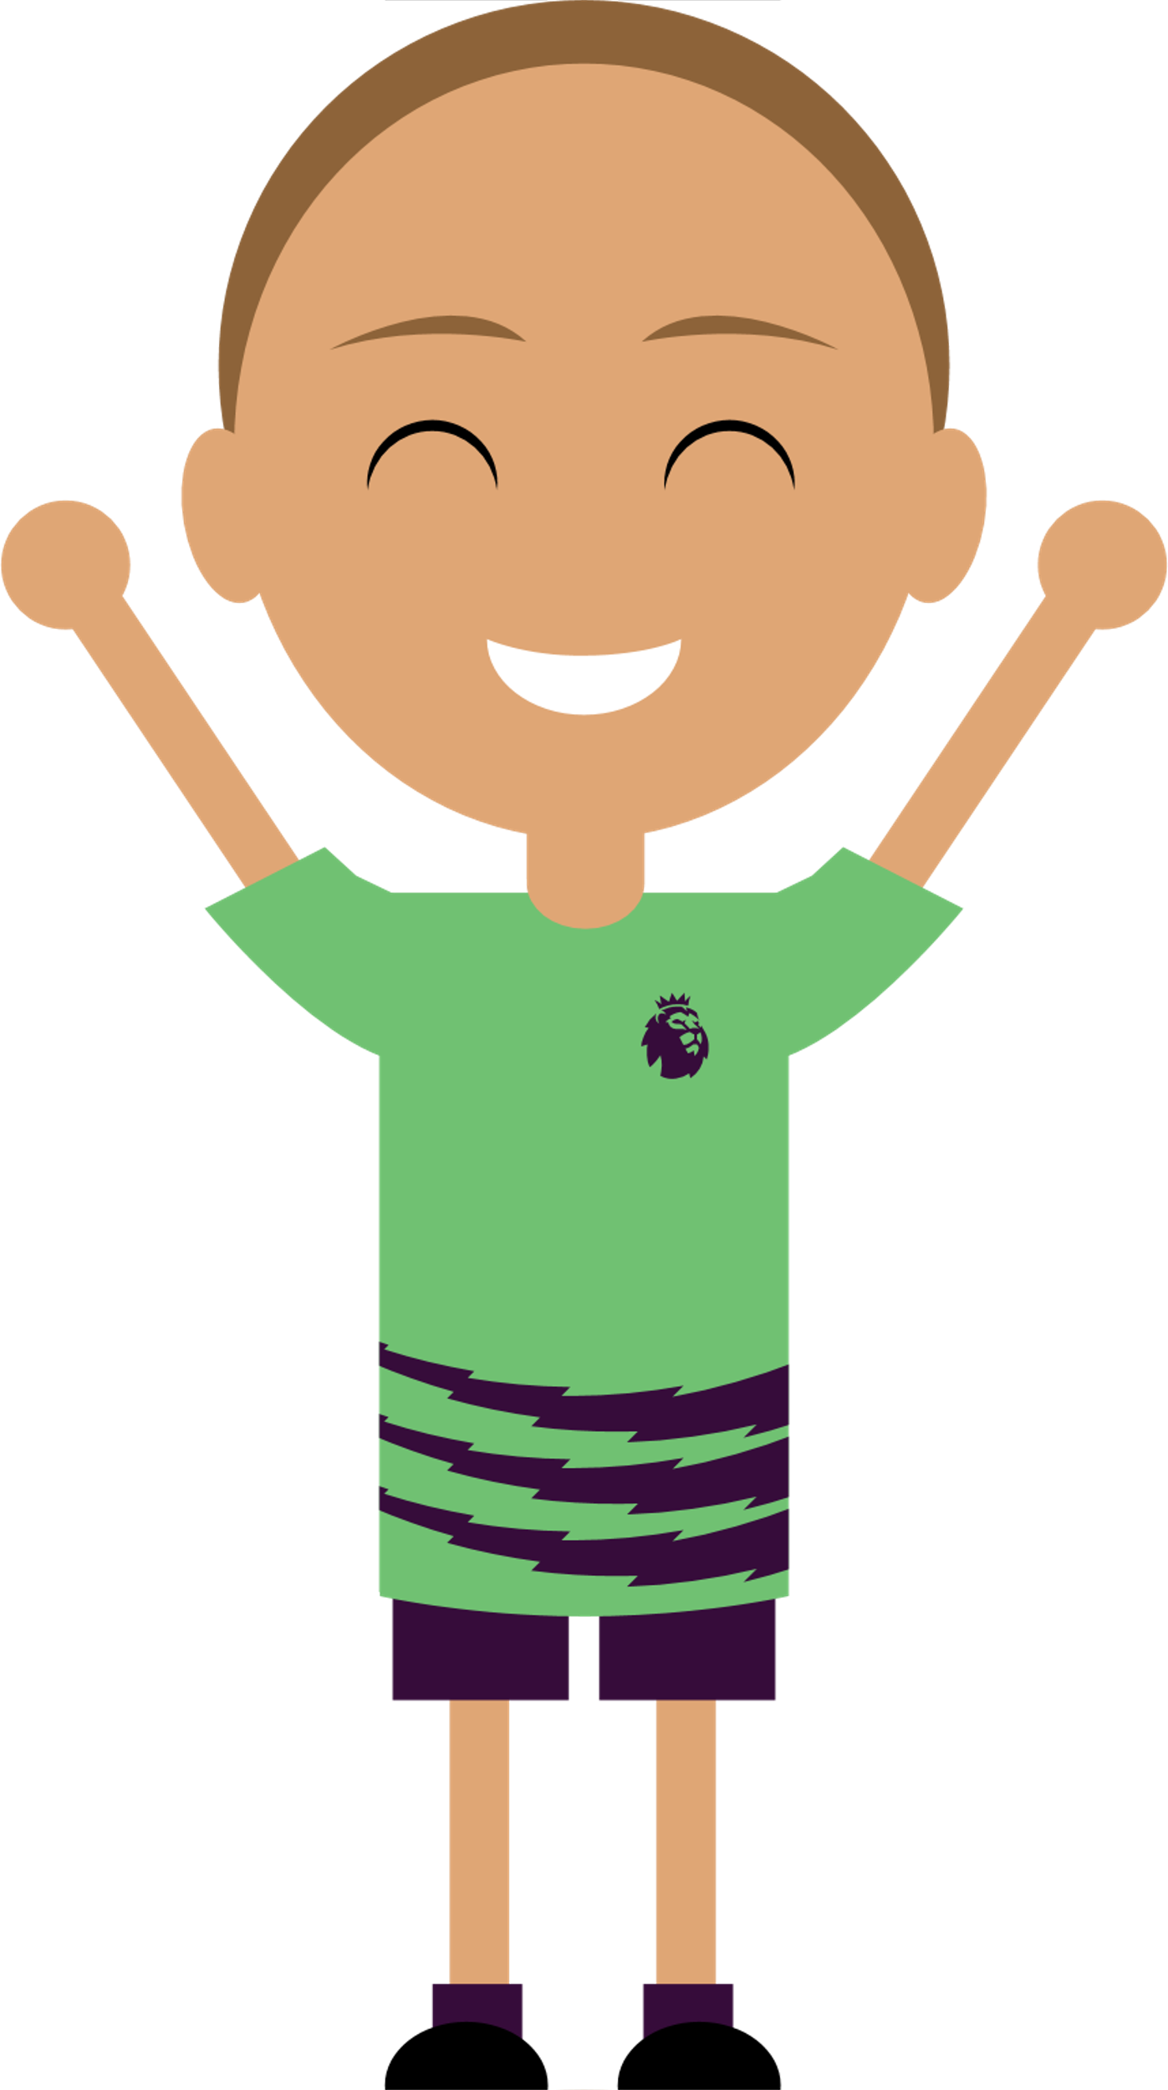
What does ‘joking about’ and bullying mean?
What does ‘joking about’ mean?
What does bullying mean?
Notes:
Starter activity | 10 minutes | Slide 2 of 5 | Aim: To highlight the differences between friendly joking about and hurtful bullying.
Introduce the idea of joking about and bullying.
Pupils discuss and answer the questions on the slide. They can complete as a Think-Pair-Share activity or simply gather ideas as a class.
Use a show of hands, red, amber, green, emojis or have pupils move to a place in the room (active learning) to see how many pupils feel they would be confident to explain one or both of joking about and bullying to a friend. You can revisit this poll at the end of the lesson as one way to measure progress, so ask pupils to remember their responses.

Slide 11
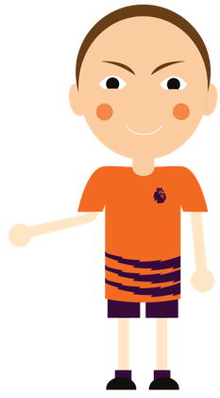
What does ‘joking about’ and bullying mean?
Joking about is the playful and friendly exchange of teasing remarks. It’s sometimes called ‘banter’.
Bullying is the repetitive, intentional hurting of one person or group by another person or group.
Bullying can be physical, verbal or psychological.
It can happen face to face or online.
Notes:
Starter activity | 10 minutes | Slide 3 of 5 | Aim: To highlight the differences between friendly joking about and hurtful bullying.
Discuss the definitions of joking about and bullying on the slide and compare with pupils' ideas.
Use the word bank slide on slides 7 and 8 to help discuss the concepts in the definitions.
With due care, pupils could share some hypothetical examples of bullying, while avoiding sharing real situations or names. Have pupils consider examples they may have seen out of school, for example on the bus, on TV, online or on the football pitch.

Slide 12
When does ‘joking about’ become bullying?
Sort the statements into two categories:
A positive statement about joking about.
A negative statement about bullying.
It shows acceptance in a friendship group.
It’s light-hearted and fun.
One person is more powerful than the other.
It’s repeated.
The activity or topic is uncomfortable or hurtful to the other person.
It’s deliberately done to hurt or to get a reaction.
It helps you feel closer to each other.
It shows you trust each other.
Notes:
Starter activity | 10 minutes | Slide 4 of 5 | Aim: To highlight the differences between friendly joking about and hurtful bullying.
Ask pupils to think about the following questions:
What makes joking about a positive thing?
What signs can help a person to know when joking about has stopped being fun and has instead turned into bullying? What is happening and what has changed about what is being said or done?
Pupils use their ideas to sort the statements into positive things about joking about, and negative things about bullying. Pupils can discuss and share in pairs, table groups or as a class.
When you click the presentation, the animation will show the answers.
Add support: Explain to pupils that there are four positive statements about joking about and four negative statements about bullying. For added support, print copies of the slide for pupils to colour statements in green for joking about and red for bullying.
Add challenge: Pupils work independently and can add more examples of their own to illustrate the positive aspects of joking about and negative signs or impacts of bullying.

Slide 13
‘Joking about’…
Bullying is when…
…is light-hearted and fun.
…one person is more powerful than the other.
…shows acceptance in a friendship group.
…the activity or topic is hurtful to the other person.
…helps you feel closer to each other.
…it’s deliberately done to hurt or to get a reaction.
…shows you trust each other.
…it’s repeated.
Notes:
Starter activity | 10 minutes | Slide 5 of 5 | Aim: To highlight the differences between friendly joking about and hurtful bullying.
Review each example on the slide. Use the word bank on slide 7 and 8 to help discuss any complex words.
To share more information with your pupils, share the following:
A topic may be hurtful because it relates to something that person is embarrassed about. This could be something they did or something that happened to them, or some wider circumstance about their life. It may be about something that makes them unhappy, such as an unhappy event in their life. As well as personal events, this can include things like their favourite football team losing an important match.
Someone has power over someone else when they can influence how that person feels or behaves. This can come from being physically bigger or stronger, older, or in some way being seen as superior. Power can be formal, for example a football team manager or captain has formal power over the team members. Or it can be informal, for example where one pupil is more dominant in the playground. What matters is that when power is used to bully, the other person becomes scared and upset.
Bullying can happen in any situation. It may happen in private, when someone bullies another to get them to do or not do something, or to hurt their feelings, or it may happen in front of others to get a reaction that the bully thinks will make them look good and the bullied person look foolish.
A lot of bullying happens repeatedly as part of a pattern of behaviour. But it is also important not to overlook that some bullying can be a one-off action or comment.
Bullying is deliberate. If a pupil hurts someone else without meaning to, it's important to apologise.
Bullying is done to cause a reaction both in the person being bullied (who the bully intends to hurt) and in any bystanders.
Feel free to adapt the statements above and on the slide to suit the needs of your pupils.
Ask pupils to share other positive examples of how joking about can be a positive thing between friends.

Slide 14
How does it feel to be bullied?
Premier League pundit Karen Carney discusses how it felt to be bullied as a young girl.
“At secondary school, I never played football really, just because I was bullied for it. It’s really funny now. The people that bullied me have since gone on and apologised.”
“It’s been a big shift. With the role models, especially with the Lionesses, it’s opened everybody’s eyes and now hopefully more girls will have the opportunity to play.”
Notes:
Main activity | 25-40 minutes | Slide 1 of 5 | Aim: To highlight the differences between friendly joking about and hurtful bullying.​
​
Review the quotes from Karen Carney about the effects of bullying.​
Discuss some of the quotes below as a class and please adjust to suit the needs of your pupils:​
Why do you think Karen was bullied at school?​
Why do you think she then stopped playing football?​
How have the lionesses created this shift?​
Why is it important that Karen is speaking up about this time in her life?​
How do you think she felt when she experienced this?​
Bullying can take place in any place on any occasion, and so like a school or other organisation, Premier League clubs have bullying policies in place and take an active role in preventing bullying. You could link this to your school's own anti-bullying policy, practices and expectations.​
Vocabulary: A pundit is an expert in a particular subject or field who is frequently called upon to give their opinions to the public.
Source: https://www.premierleague.com/news/3100113

Slide 15
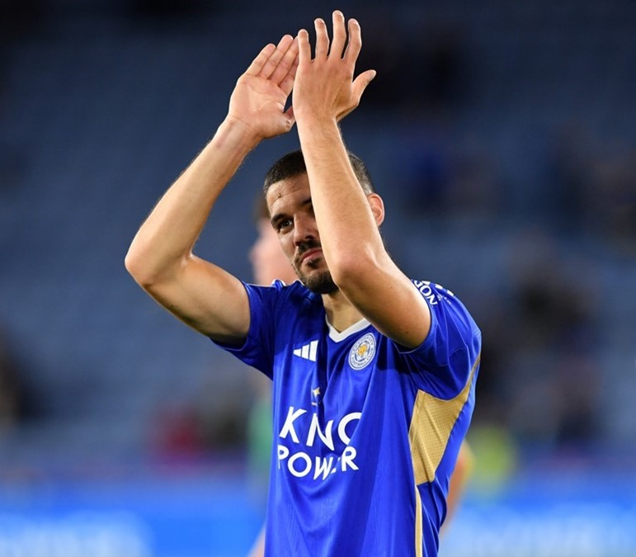
Top tips from player Conor Coady
Click icon to add picture
Conor Coady
Leicester City FC and England national team
Conor Coady
Leicester City FC and England national team
Don’t let people affect how you’re thinking.
Stick to the people you are closest to.
All of the people who want to bring you down, they don’t entertain your life. Keep them away.
Notes:
Main activity | 25-40 minutes | Slide 2 of 5 | Aim: To identify what actions pupils can take to speak out about bullying and to find help for themselves or others when bullying happens.
Briefly review the player quote on this slide.
Discuss some of the tips from Conor Coady on bullying.
Discuss what the tips mean and how they can help support others experiencing bullying.
Vocabulary: If you stick to something or someone, you stay close to them.
Source: https://www.premierleague.com/news/2357759

Slide 16
What can we do when we see or hear bullying?
Notes:
Main activity | 25-40 minutes | Slide 3 of 5 | Aim: To identify examples of when or how friendly joking about can become hurtful bullying.
Watch the video (2 minutes).
Pause the video after 0:56 to ask the question posed in the video: if pupils had a superpower to help them make a noise about bullying, what would it be? In table groups, pupils discuss their ideas.
Discuss pupils’ ideas before continuing the video.

Slide 17
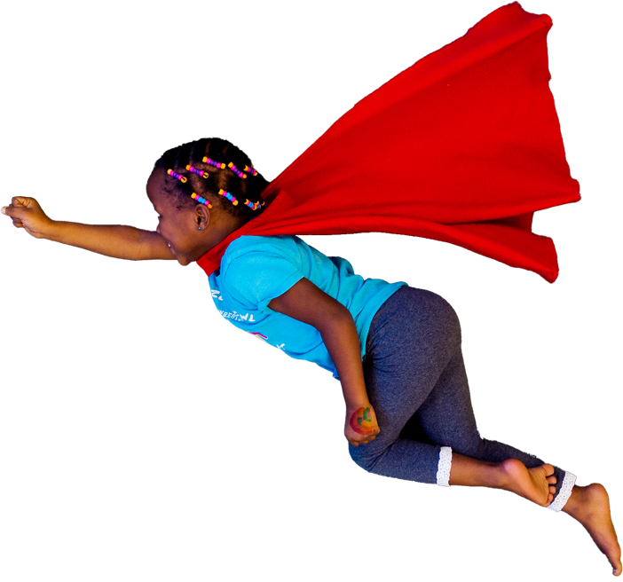
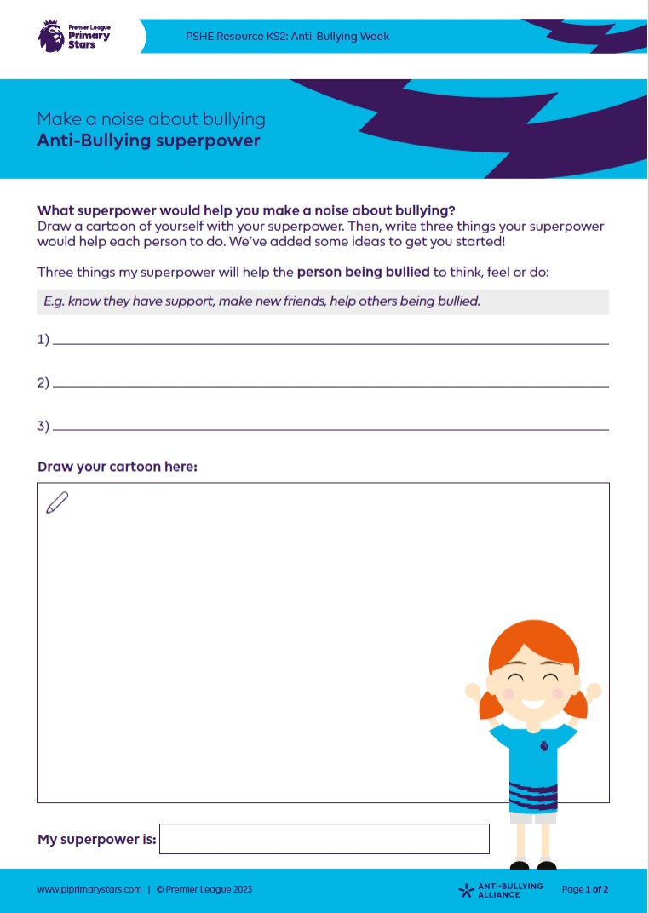
What superpower would help you make a noise about bullying?
In the video, pupils explained what superpower would help them to make a noise about bullying.
What would yours be?
Answer the questions on the worksheet to share how your superpower will help make a noise about bullying.
Draw a cartoon of yourself with your superpower.
Notes:
Main activity | 25-40 minutes | Slide 4 of 5 | Aim: To identify what actions pupils can take to speak out about bullying and to find help for themselves or others when bullying happens.
For the main activity, pupils draw a cartoon of themselves with their superpower.
How will this superpower change the feelings and actions of both the person who is being bullied, and the person(s) doing the bullying?
Pupils use the worksheet to explain how their superpower will help make a noise about bullying.
Pupils can use the worksheet provided or they can complete this activity on paper.
Display your superheroes around your classroom, or as a hallway display.
Share these with us to feature on our gallery. You can Tweet us @PLCommunities using #PLPrimaryStars and #AntiBullyingWeek or email us at PLPrimaryStars@premierleague.com. We would love to see how you are getting on!
Add support: Discuss ideas for statements to write on each side of pupils’ sketches. Think about what pupils would want a bullied person to think, feel or do, as a result of their superpower. List words or phrases on the board. Repeat for how they would want to change bullying behaviour in positive ways.
Add challenge: Pupils write more detailed explanations of how their superpower would benefit victims of bullying and change bullying behaviour for the better.

Slide 18
How will you make a noise about bullying?
Remember the hurt that bullying can cause.
Don’t let joking about turn into bullying.
Tell a trusted adult or help a friend to do this.
Be a good friend: listen to and help them.
Notes:
Main activity | 25-40 minutes | Slide 5 of 5 | Aim: To identify what actions pupils can take to speak out about bullying and to find help for themselves or others when bullying happens.
Review the four actions on the slide.
The first two actions are important because they help pupils to avoid becoming bullies.
The second two actions give pupils concrete advice for when bullying happens.
Discuss who is a trusted adult in your school setting, for example a teacher, teaching assistant, playground or dinner assistant, or one of your leadership team. You may wish to explain what will happen if a pupil reports bullying in your school.
You may wish to discuss, in a way that is appropriate for your school and pupils, safe boundaries about speaking up against bullies. It’s important that pupils contribute to a culture that clearly states that bullying is not ok. However, it’s also important that pupils don’t escalate a situation or put themselves in danger by directly challenging or confronting a bully. They might instead help the person to remove themselves from the situation, for example by inviting them to join them in a different activity or conversation.
Add support: Invite volunteers to help you model how to support someone being bullied without escalating the situation.
Add challenge: Pupils can work in table groups to create their own brief role-plays to model examples.

Slide 19
Anti-Bullying Week 2023 – How will you make a noise about bullying?
Can you now explain what ‘joking about’ and bullying means, to a friend?
How can we make sure that ‘joking about’ never turns into bullying?
How can we speak up against bullying, instead of staying silent?
What can you do to help make these things happen?
Be Ambitious
Work hard and never give up on your goals
Be Inspiring
Set a great example to others
Be Connected
Work well with others and in a team
Be Fair
Treat people equally and think of others
Notes:
Plenary | 10 minutes | Slide 1 of 2 | Aim: For pupils to commit to preventing bullying in your school.
Discuss the three questions on the slide.
Pupils can complete printed copies of the Make noise about bullying pledge.
A simpler version lists the actions, for pupils to sign.
A second version includes space for older or more able pupils to write ideas of their own.
If preferred, this can be completed on paper or on a whiteboard instead of using a worksheet.
As a post-assessment, use a show of hands, red, amber, green or emojis to see how many pupils feel they would be confident to explain what ’joking about’ and bullying means to a friend. Ask pupils to show how well they feel they can now do this.
End the lesson by sharing the Premier League values and/or your school values (as mentioned on slide 6) and discuss why it’s important to demonstrate these values whilst reflecting on the lesson message.
Extension:
Pupils can display their pledges in your classroom, corridor or foyer, or take home to share the message with their families or sports clubs. Share pledges with families on your school’s website or social media feeds.
Pupils could develop an anti-bullying assembly to present to your school, featuring their own brief scenarios and positive responses. This is a great way to share your anti-bullying messages! Why not:
Develop pupils’ superhero ideas into role-plays that demonstrate how joking about can become bullying, and how to help someone without escalating the situation.
Write a song to capture pupils’ ideas to make noise about bullying.
Demonstrate how these ideas complement your school’s values and existing anti-bullying practices.
Invite parents or record the assembly to share on your website and school social media accounts.
After the assembly, create classroom pledges that are displayed in every class, to involve your whole school.

Slide 20
Childline: Whatever your worry, we’re here for you
If you can’t reach a trusted adult, but really need to talk, Childline is there for you:
0800 1111 (free to call) childline.org.uk
Notes:
Plenary | 10 minutes | Slide 2 of 2 | Aim: For pupils to commit to preventing bullying in your school.
Signpost children to Childline, which they can call for free or contact online if they are unable for any reason to reach a trusted adult they know. The service is free and confidential and there to listen and help 24 hours a day.

Slide 21
Monday 13th to Friday 17th November 2023
#AntiBullyingWeek
#MakeANoise

