Slide 1
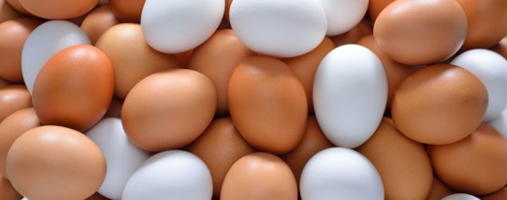
Monday
What are the differences between these eggs?
What do you think? Talk about your ideas.
Are they different colours?
Are they different sizes?
Are they different shapes?

Slide 2
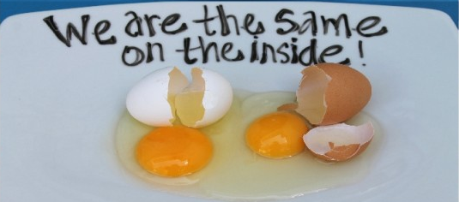
Monday
The eggs look different on the outside but are the same on the inside and so are we!
We are the same in so many ways.
Can you think about how we are the same?

Slide 3
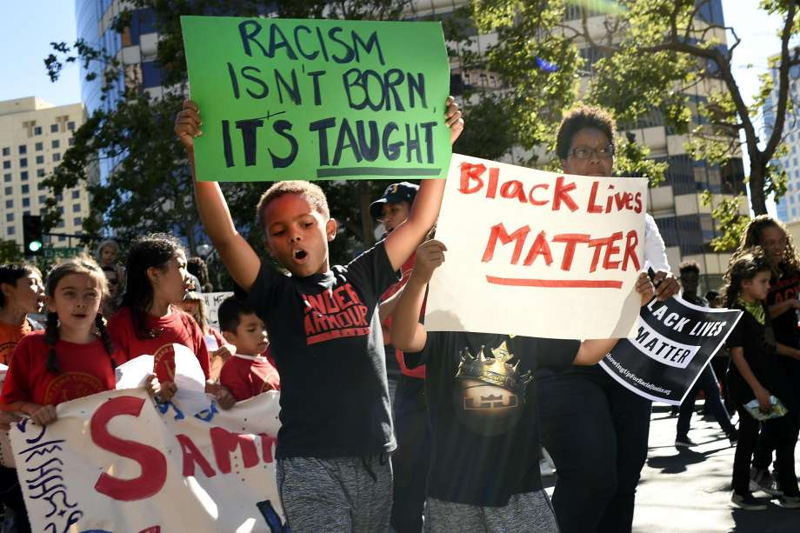
Tuesday
Why are these children holding banners?
What do the
words say?

Slide 4

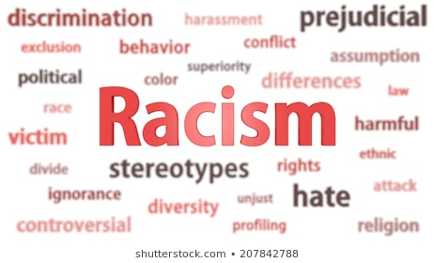
Tuesday
Racism is when you treat someone differently and unfairly because; they have different coloured skin or they are from a different country or their culture is different.
Is that fair?
Talk about it.

Slide 5

Where is Racism?
Tuesday
Racism is all over the world and it must be stopped!
Sometimes people in power can be racist.
Sometimes they use their power to treat people unfairly.

Slide 6
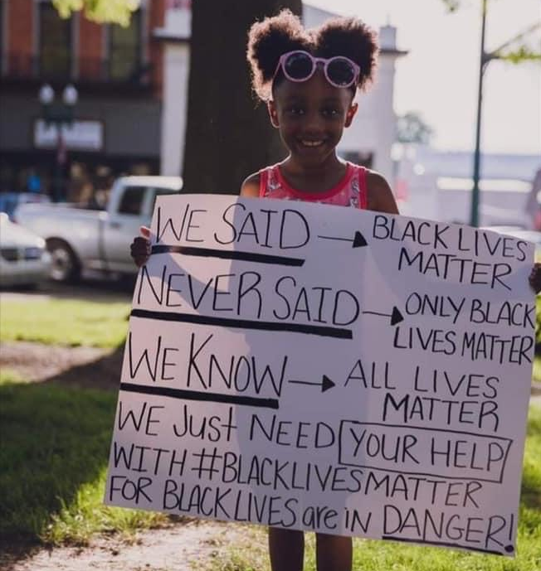
Wednesday
How does this little girl feel?
What is she telling us?

Slide 7
Wednesday
There are many differences between people; one difference is the colour of our skin.
It is important to make sure that all people are treated fairly, and that’s why lots of people all over the country and the world are part of the Black Lives Matter movement.

Slide 8
What is the “Black Lives Matter Movement”?
Wednesday
Black Lives matter was created in 2013.
Their mission is to end violence.
This organisation holds events to educate people.

Slide 9

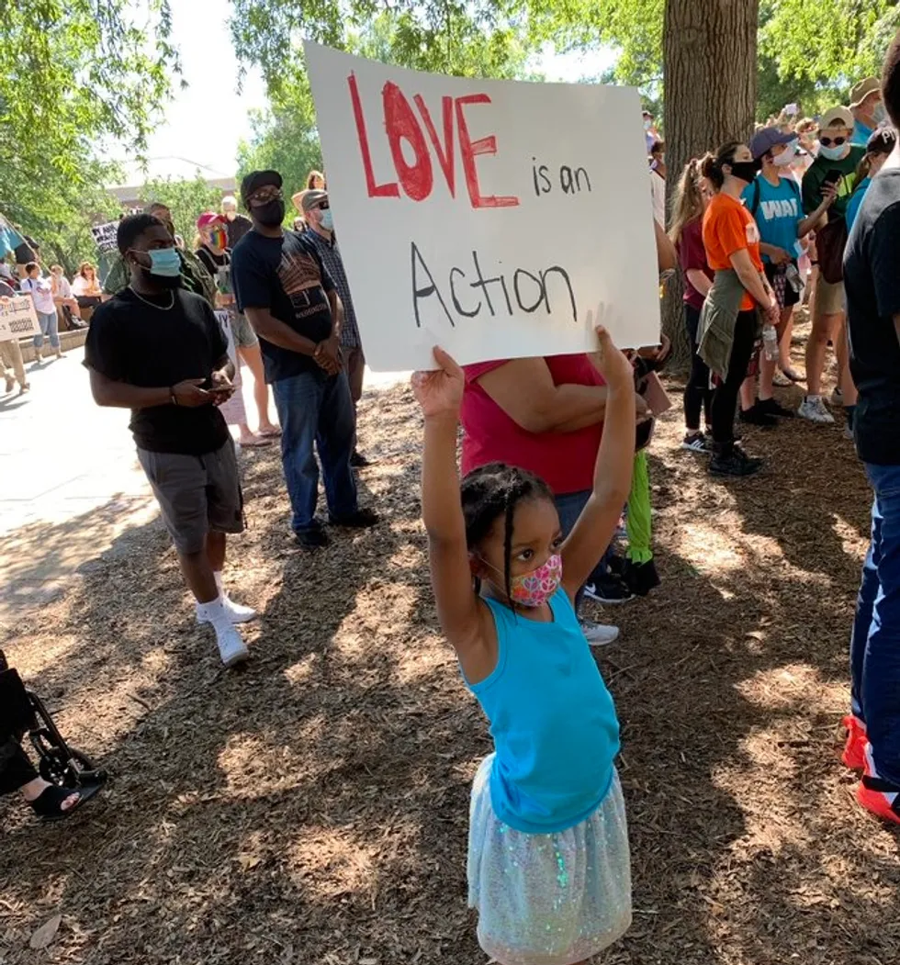
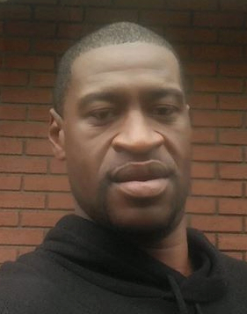
Why is this issue so important right now?
Thursday
This has always been an important issue. Right now, the whole world is speaking out against racism and the unfair treatment of black people, especially George Floyd who died on 25th March.

Slide 10
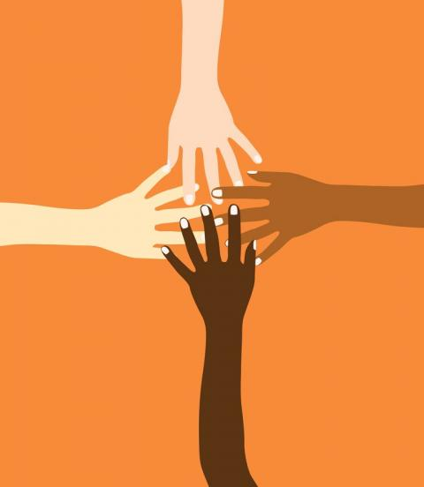
Everybody is important, and has the right to be safe and happy even if they are different.
What/who makes you feel safe and happy?
Thursday

Slide 11
Can you tell someone why they are important and matter to you?
Can you also think of ways to show that everybody is important and that all lives matter?
Friday

