Slide 1
Parent Information – Reading & Phonics

Slide 2
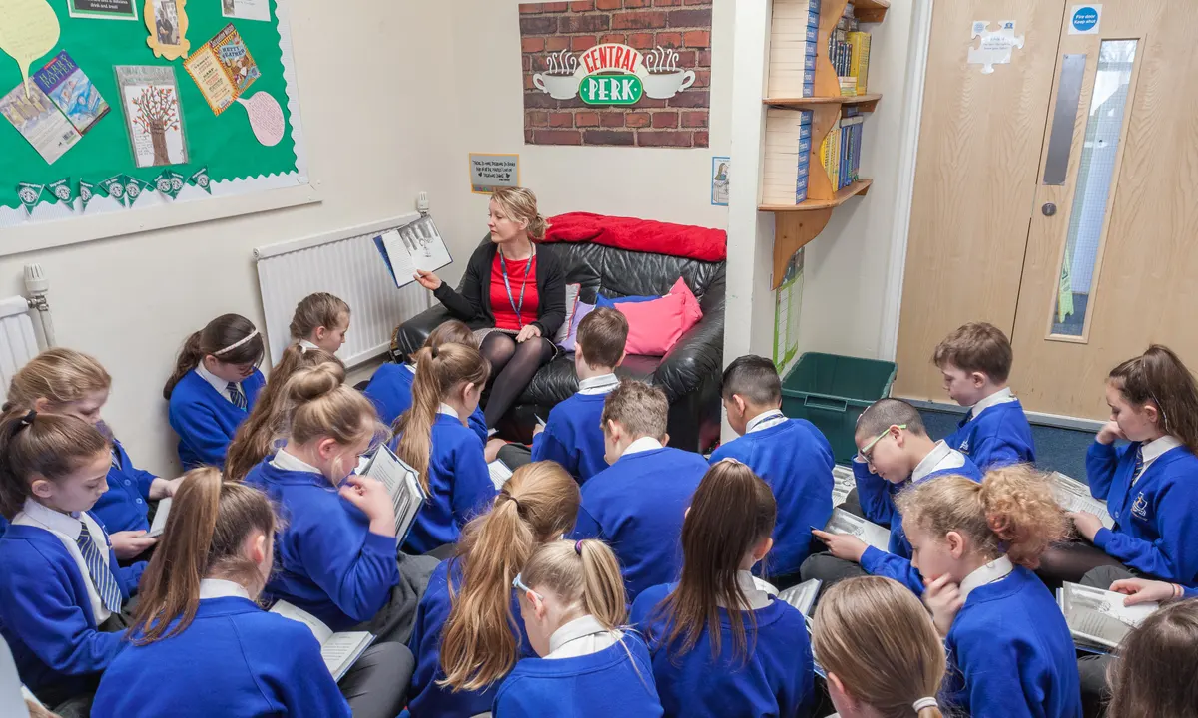
Reading

Slide 7
Developing the Love of Reading at
daily story time sessions at 3pm
exciting and engaging books used as part of our curriculum
inviting book areas in every classroom
a school library
the Reading Race from Year 1 –Year 6
shared reading sessions from Year 1 to Year 6

Slide 9
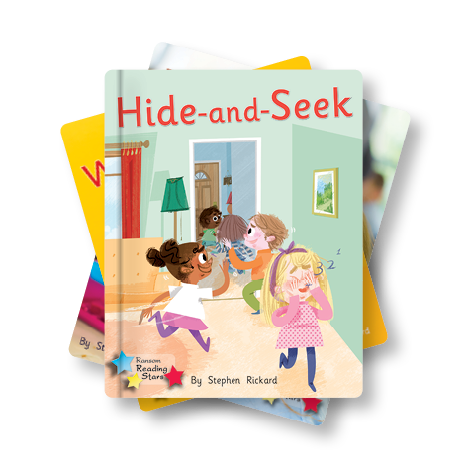
Reading in School
Foundation Stage – daily whole class phonic sessions, individual reading, whole class shared reading from Spring term
Year 1 - daily whole class phonic sessions, individual reading, whole class shared reading
Year 2 - daily whole class phonic sessions for the Autumn term, individual reading, whole class shared reading including using VIPERS from the Spring term
Key Stage 2 – Whole class shared reading using VIPERS, individual reading
Decodable reading books match the phonic phases that are taught

Slide 10
Shared Reading in School Year 1 & Year 2 in the Autumn term (& Foundation Stage from the Spring term)
These sessions are where we explicitly teach the children to apply their phonic knowledge to read phonetically decodable books. The emphasis of these sessions is to encourage children to use their skills in a more fluent manner to read more accurately.

Slide 11
Shared Reading in School Year 2 from the Spring term
Children are taught the skills of reading through the use of VIPERS. VIPERS is an anagram to help aid the recall of the six reading domains as part of the reading curriculum. These key areas we feel children need to know and understand in order to improve their comprehension of texts.

Slide 12
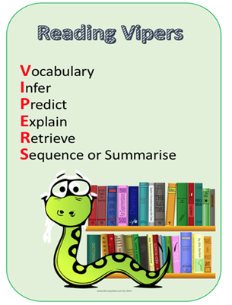
Yr2 VIPERS Progression Grid

Slide 13
Reading at Home FS2 & Year 1
children will bring home a phonetically decodable book and a shared library book
phonetically decodable books are matched to the children’s phonic knowledge and should be able to be read with 95% accuracy
practise is key - phonetically decodable books will be read three times before it is changed. This helps to develop fluency and comprehension
rereading sentences helps to build fluency
read along with your child for the first read, if needed
reading at home is a celebration of the child’s reading
please try and listen to your child 5 -10 minutes every day,
the shared library book should be read by the adult to the child. This helps widen their vocabulary and gain insight into appropriate use of prosody when reading. Adults can model how to use tone, timing, phrasing, expression and emphasis effectively. Book talk is important when reading the shared text.

Slide 14
Reading at Home Year 2
Once children progress beyond decodable texts (after Phase 5), they move onto our banded book scheme and a shared library book. Using the banded book scheme they can continue to progress in their fluency, inference and comprehension skills to become avid, expert readers.
Children that did not reach the required standard in the Year 1 Phonic Screening Check will continue to bring home a phonetically decodable book and a shared library book.

Slide 15
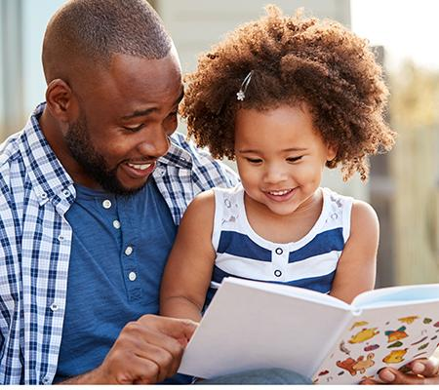
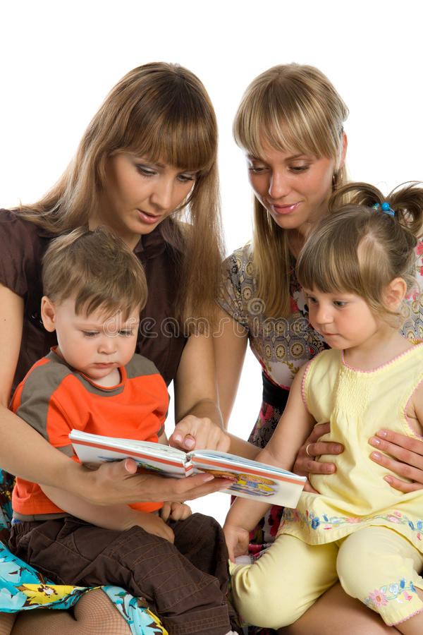
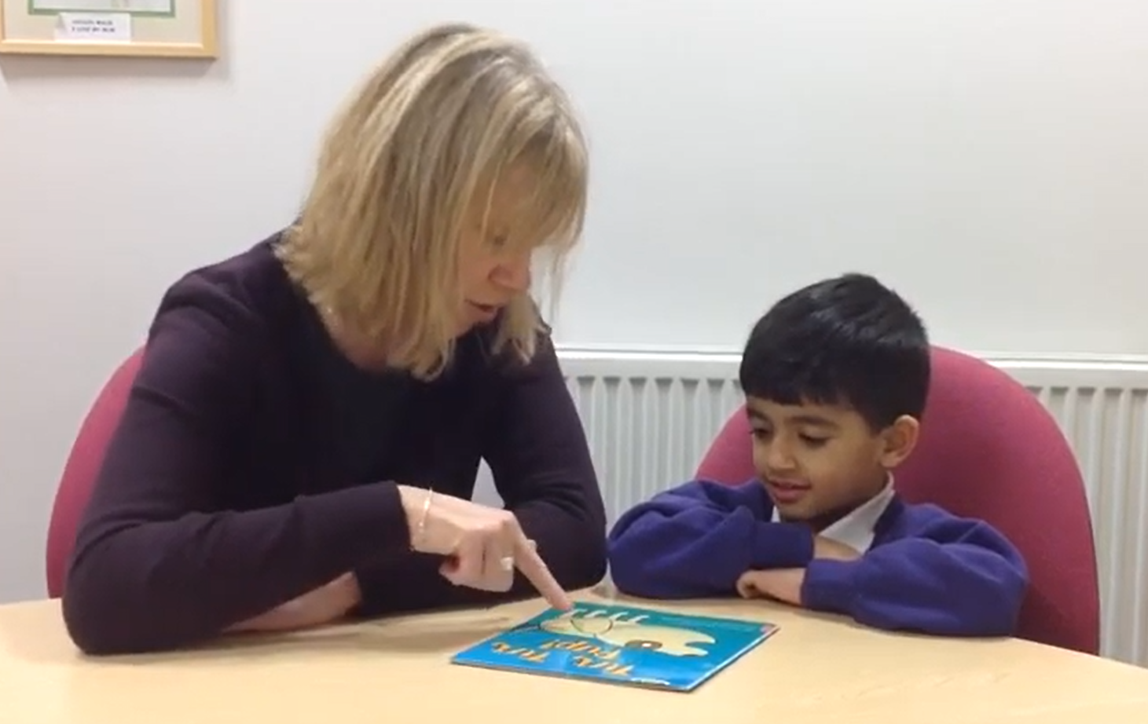
Book Talk question prompts to use when reading with your child
https://www.youtube.com/watch?v=g8Rr5dnlmzw

Slide 16
Emergent Writing

Slide 17
What is emergent writing?
Emergent writing is the first step taken by students learning to write.
It relates to the first time that children begin to understand that that writing is a form of communication and that their marks on paper convey a message.
A child's emergent writing will eventually evolve into proper letters and words during ‘early phase writing’.

Slide 18
Different stages of mark making and emergent writing: mark making

Slide 19
Drawing:
‘I have drawn the sea. These are the waves and it has mermaids inside’

Slide 20
Randomised Mark-Making:
I went to the
pet shop

Slide 21
Mock handwriting/directional mark making:
In the Autumn you can see
orange
and brown leaves.

Slide 22
Symbolic Mark-making/Letter-like formations:
Stick man lives in a tree

Slide 23
Letter strings:
Rama and Sita lived happily ever after.

Slide 24
Transitional Writing using groups of letters:

Slide 25
Different stages of mark making and emergent writing: Phonic application in emergent writing

Slide 26
Letter/word representation:
I went to town

Slide 27
First and last letter to represent a word:
bird snake

Slide 28
Medial letter sound inclusion:
I like school

Slide 29
Beginning phase writing:

Slide 30
How to help your child use their Phonic skills in their writing

Slide 31
Ask your child what it is they would like to write
It may be that your child has disjointed ideas that you need to discuss and help the to put into a sentence e.g. when writing about ‘The Gruffalo,’ they might say ‘he’s big, he’s scary.’ It’s Okay to model this back to your child in a proper sentence e.g. ‘The Gruffalo is big and scary.’
It’s important to keep reiterating the sentence back to your child after every word as it’s easy for them to forget when putting so many skills together at once!
Help your child to break the sentence down into individual words, focussing on one at a time, stressing the sounds in each word as they write.

Slide 32
It might be that your child cannot hear all of the sounds in the word (as we have seen in examples of emergent writing) and this is absolutely fine. They may be hearing some sounds or perhaps only the initial sounds in words.
It might be the case that your child will not be able to hear and write the correct grapheme in every word as so far, each year group is working at a different Phonics Phase. Children therefore might not yet have learned some graphemes.
Because of this, your child may try to use the graphemes that they do know e.g. writing the word ‘bike’ as ‘bik’, or ‘cake’ as ‘caic’, ‘kaik, or ‘cyk’ etc. This is showing that your child is using their Phonic knowledge but hasn’t yet learned the alternate graphemes – and this is fine!

Slide 33
Encourage your child to write down the sounds that they can hear
If your child can identify a sound (phoneme) but they cannot remember what it looks like, sound mats are essential! Often, as soon as children see they correct grapheme (written sound) on a sound mat, they can quickly identify it and use it appropriately. You can find Phase 2 and Phase 3 sound mats in the Useful Reference Resources section of FS2 on the Markeaton website

Slide 34
Although very tempting (!), please do not correct your child as they try to use their Phonics skills to write a word. For example, if they miss the double ‘b’ in the word rabbit, it’s important not to ask them to add letters in. This is due to the fact that they are using the Phonic knowledge that they already have, and will learn alternate graphemes and common exception word spellings as they progress!
As mentioned previously, staff will often ‘overwrite’ what the child has written to record exactly what it is that they were trying to say.

Slide 35
Handwriting
It is extremely important that children get into the habit of writing letters correctly – at this stage, it is not about how the finished letter looks, it’s about how your child writes the letter - which direction they move their pencil
It’s very difficult to get children out of bad writing habits and, whilst it may seem easier to allow children to write in whichever way is easiest now, this makes handwriting much more complicated as children progress with their cursive handwriting
Please do not use ‘dots’ for your child to write on top of. You can do this to show your child which way a letter is written and ask them to write their own letter next to yours, but getting them to ‘write’ over the top of dotted letters teaches them to trace or draw – not write!
You may need to indicate where on the line your child needs to write – and they may need reminding to write on the line!

Slide 36
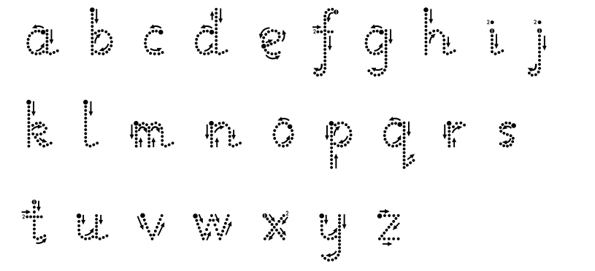
Please encourage your child to try and write each letter without taking their pencil off the page (other than to dot or cross letters)
Don’t worry if their letters seem big – their fine motor skills will improve as they practise!
If your child is struggling, the best way to help them with formation is to hold their pencil with them and write so they can ‘get a feel’ for directionality and formation, or to let them see you writing the letter and allow them to imitate this.
A letter formation reference document can also be found on the school website in the Useful Reference Resources section in FS2

Slide 37
Phonics

Slide 38
Teaches children to listen to and identify the sounds that make up words. This helps them read and write.
Over 100 ways to spell these sounds
letters
sounds

Slide 39
Terminology
Phoneme - A phoneme is the smallest unit of sound e.g. the word 'cat' contains three phonemes; c - a - t.
Grapheme - A grapheme is a visual representation of a sound (how it is written) e.g. a letter or a group of letters. Some sounds are represented by a single letter whilst others are represented by more than one letter.
Digraph - A digraph is a sound that is represented by two letters e.g. the sound 'a' in rain is represented by the digraph 'ai'.
Trigraph – A trigraph is a sound represented by three letters e.g. the ‘air’ in hair is represented by the trigraph ‘air’

Slide 40
Blending - Blending is the skill of joining sounds together to read words. Children are taught to say the separate sounds in a word and to then blend them together to decode the word.
Segmenting - Segmenting is the opposite of blending. Children are taught to segment a word into its separate sounds in order to spell it.
Common Exception Words – Words that cannot be easily decoded e.g. the, said, have.

Slide 41
Phases
There are 5 phases.
The phonic phases are taught in different year groups and children are supported to keep up through interventions. ‘Keep up, not catch up’.
It is taught as a whole class approach.

Slide 42
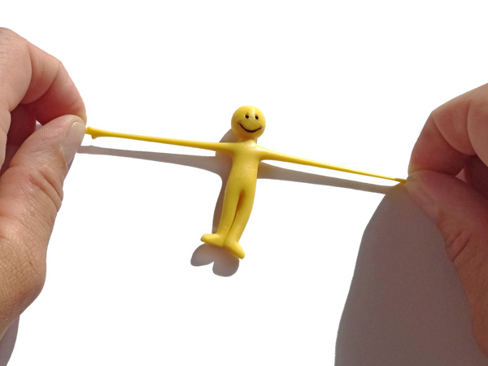
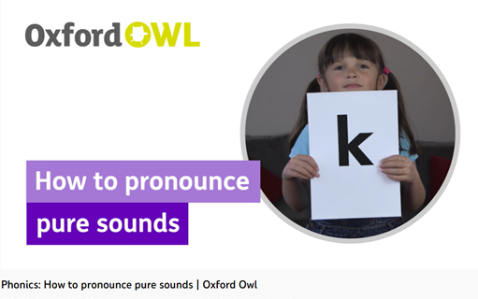
Stretchy sounds
Children taught to say the sounds correctly
mmmmmm not muh
/f/, /l/,/m/,/n/,/r/,/s/,/v/,/z/,/sh/,
/th/,/ng/
/b/,/k/,/d/,/g/,/h/,/j/,/p/,
/qu/,/t/,/w/,/x/,/y/,/ch/,/a/,/e/,/i/,
/o/,/u/
Bouncy sounds
These are clipped and pure. Helps to repeat the sound e.g bbbbb
Phonemes should be articulated clearly and precisely – watch out for the ‘schwa’!

Slide 43
Phase 1- taught in Nursey. We will teach this phase to children who need it in FS2 and activities during continuous provision will support this phase too. Children learn to hear and say sounds, play with rhyme, rhythm & alliteration and orally blend and segment.
Phase 2 – begins in FS2. The children learn
s a t p i n m d g o c k e u r ck h f b l ss ll ff
Each sound has an action and picture to help the children remember the phoneme. The actions can be found on the school website.

Slide 44
Phase 3 – teaches the children the rest of the phonemes including digraphs and trigraphs-
j v w x y z zz qu sh ch th ng ai ee igh oa oo oo ar or ur ow oi ear air ure er
Phase 4 – teaches the children to use the graphemes they know to blend and segment words with 4 or 5 phoneme, and longer words that can be chunked to read e.g. desktop – desk/top. This phase is revised in the Autumn term of Year 1. Year 1 NC requirements are taught here too e.g. reading contractions (isn’t, doesn’t), adding the prefix un- to verbs, adding the suffix –ed to verbs.

Slide 45
Phase 5 – begins in Year 1 and continues in to the Autumn term of Year 2. It teaches the children the alternative grapheme for the 42 phonemes they know. Year 1 NC requirements are continued here.
5a - ay ou ie ea nk oy ir ue ue ph aw ew wh au oe ey tch a-e e-e i-e o-e u-e u-e
5b – alternative pronunciations for graphemes – a e i o u ow ea er ou y ch c g ey ie
5c – alternative graphemes for these phonemes – ch j m n r s z u i ear ar air or ur oo ai ee igh oa oo oo sh
See the school website for the ULS progression grid

Slide 47
Blending - sound buttons
We put sound buttons under the grapheme (the letter or the letters that make that sound) and then tap the buttons to blend the sounds together to read the word e.g.

Slide 48
Daily Phonic Lessons
Takes place during the morning for 25 minutes.
Lessons consists of:-
Revisit and review – flashcard previous phonemes
Teach – teach new sound
Practise – practise using the new phoneme, reading words or writing words with the new phoneme in
Apply - apply in to a situation either reading or writing sentences
Common exception words are taught during the daily sessions, either read or spelt.
For reading and blending, children should use the phonemes (sounds).
For spelling, children should use letter names.

Slide 49
Year 1 Phonics Screen Check
Children are assessed in school in September, December and March using previous Year 1 screening checks.
We introduce monster words e.g. blit, pimms, blarb through our English Fast Four.
There are 40 words to read- a mixture of monster words and real words. Children are told if the words are real or monster words. The children read one-to-one to the teacher.
There is no time limit (usually takes between 4 and 9 minutes) and it takes place in a quiet area of school.
The statutory phonic screening check is in early June. Results are sent home with end of year reports.
If children do not reach the expected standard in Year 1, they will retake the test in the June of Year 2. They will have phonics interventions daily during Year 2.

Slide 51
And Finally . . .

