Slide 2
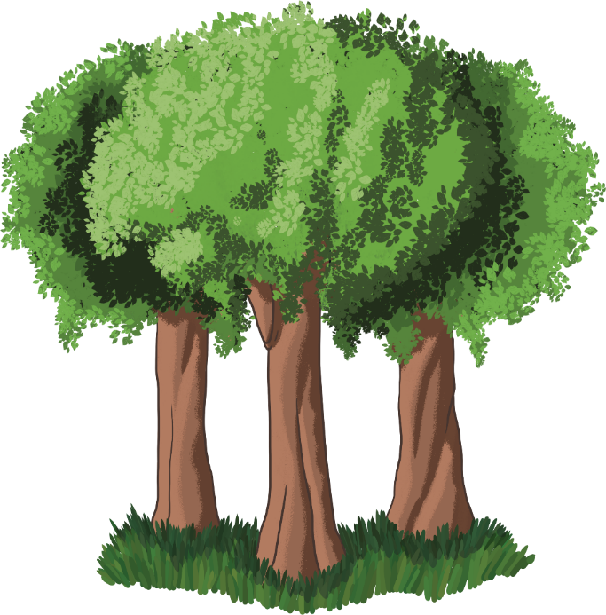
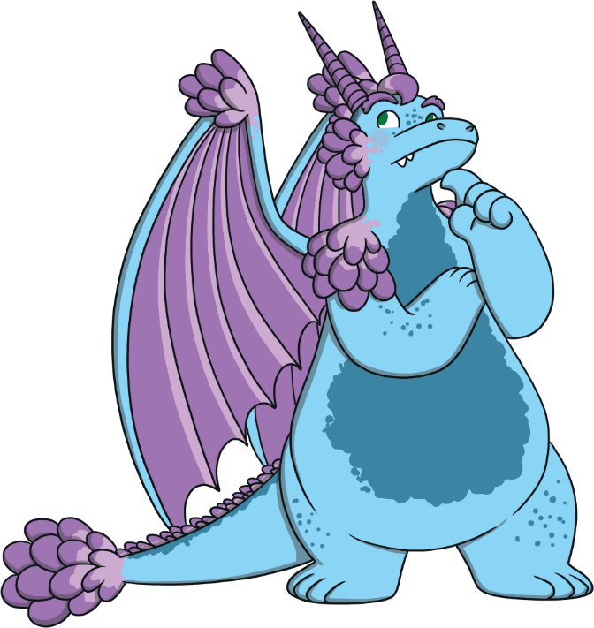
Find the Rhyme
Can you help Aristar to find all of the rhyming words?

Slide 3
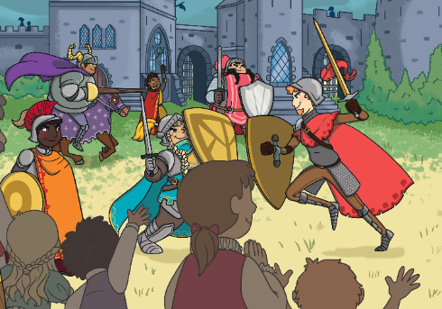
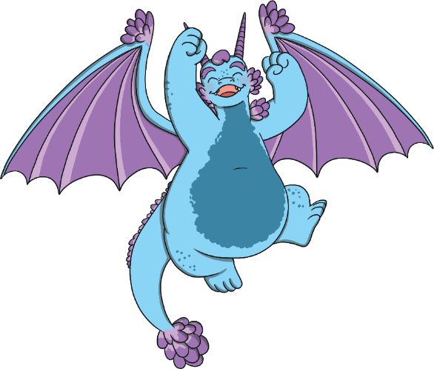
Click the correct rhyming word.
fight
Next
lie
sight
soon

Slide 4
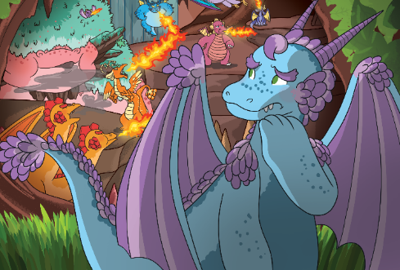
Click the correct rhyming word.
snout
Next
shout
camp
may

Slide 5
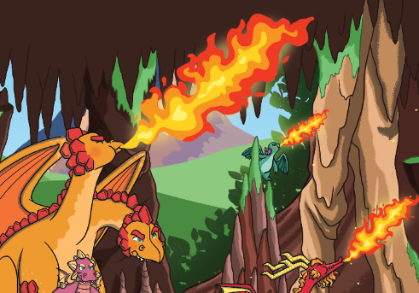
Click the correct rhyming word.
hot
Next
smart
lot
tall

Slide 6
Click the correct rhyming word.
wood
Next
snake
tight
stood

Slide 7
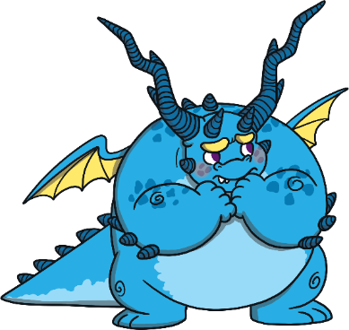
Click the correct rhyming word.
shy
Next
try
crab
messy

Slide 8
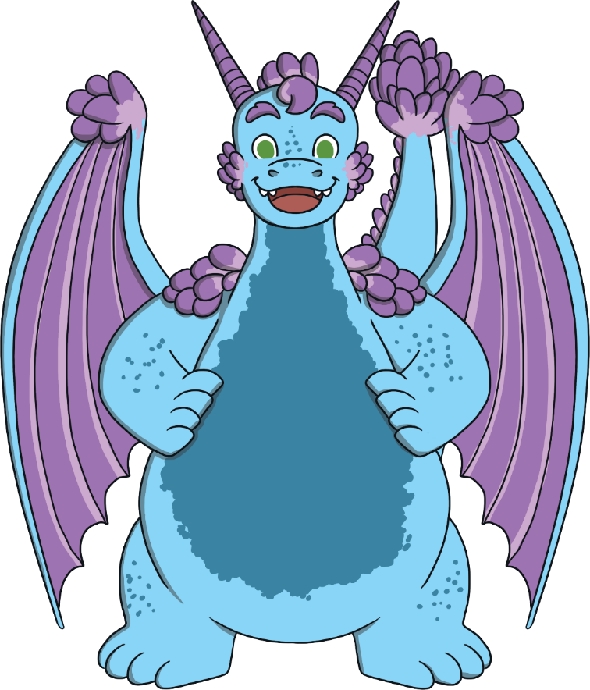
Find the Rhyme
Now, can you help Aristar to find the rhyming words to finish the story?

Slide 9
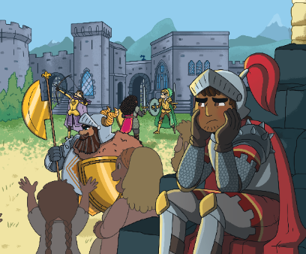
Click the correct rhyming word to fill in the blank.
Sir Gorrell was uncomfortable
with swords and angry steeds.
He found it all too scary and
preferred to do good .
Next
deeds
things
jobs
deeds

Slide 10
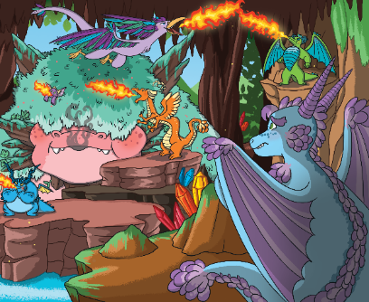
Click the correct rhyming word to fill in the blank.
Young Aristar disliked the flames
which scorched as they shot by.
She found it all too scary and
preferred the cooling .
Next
sky
sky
clouds
walk

Slide 11
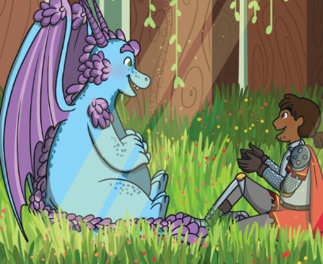
Click the correct rhyming word to fill in the blank.
“If only we weren’t enemies,
we wouldn’t need to fight.
And maybe if we worked together,
things would be .”
Next
alright
okay
alright
good

Slide 12
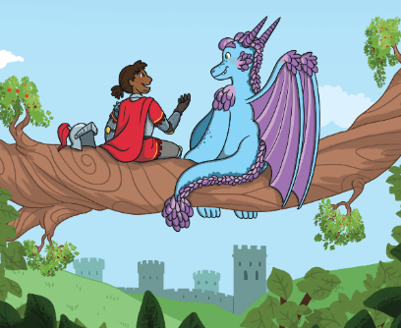
Click the correct rhyming word to fill in the blank.
Then suddenly, Sir Gorrell turned
to Aristar and said,
“Forget this silly training;
let’s put on a show .”
Next
instead
today
tonight
instead

Slide 13
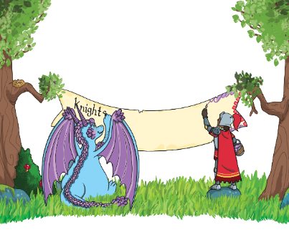
Click the correct rhyming word to fill in the blank.
They laughed and worked all afternoon, with growing, hopeful grins;
This plan could bring a peaceful truce where everybody .
Next
wins
wins
cries
talks

Slide 14
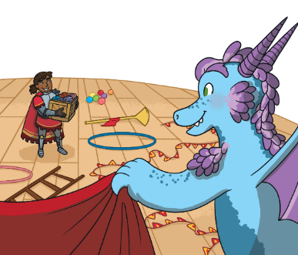
Click the correct rhyming word to fill in the blank.
They worked until the sun went down and left a dusky glow,
Preparing all the things they’d need
for putting on a .
Next
show
song
show
play

Slide 15
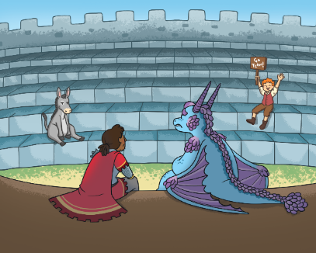
Click the correct rhyming word to fill in the blank.
Sir Gorrell sat with Aristar
upon the empty stage.
The audience consisted of
a donkey and a .
Next
page
sheep
girl
page

Slide 16
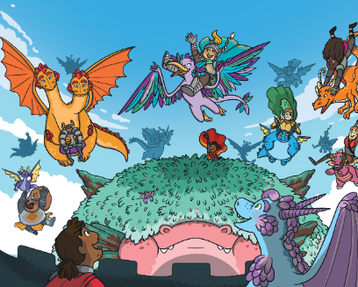
Click the correct rhyming word to fill in the blank.
They looked up to the sky and
saw the most amazing sight:
A host of flying dragons,
each one carrying a !
Next
knight
fish
sword
knight

Slide 17
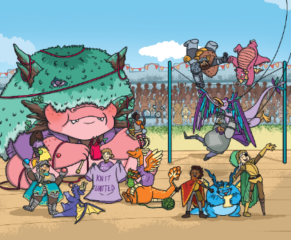
Click the correct rhyming word to fill in the blank.
The audience were captured by the a cappella squires,
And Maddox and Sir Trundlefoot did somersaults on .
Next
wires
chairs
tables
wires

Slide 18
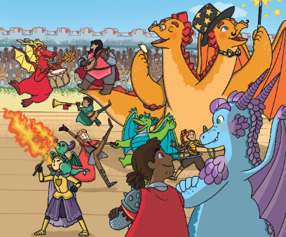
Click the correct rhyming word to fill in the blank.
Their lives were much more wholesome with new talents and new friends.
They realised that life becomes more fun when fighting .
Next
ends
ends
stops
starts

Slide 19
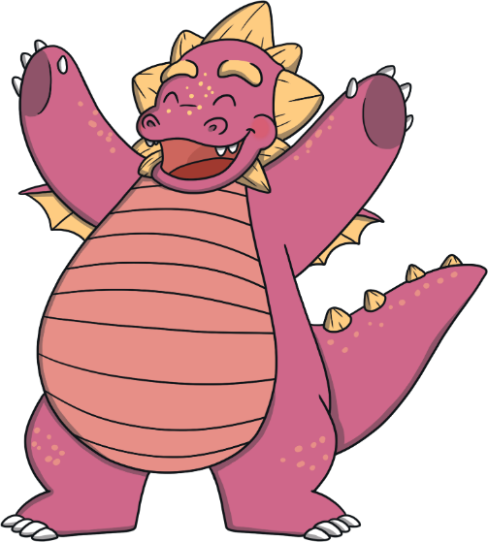
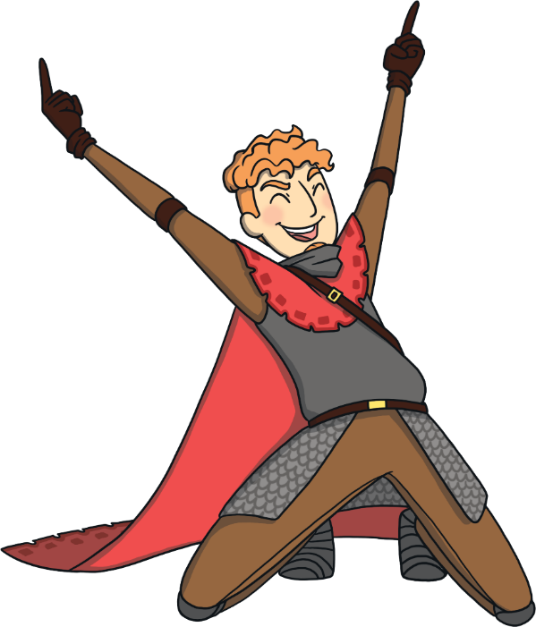
Well Done!
You found all the rhyming words to tell the story!

