Slide 1
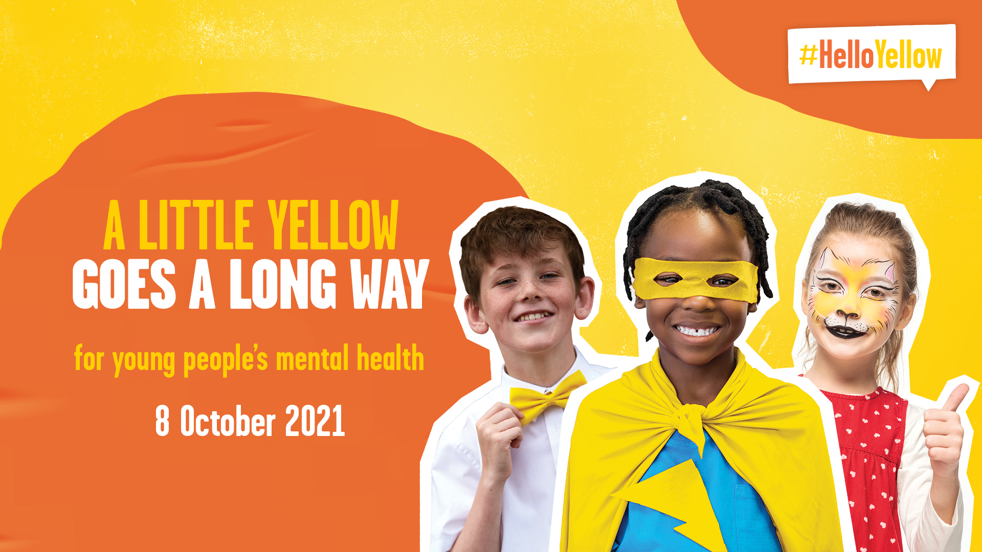
We are celebrating on 11th October 2021

Slide 2
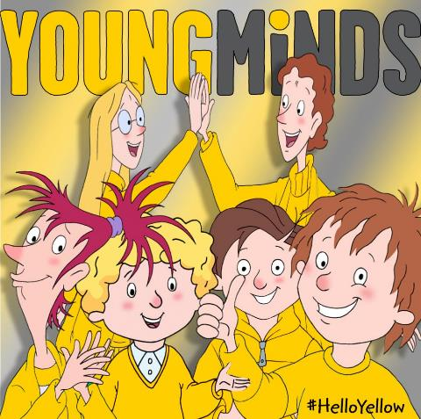
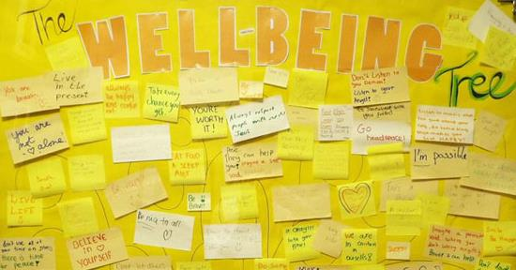
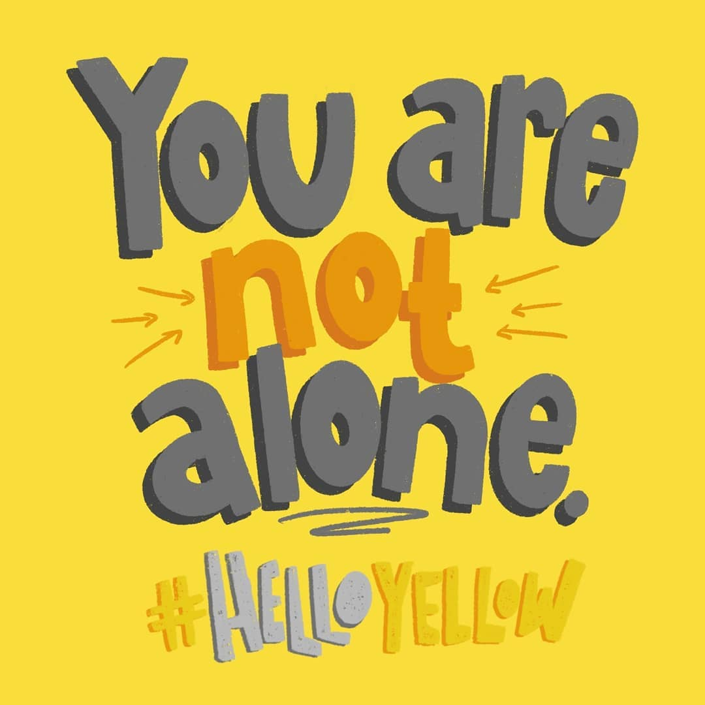
It’s !
Today we’re showing young people that they’re not alone with their mental health and raising vital awareness for YoungMinds.

Slide 3
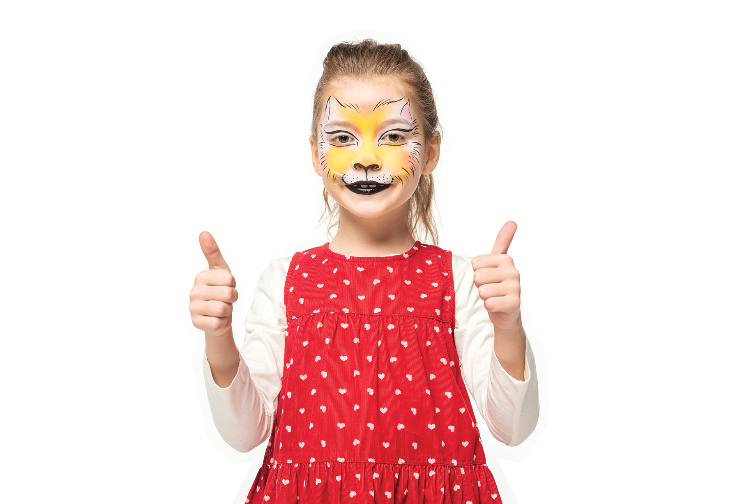
Why are we wearing yellow?
It’s normal to have ups and downs – and this year might have felt a little more down than up. But it’s the little things that have got us through it.
Wearing yellow today is a little thing we can do to make a big difference. Today let’s celebrate the little things we can do to look after ourselves and support each other, and together, we can show young people they’re not alone with their mental health.
The more people who show they care, the more comfortable young people will feel about talking to someone if they’re struggling.

Slide 4
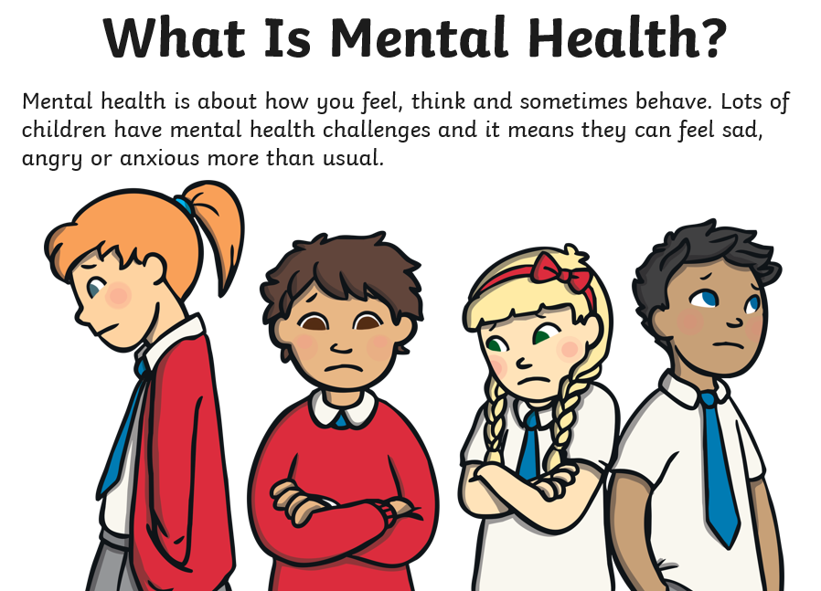

Slide 5
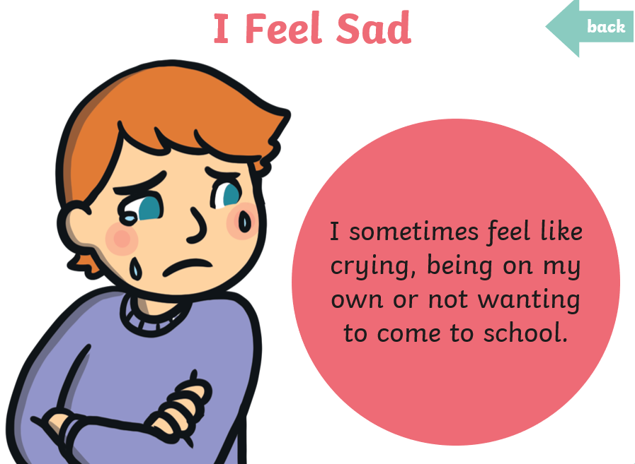

Slide 6
It is normal to feel sad sometimes but feeling sad a lot of the time means you might need to ask for help.

Slide 7
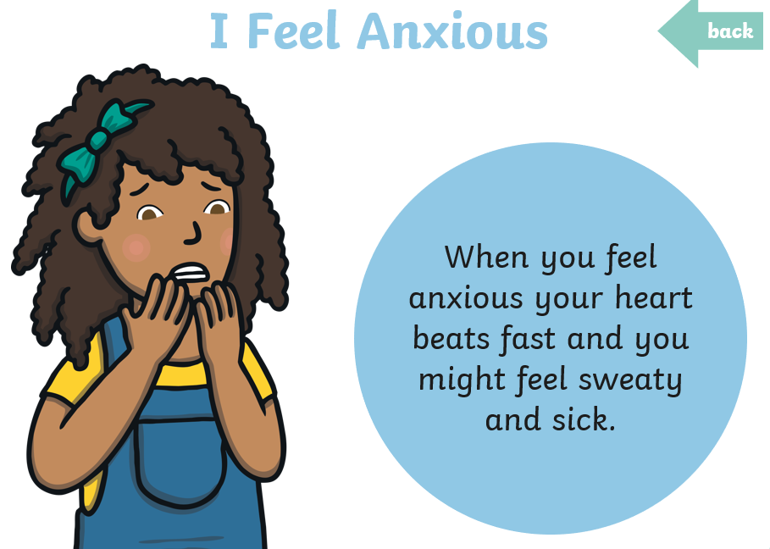

Slide 8
It is normal to feel worried sometimes but feeling worried a lot of the time means you might need to ask for help.

Slide 9
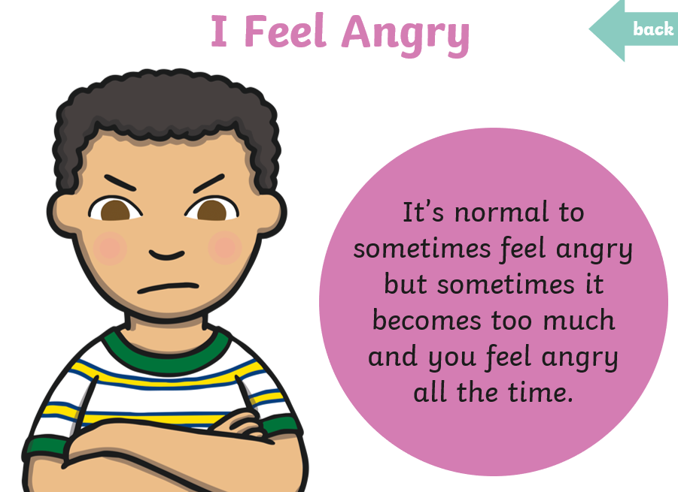

Slide 10
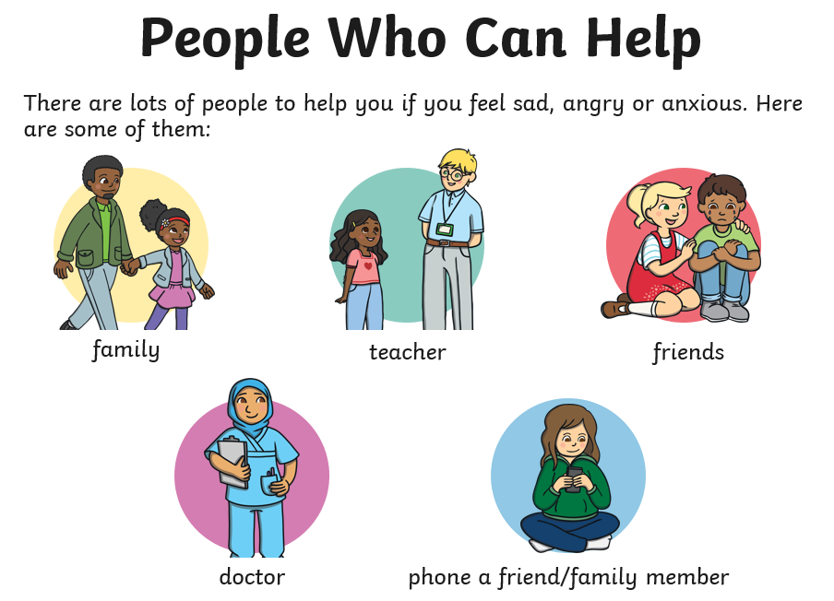

Slide 11
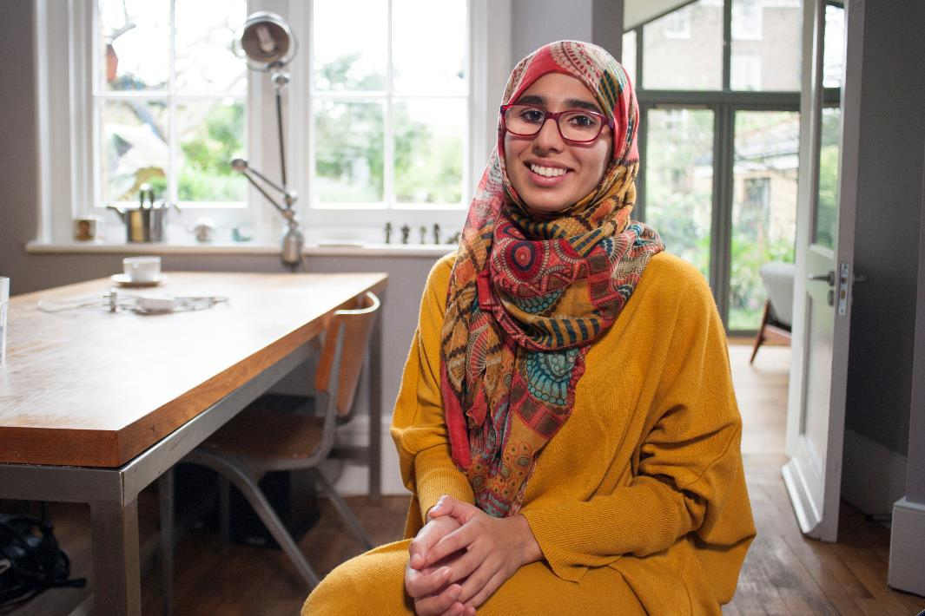
Meet Aaliyah

Slide 13
Thank you!

