Slide 1
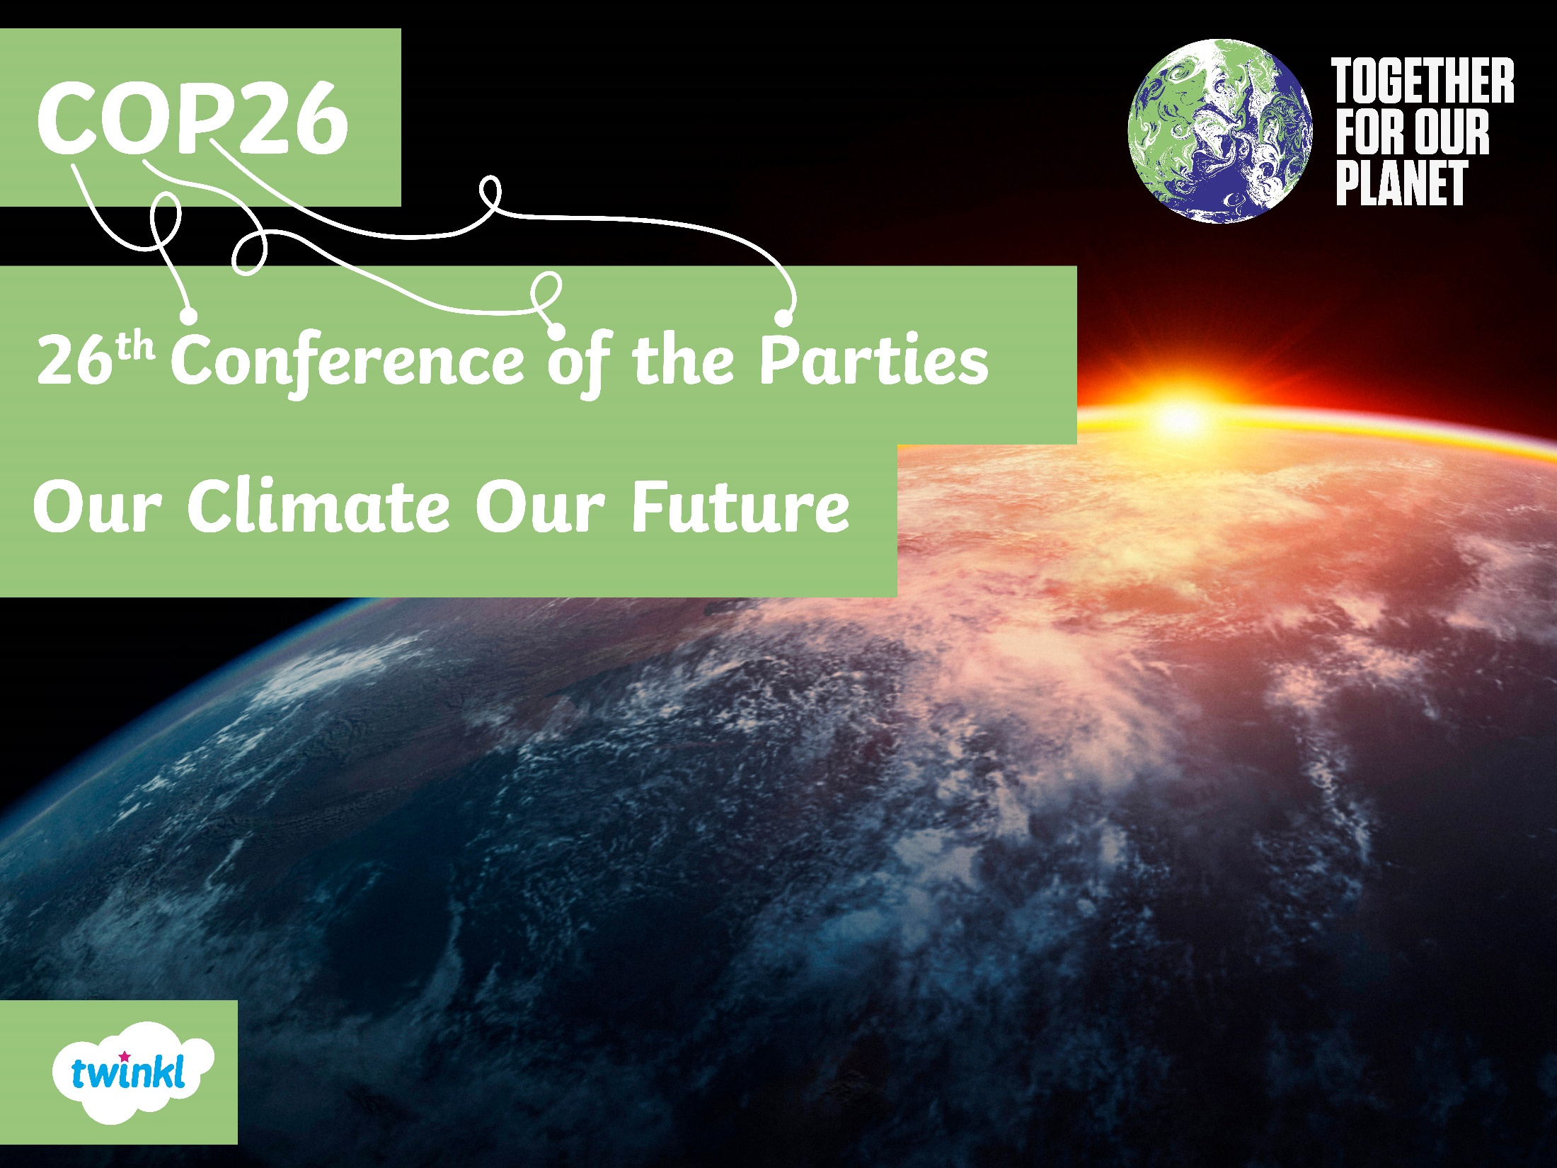

Slide 2
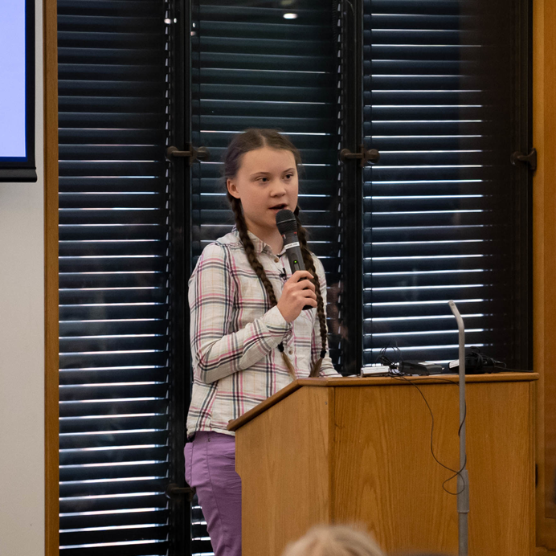
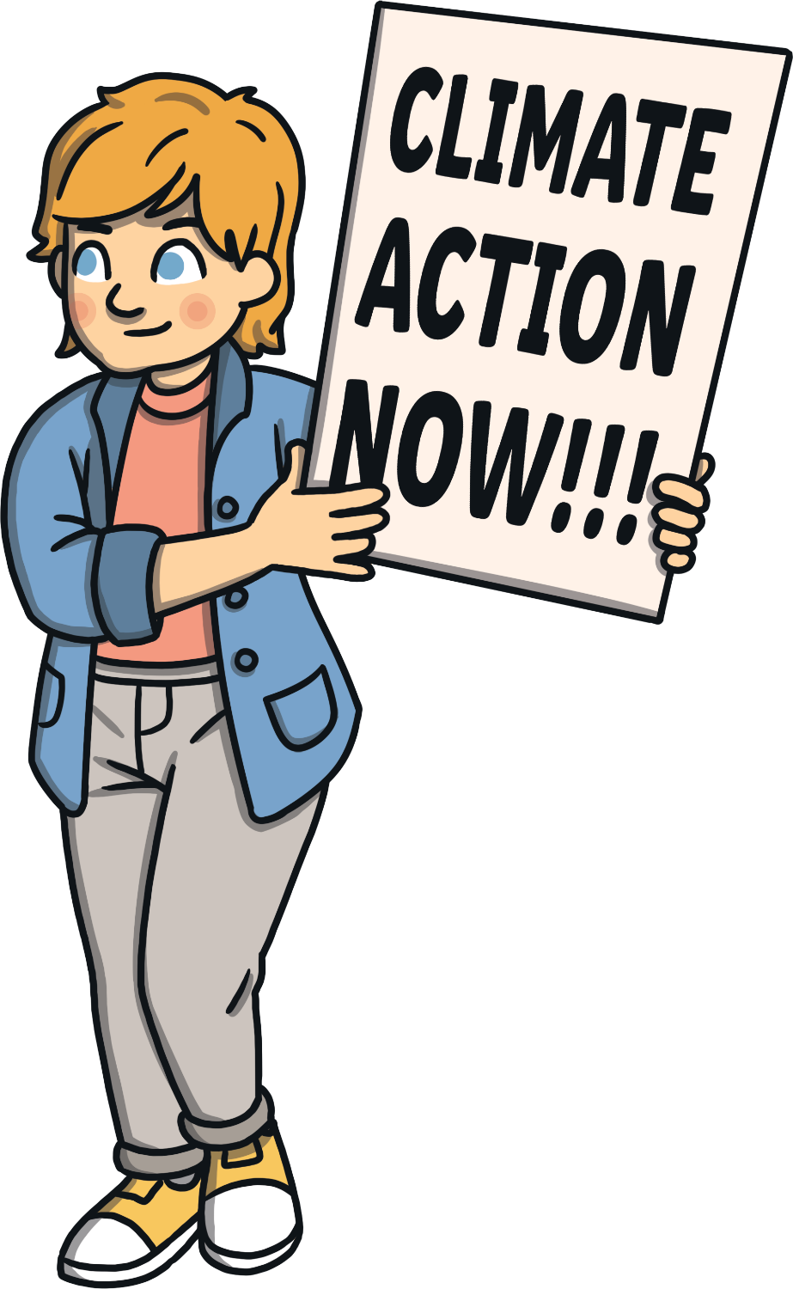
COP26 – Our Climate Our Future
Our planet is at risk and the world must come together to find solutions.

Slide 3
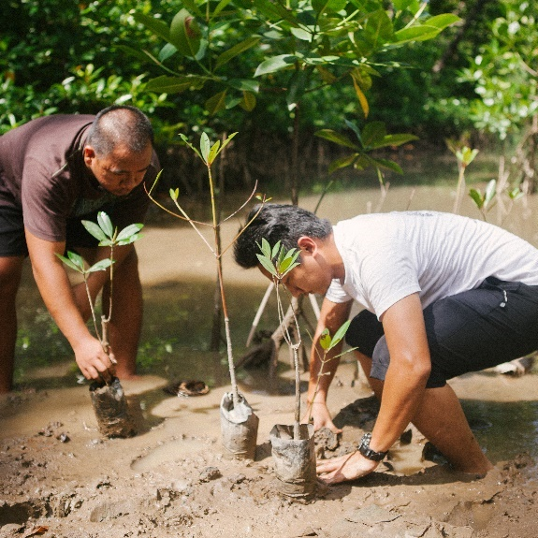
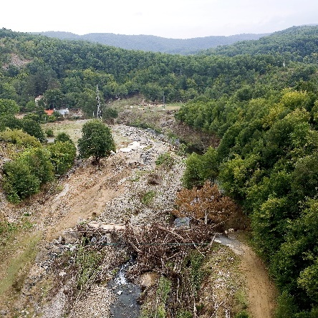
COP26 – Our Climate Our Future
An organisation, called the United Nations (UN), bring together most countries around the world to work with each other and to talk about global problems.
They find ways to work towards solving these problems in order to benefit the entire planet.
Climate change is one of those problems.
In fact, it is a huge issue affecting the whole world
and all of its living things: people, animals and plants.

Slide 4
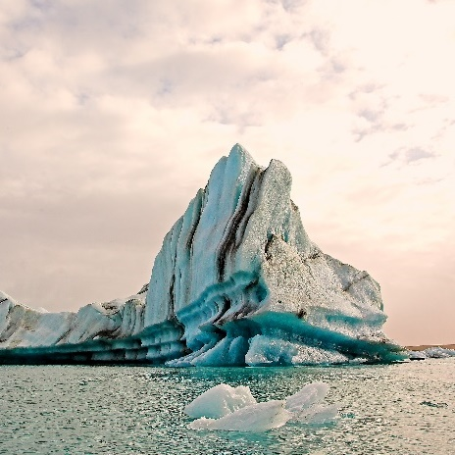
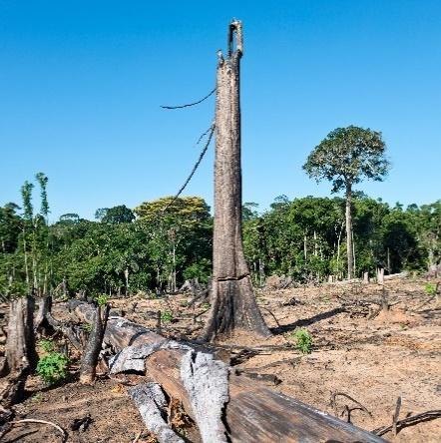
COP26 – Our Climate Our Future
Climate change is sometimes called global warming because the whole world is warming up, much more quickly than it should be.
For 25 years, people from almost every country in the world (known as parties) have been meeting every year to talk about actions that humans can take to help slow down climate change.
This is known as the Conference of the Parties (COP) and COP26 will be the 26th meeting.

Slide 5
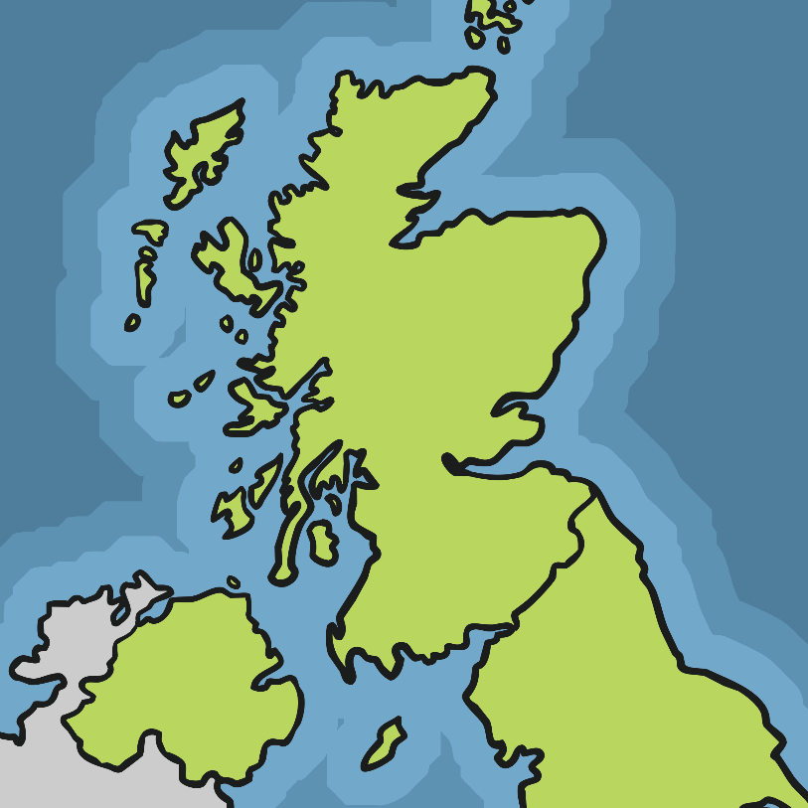
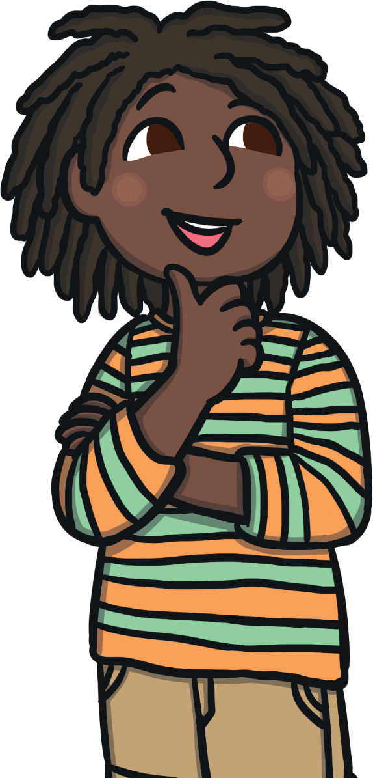
COP26 – Our Climate Our Future
‘Uniting the World to Tackle Climate Change’
Where?
Glasgow, UK
Glasgow

Slide 6
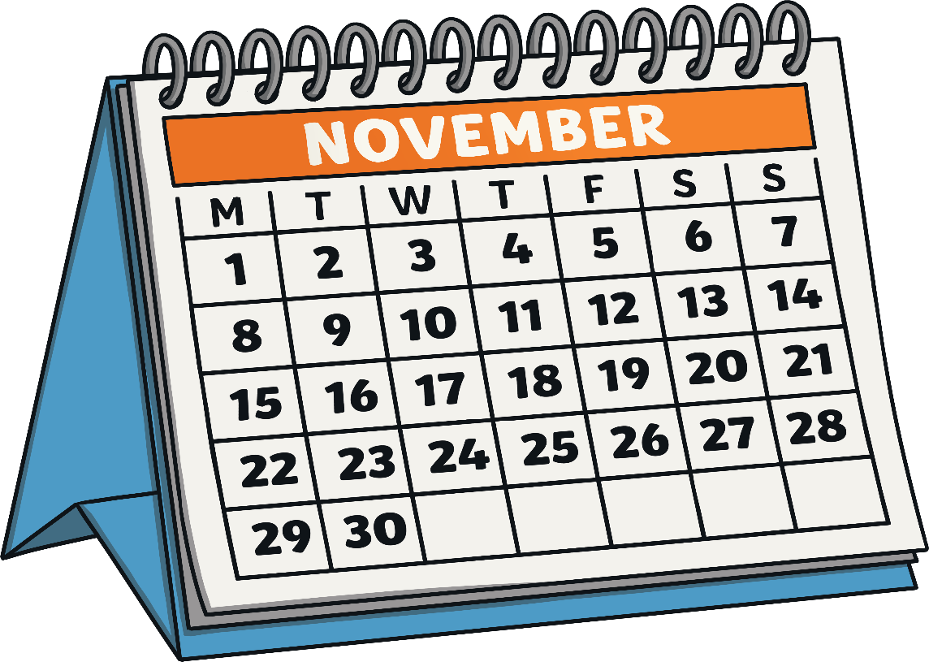
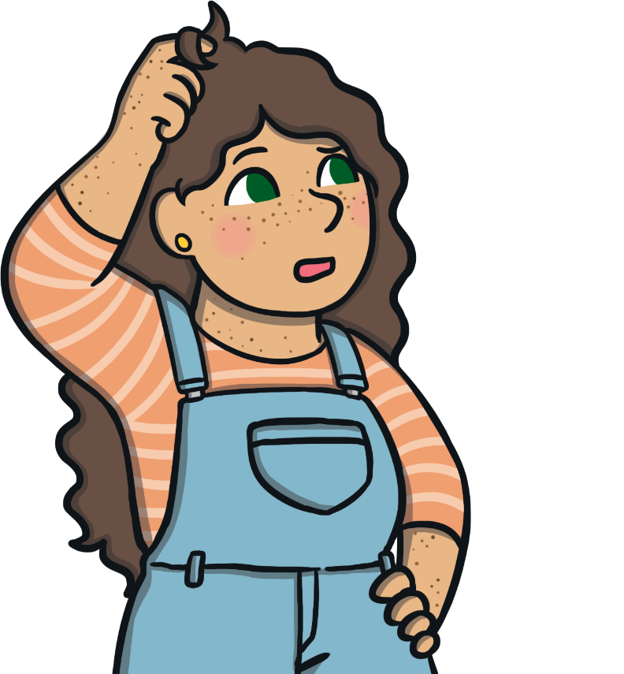
COP26 – Our Climate Our Future
‘Uniting the World to Tackle Climate Change’
When?
1st–12th November 2021

Slide 7
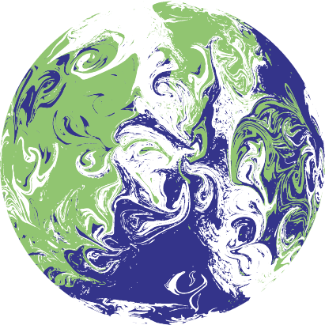
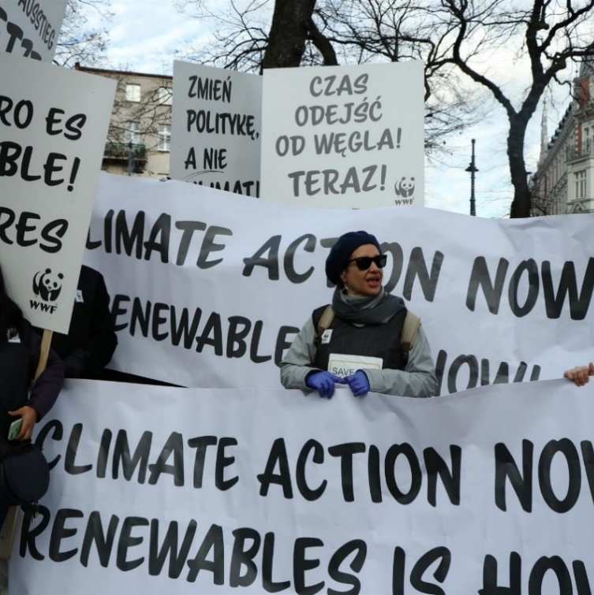
COP26 – Our Climate Our Future
‘Uniting the World to Tackle Climate Change’
Who?
Thousands of people will be at COP26.
Leaders from countries around the world will be there, as well as people who understand climate change, groups of people who want to take action and news reporters.
Every single person around the world will be affected too.

Slide 8
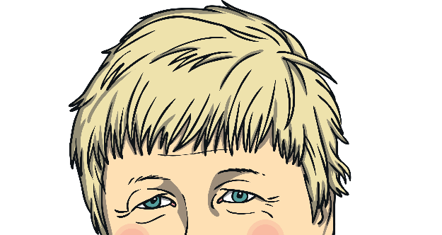
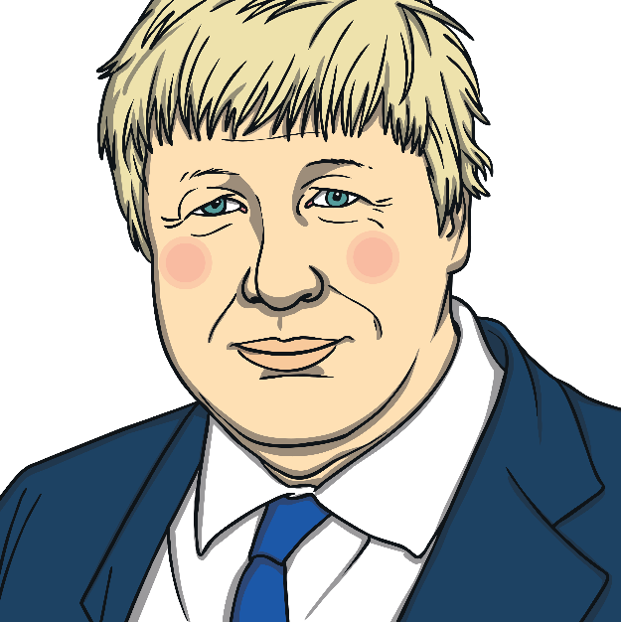
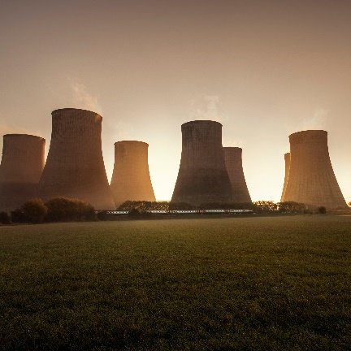
COP26 – Who?
World Leaders
The UK’s Prime Minister, Boris Johnson, will be one of these leaders. He launched COP26 by saying the world will come together to create a cleaner and greener
future for all.
Negotiators
Negotiators are people who say what their countries will do to slow climate change and help people to get ready for changes.

Slide 9
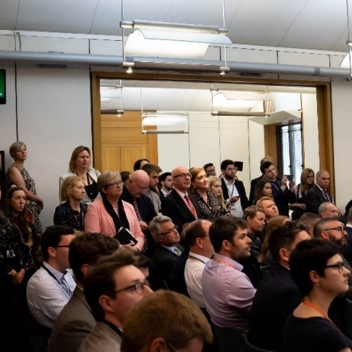
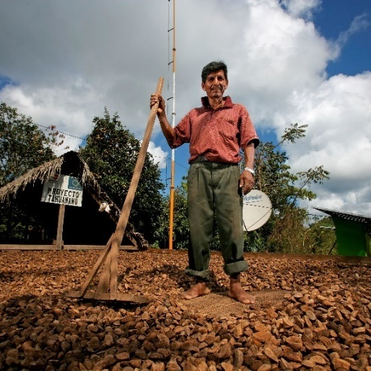
COP26 – Who Else?
Observers
Observers are groups of people who will speak out to say what actions they think are important for the leaders to take.
They can also help other people who will attend COP26 to understand what is happening.
Observers might be people from youth groups, farms, companies and news teams.

Slide 10
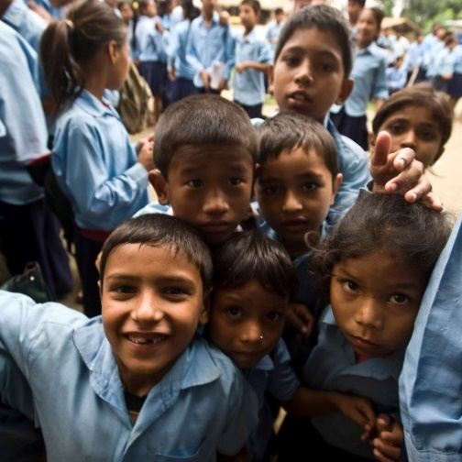
COP26 – Who Will This Affect?
‘Uniting the World to Tackle Climate Change’
Climate change affects everyone.
In many parts of the world, the people who do
the least to cause climate change can be most affected by it.
The parties at COP26 must agree on actions that will help people in communities around the world to have better lives and incomes.

Slide 11
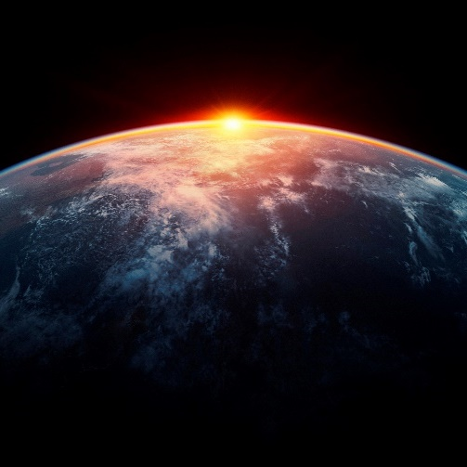
COP26 – What Is Climate Justice
People from all parts of the world must work together.
It is important that world leaders think about everyone in the world – not just people in their
own countries – when deciding how to deal with climate change.
The companies and people that have helped to cause climate change should lead the way in helping to find solutions to the problem.

Slide 12
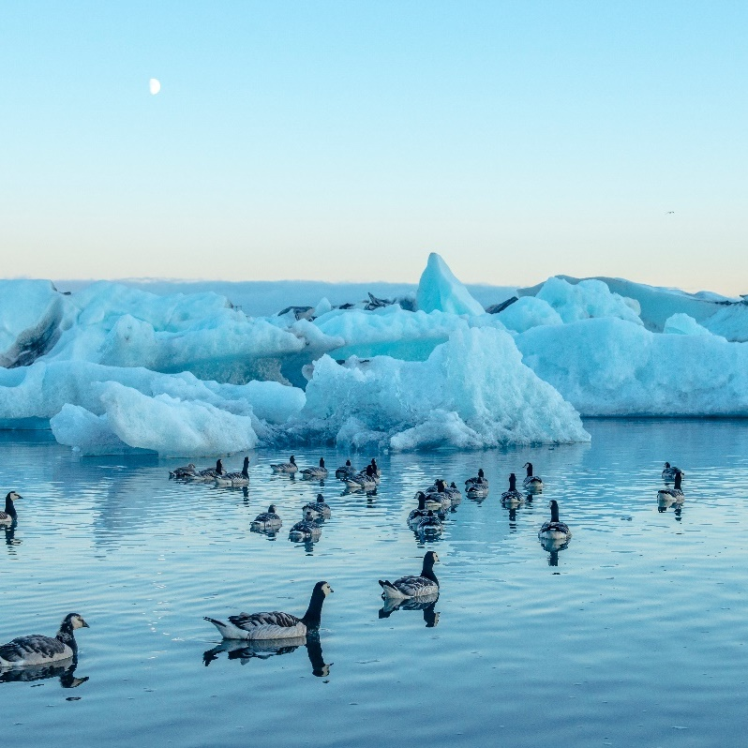

COP26 – Our Climate Our Future
‘Uniting the World to Tackle Climate Change’
What?
Parties must agree on actions to tackle climate change.

Slide 13
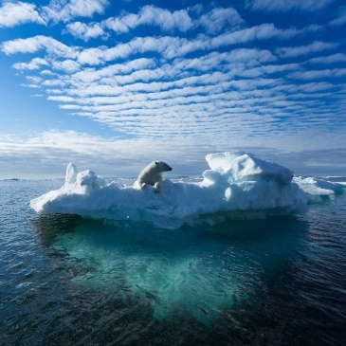
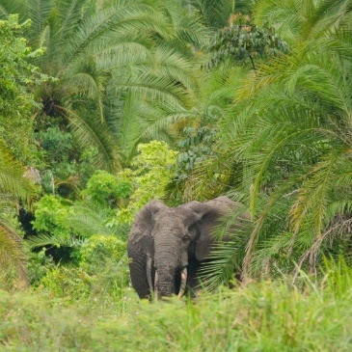
COP26 – What?
Stop or Start?
What do world leaders need to agree to stop or start
at COP26 to slow down climate change?
Start
Start
Start
Start
Stop
Stop
Stop
Stop
Helping people to cope with climate change.
Using cheaper and cleaner energy
(wind, solar).
Protecting natural places(forests,
oceans, wetlands).
Finding more money to spend on slowing climate change.
Letting so many greenhouse gases (gases that trap heat) into the Earth’s atmosphere.
Burning fossil fuels (coal, gas, oil).
Raising the risk of more extreme weather.
Making vehicles that cause pollution.

Slide 14
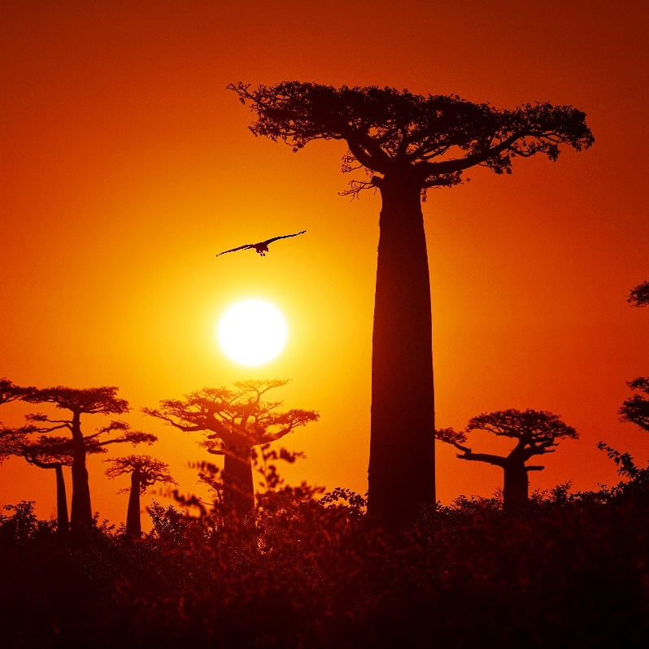
COP26 – Our Climate Our Future
‘Uniting the World to Tackle Climate Change’
Why?
The temperature of the Earth is going up. COP26 must find a way to make sure that this is not more than 1.5°​C and help people to cope with the changes to come. The clock is ticking on climate action.

Slide 15
COP26 – Why?
Change for the Future
At COP26, the parties must agree on actions that will tackle climate change and help the whole planet in different ways. These include:
Food and Farming
Energy
Oceans
Forests
Health and Happiness

Slide 16
