Slide 1
Whole School Assembly
(first one in nearly two years!!)
28.2.2022

Slide 2
Democracy
Rule of law
Individual liberty
Mutual respect
Tolerance
What are these?

Slide 4
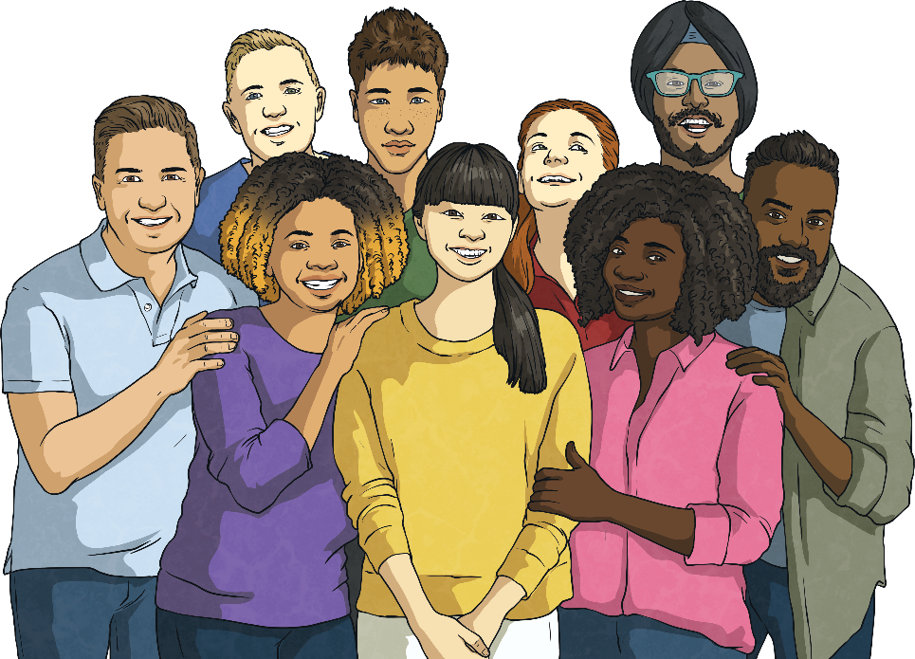
What Is Respect?
Respect means thinking about other people and their feelings.
Respect means thinking about other people and their feelings.
We can show respect in many ways, through how we act and in
what we say.
Ngbfnjfvnbgfnj
gnnj

Slide 5
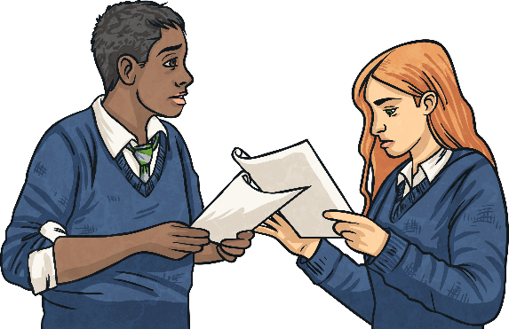

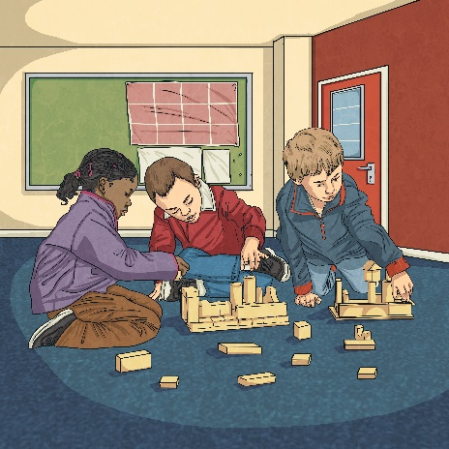
How Can We Show Respect in School?
We can show respect by:
Respect means thinking about
listening to others;
following school rules;
saying kind things to others;
waiting our turn;
including others in our activities;
using good manners.

Slide 6
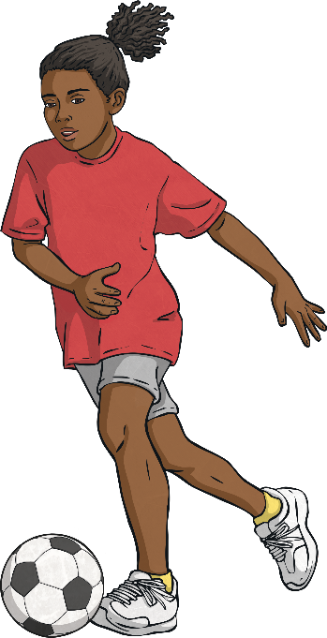
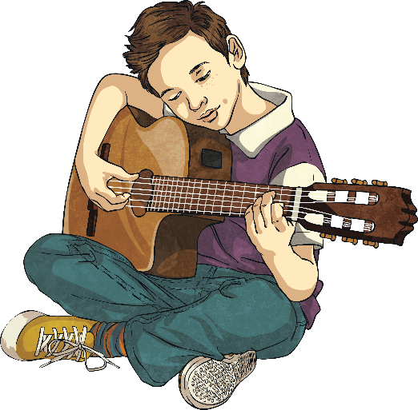
How Do We Respect Ourselves?
Not only is it important to respect others, but also to respect ourselves.
We should look after our bodies.
We should follow our dreams.
We should love ourselves and believe in our abilities.
Ngbfnjfvnbgfnj

Slide 7
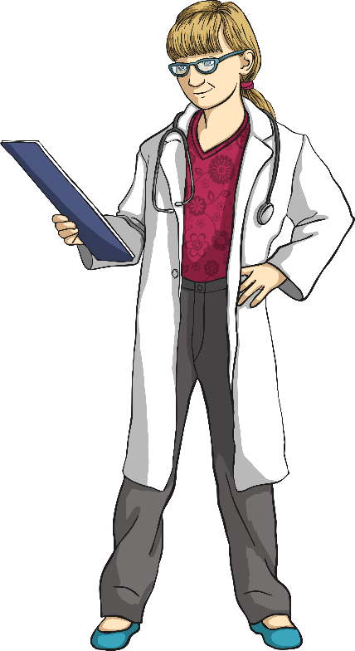
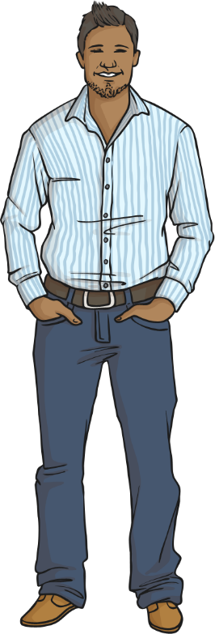
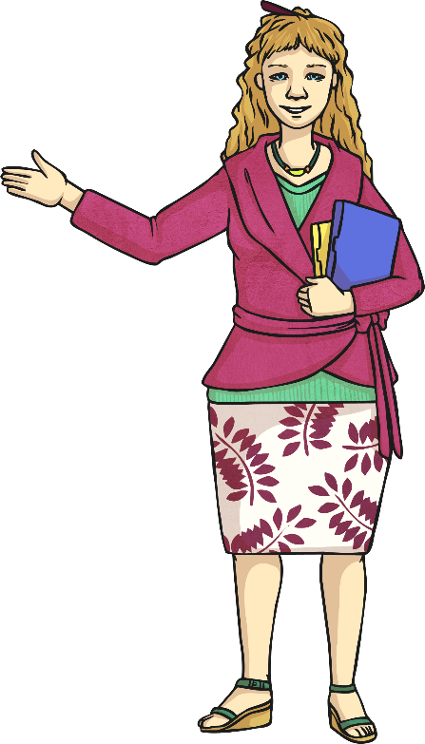
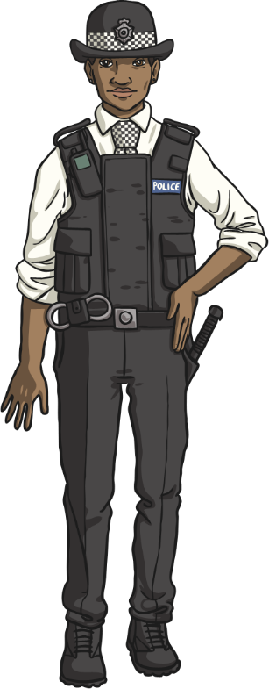
Who Should We Respect?
surgeon
parents
teacher
police officer
Can you think of any other types of people we should respect?

Slide 8
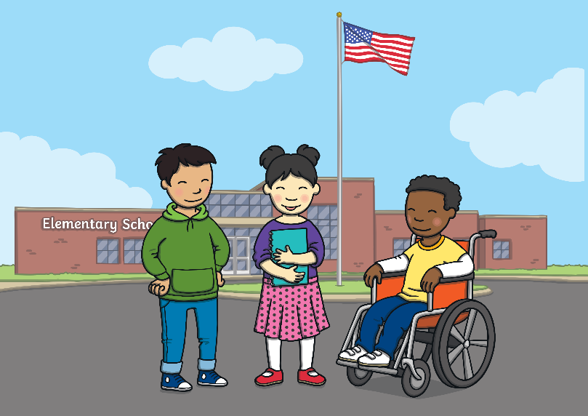
When you arrive to school, what should you do first?
play with your friends
eat your snack
read a book
greet your teacher

Slide 9
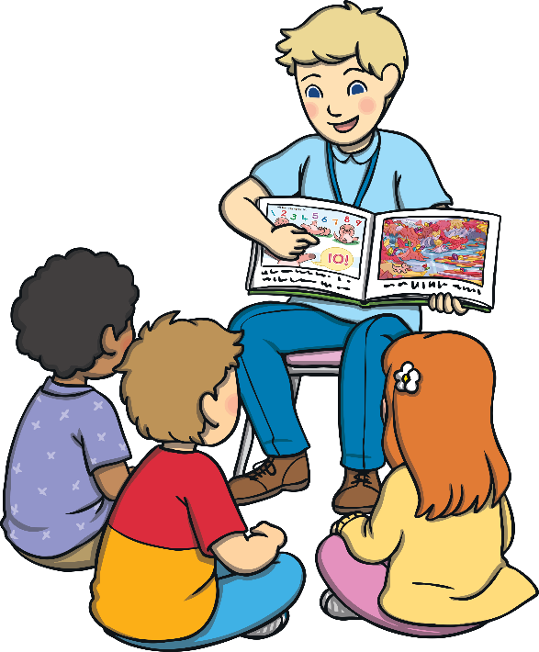
If your teacher is talking during class, what should you not do?
wiggle in your seat
talk to your neighbor
look out the window
all of the above

Slide 10
If someone is alone and has no one to play with, what should you do?
continue with whatever you were doing
point at the person
go over to the person and ask them to play with you
none of the above

Slide 11
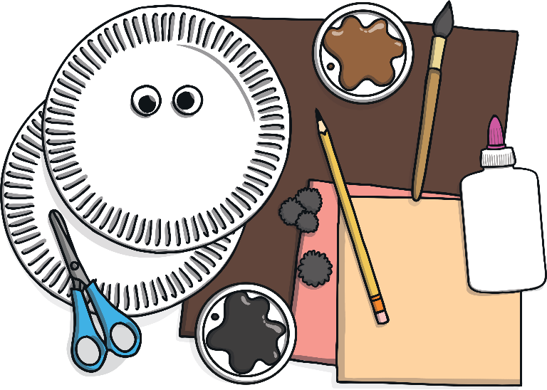
After you do an art project, what should you do?
take a rest
talk with your neighbor
read a book
clean up your things

Slide 12
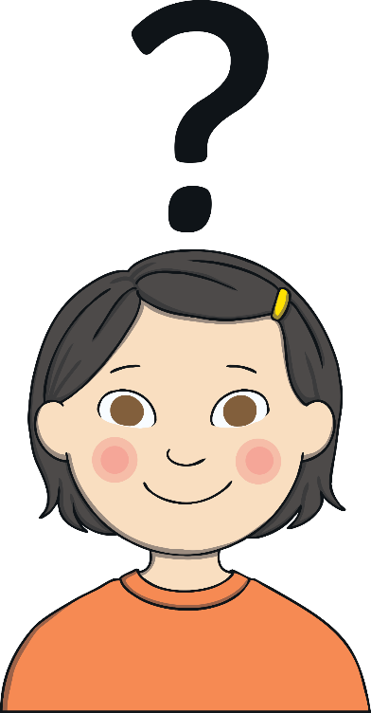
When you need to ask the teacher a question, what should you do?
raise your hand
ask the question right away
do something else
talk to your neighbor

Slide 13
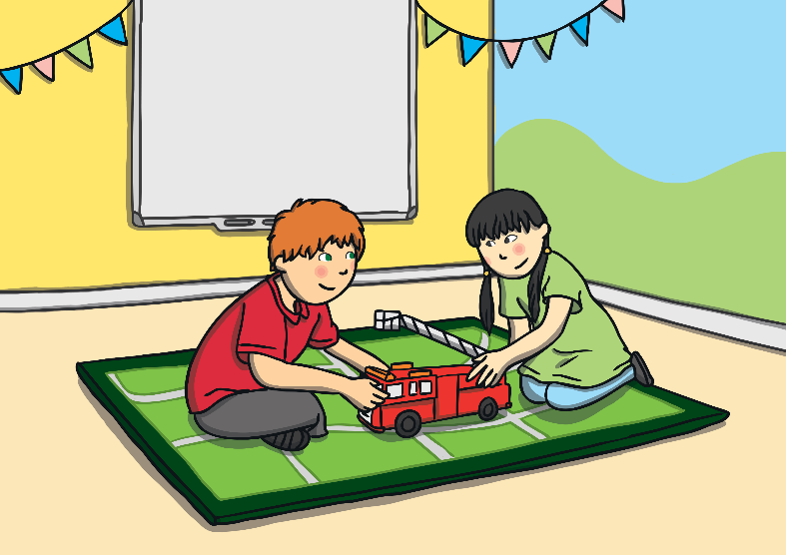
What is a good thing to say in the classroom?
can
will
please
sure

Slide 14
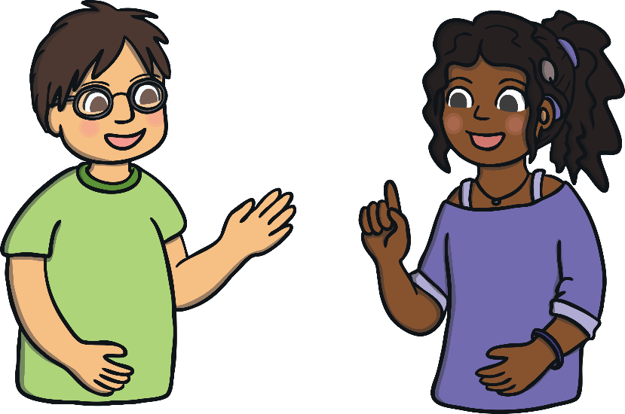
When someone is talking to you, what should you do?
look the person in the eyes
talk to another friend
colour a picture
all of the above

Slide 15
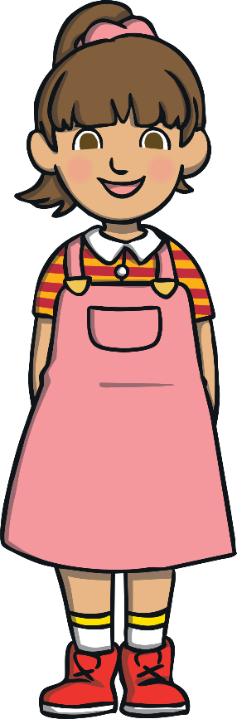
What is a good thing to do in the classroom?
say nice things to your classmates
be polite
share with others
all of the above

