Slide 1
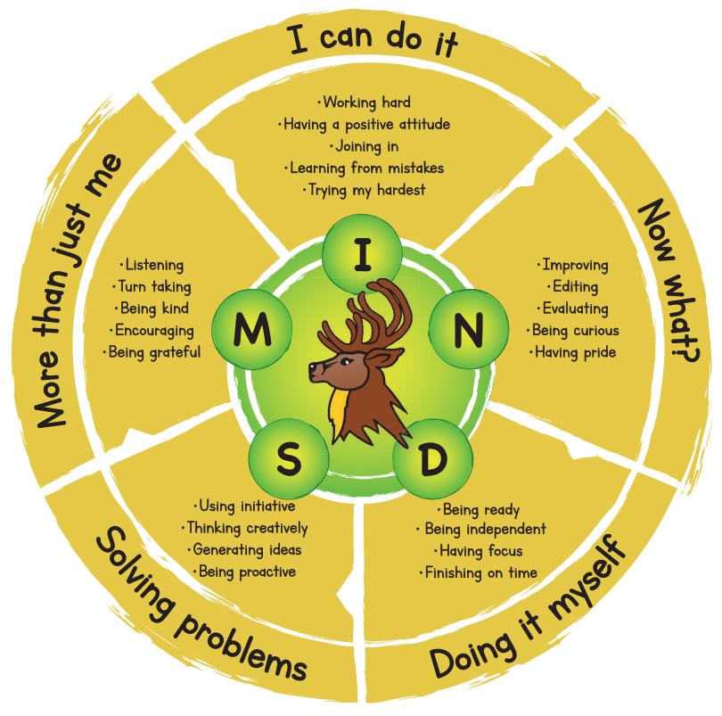

Slide 2
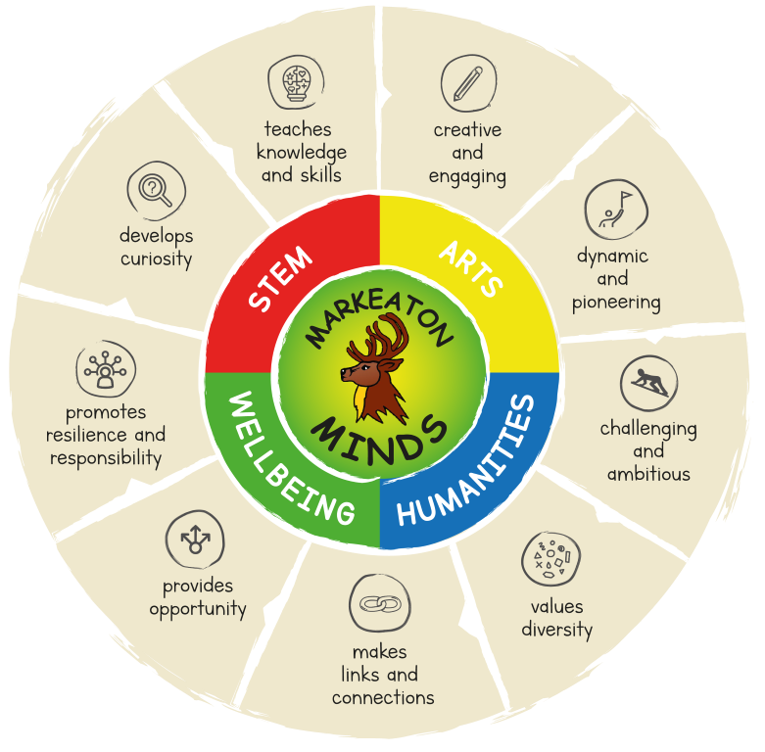

Slide 3
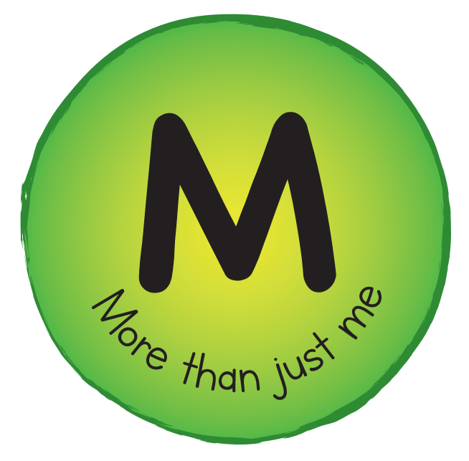
Stickers

Slide 4
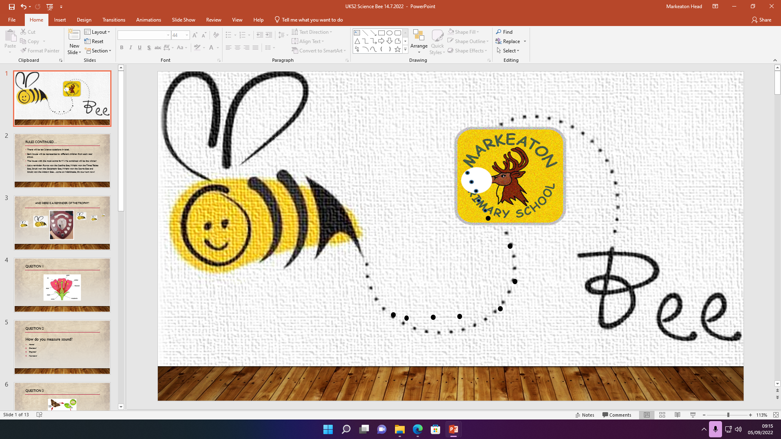
Any ideas? So far we have had spelling, capital cities, History, Times Tables, Science and Sport

Slide 5
