Slide 1
Parents and Carers as Partners: Supporting children with writing

Slide 2
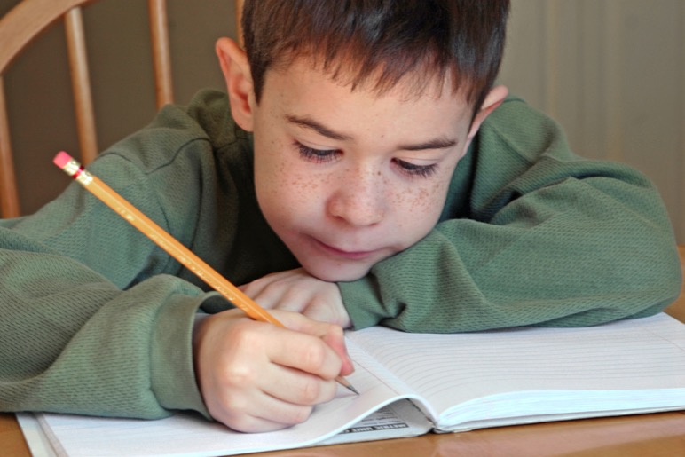
Who am I writing for?
(audience)
What will I write about?
(Ideas)
What’s the order of my writing?
(structure and organisation)
How do I spell the words I write?
What kind of sentences will I build?
(grammar)
Which punctuation will I use?
How do I form the letters?

Slide 3
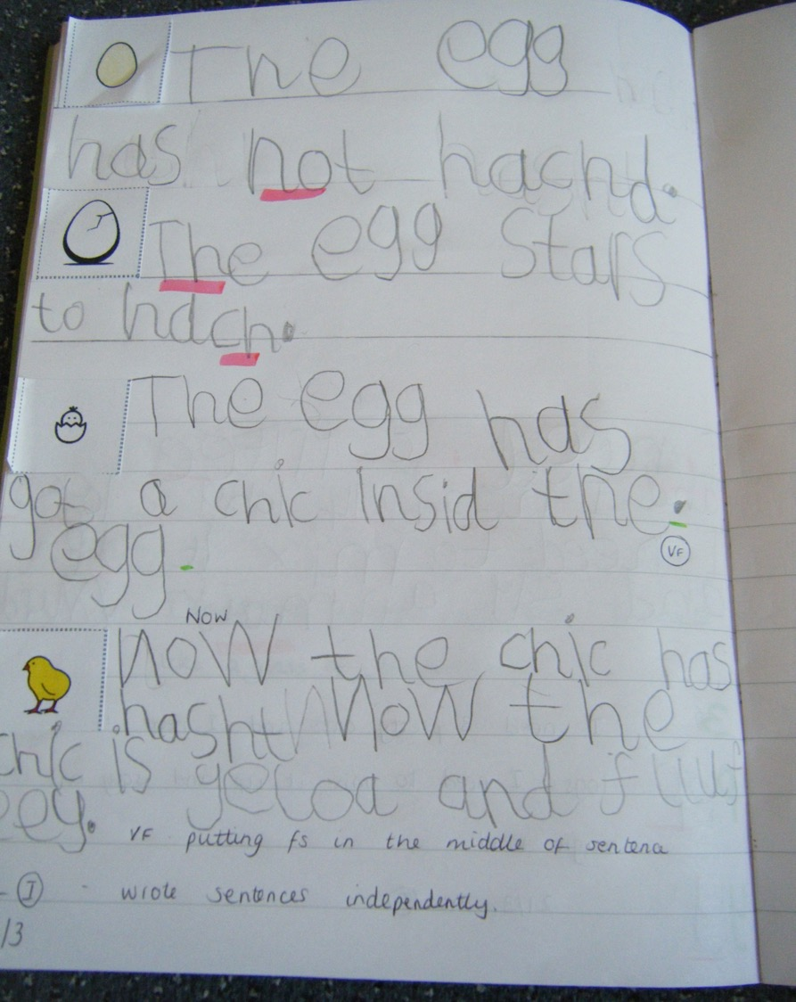
End of Reception

Slide 4
Year 1

Slide 5
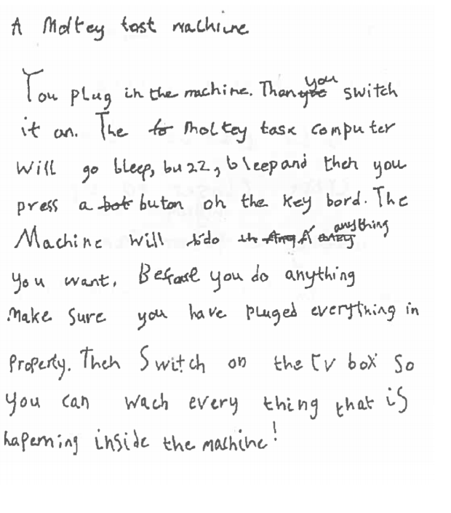
End of Year 2

Slide 6
End of Lower KS2

Slide 7
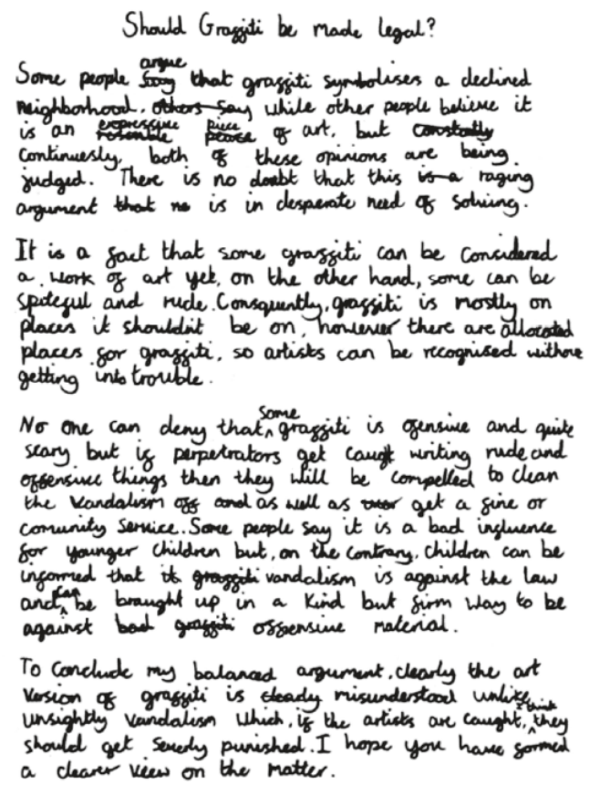
End of
Year 6

Slide 8
Getting going with writing : the right conditions.

Slide 9

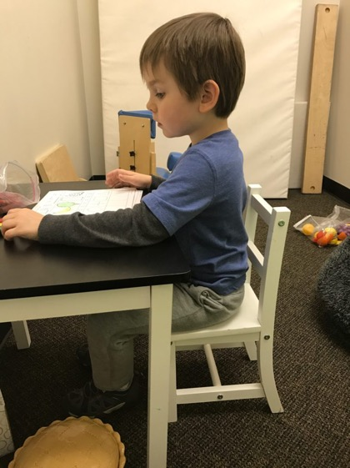
Well developed Core Strength
Poor posture
Gross motor skills less developed
Less control with fine motor skills and precision.

Slide 10
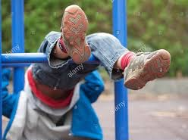
Squeeze , climb things and hang from things!

Slide 11
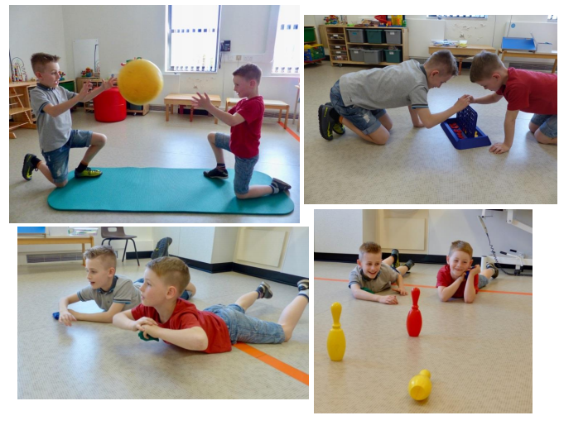

Slide 12
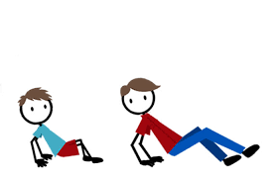
Strengthening Core Stability
You need
An area of floor or grass and a bean bag or soft toy.
How to do it
Get your child to sit on the ground with their hands and feet on the floor, fingers pointing behind them, raise their bottom off the floor to make a table shape. In this position get them to walk backwards, like a crab, to a destination and back again. Put a beanbag or soft toy on their tummy - make sure they keep their bottom up otherwise the toy will fall off!
Tummy Skittles
You need
A large/medium sized ball, skittles or empty 1 litre or 2 litre plastic drinks bottles and space enough for your child to lay flat on their tummy and the skittles to be about 2 metres away.
How to do it
Get your child to lie on their stomach, lift their head up and then lift their arms above their head. Throw the ball at the skittles, then lower the body gently back to the floor, ready to throw again.

Slide 13
Bridge Games
You need
An area of floor or grass and some small toys to pass under the bridge such as vehicles or animals. For older children a stopwatch or clock with a seconds hand.
How to do it
Laying on their back with their knees bent and feet flat on the floor get your child to raise their bottom off the floor to form the bridge. Pass the toys under the bridge. For younger children get them to make the noise of the toys, for older children set them time challenges.
As this activity can be quite demanding start by just playing for between 30 seconds and one minute. As your child gets stronger and can play for longer why not turn it into a family competition?
http://www.cumbria.gov.uk/elibrary/Content/Internet/537/17241/17246/17271/17304/4297816652.pdf?timestamp=4302672355

Slide 14
Core Stability
Good posture for Writing,
Feet flat on the floor
Ankles at 90degrees
Knees at 90 degrees
Hips at 90 degrees
The 90/90/90 rule
‘Bottom to the back of the chair, tummy touching the table and 6 feet on the floor’

Slide 15
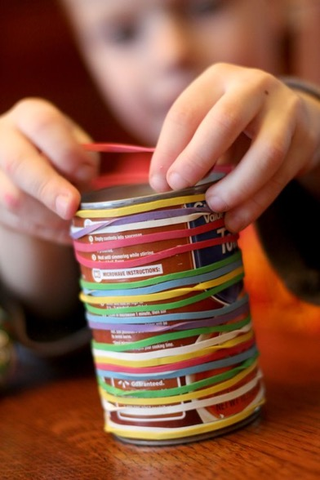
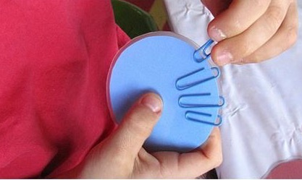
Fine Motor Skills
Tweezers
Squeezy bottles
Pegs
Straws and string
Paperclips and elastic bands
Hair scrunchies
Bubble wrap

Slide 16
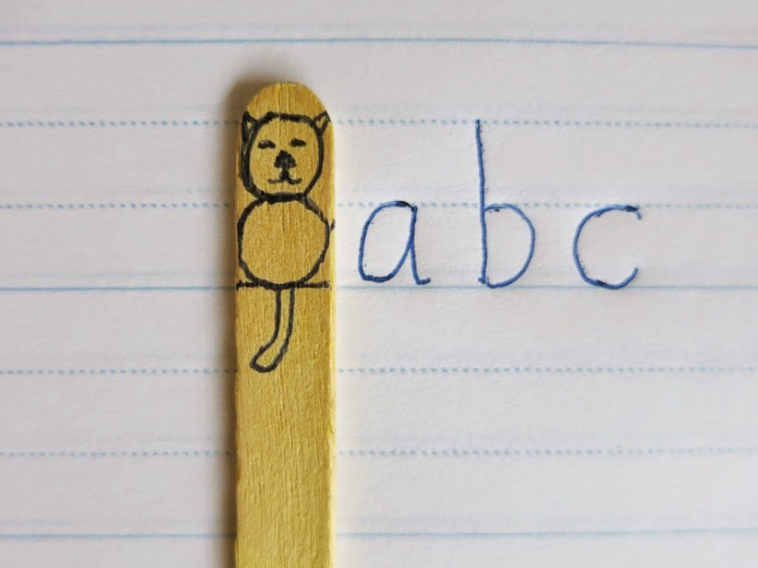
Lines are helpful
Size of the letters
‘Ascenders’ and ‘descenders’
Upper and lower case letters.
‘Clever cat’: body for lower case on the line letters, tail for descenders, head for Upper case and ascenders.

Slide 17
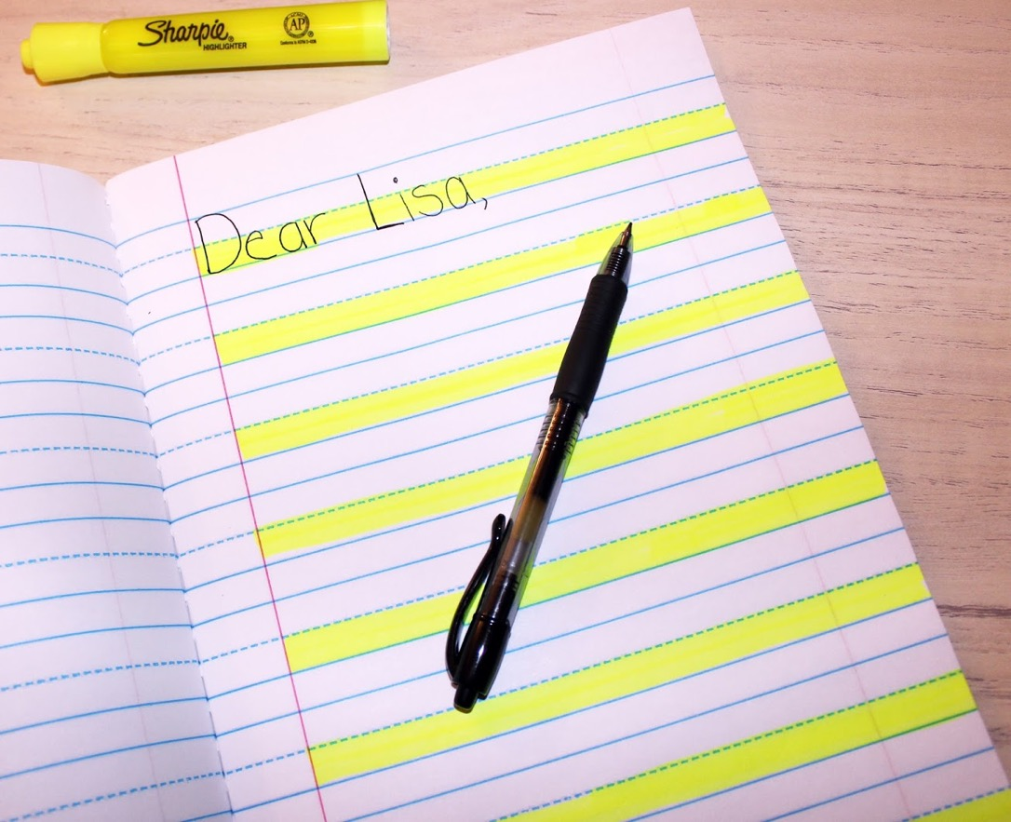

Slide 18
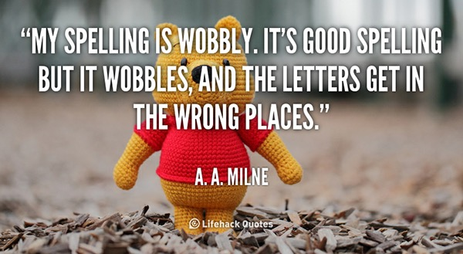
Helping with spelling.

Slide 19
Encourage your children to ‘have a go’ then ask the question “Does it Look right?”
speshul
special
speshial
Talk about which parts of a word your child has spelt correctly and which parts are incorrect. This helps them to focus on the tricky bit and memorise that part (which might always catch them out)
“Look at the word, remember it, cover, write then check”

Slide 20
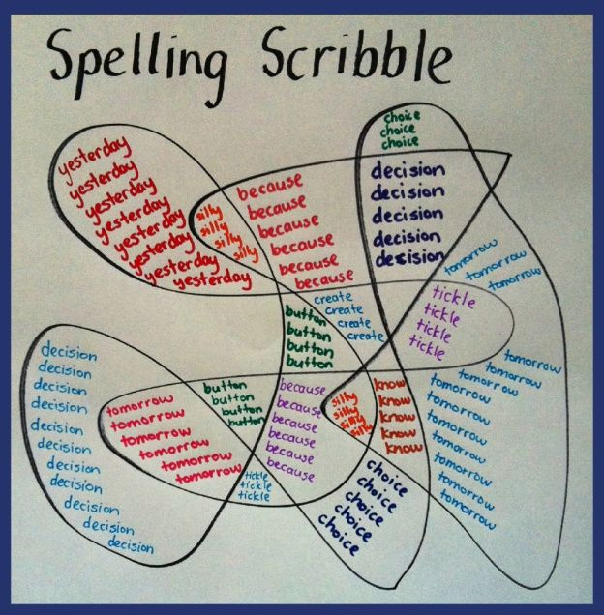
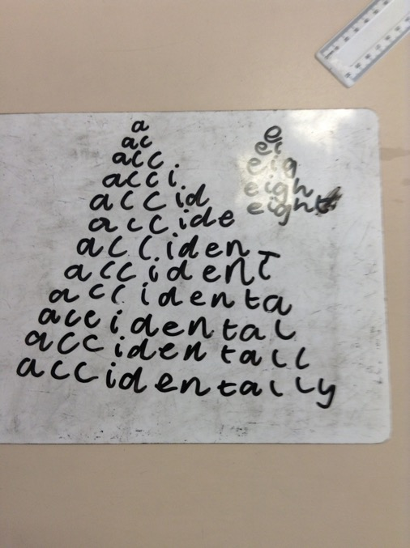
Spelling pyramids
Rainbow writing:
February
naughty

Slide 21
Devise cartoons and pictures to remember the spelling of homophones. (words that sound the same but are spelt differently)

Slide 22
stay
plate
train
hay
eight
state
main
trail
clay
today
steak
break
Get competitive !
How many words can we write in a minute that all have the /ae/ phoneme?
How many words can we write in a minute that have the prefix dis?

Slide 23
Crosswords, word searches and games will all support spelling.
Word search creator
http://puzzlemaker.discoveryeducation.com/WordSearchSetupForm.asp
Remember: whenever we’re thinking about spelling, we use Letter Names

Slide 24
Encouraging writing:
Be positive: be encouraging

Slide 25
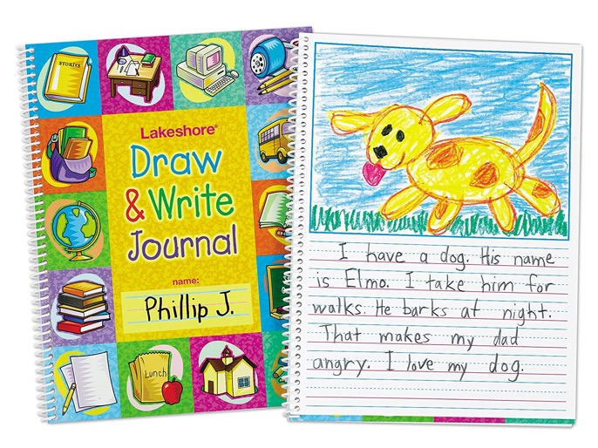
Interesting things to write in

Slide 26
Interesting things to write with

Slide 27


If you have a budding author in your house……
https://www.explorelearning.co.uk/national-young-writers-awards/
https://www.bbc.co.uk/programmes/p00rfvk1

Slide 28
But…
………the most important thing to do to help with writing is to………

Slide 29

Read….
Read with..
Read to….
Read alongside….

Slide 30
Why does Reading have such a Big impact on Writing?
I hear words and sentences I don’t hear in everyday talk and I can put these into my own writing.
I see how a story or a non-fiction text is put together.
e.g. what kind of things happen at the beginning, the middle and the end
I can ‘borrow’ ideas and inspiration from other writers.
I’ll ‘see’ lots of words and this will help me with spelling.
I’ll understand that writing has to interest my reader.

Slide 31


Slide 32
