Slide 1
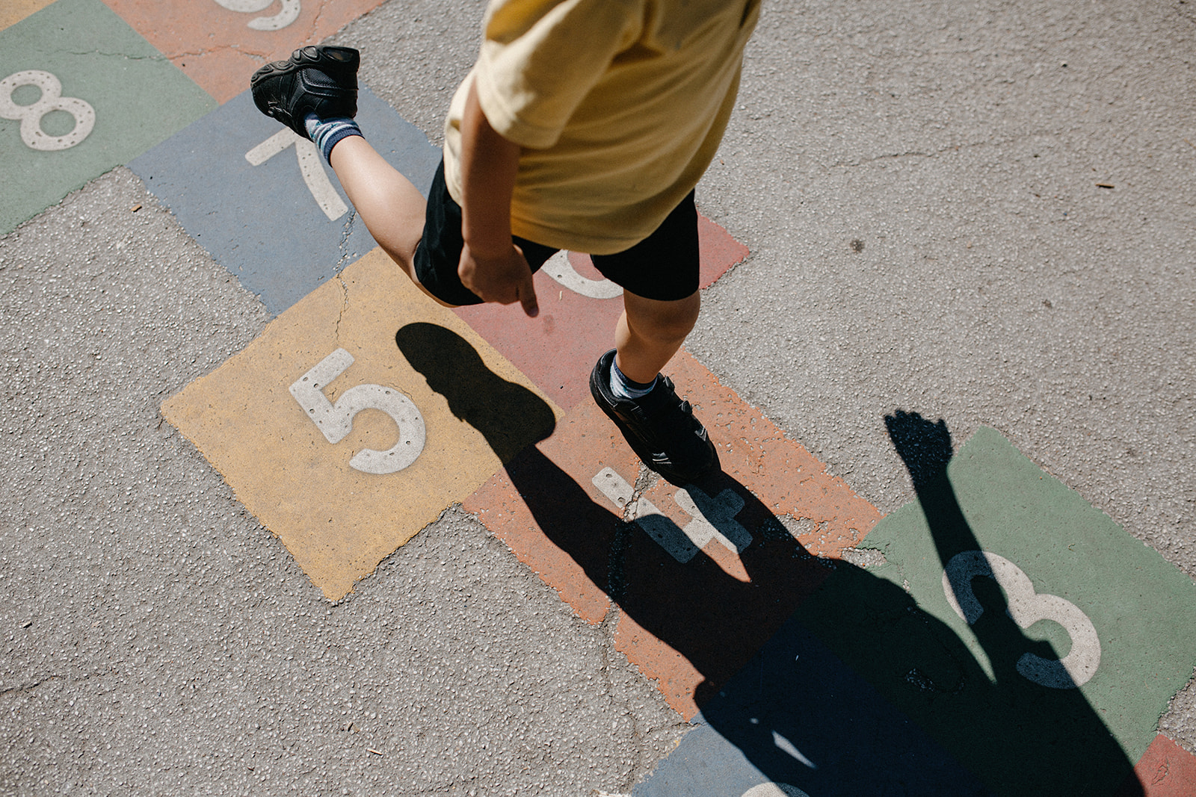
Parent/Carer Questionnaire Summer 2019

Slide 2

Thank you for your patience and thank you to all of you who took part in the survey! We now finally have the results of the Summer 2019 Parent/Carer Questionnaire.
As we chose to use online provider SurveyMonkey.com this year the results are presented in a slightly different way. That said, they are similar in some ways to previous years (use of a number to show how positive a response was). Each question has been analysed in two ways:
The percentage of answers that were Strongly Agree, Agree, Disagree and Strongly Disagree (first slide)
The numerical score for each question (second slide, also referred to as weighted average). Strongly Agree was worth four points, Agree was worthy three points, Disagree was worth two points and Strongly Disagree was worth one point.
So, in essence, anything above three points would suggest that a significant majority of the answers for that question were positive – the closer to four points, the more positive the response!

Slide 3
143
Total Responses
Date Created: Tuesday, May 07, 2019
Complete Responses: 143

Slide 4
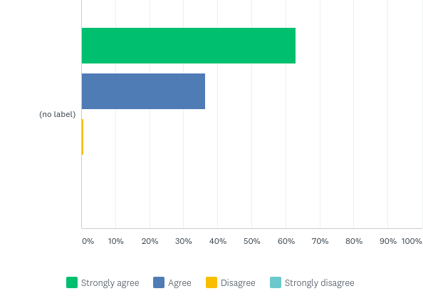
Q2: My child is happy at school.
Answered: 143 Skipped: 0

Slide 5

Q2: My child is happy at school.
Answered: 143 Skipped: 0

Slide 6
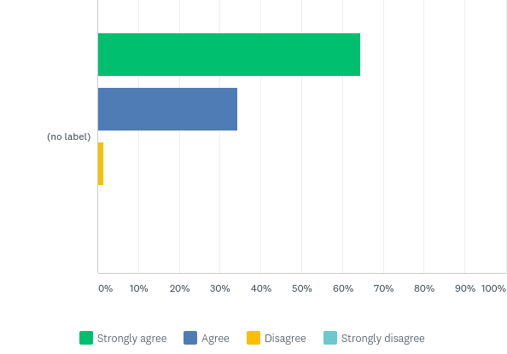
Q3: *New* My child feels safe at school
Answered: 143 Skipped: 0

Slide 7

Q3: *New* My child feels safe at school
Answered: 143 Skipped: 0

Slide 8
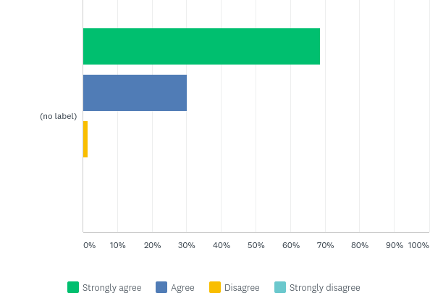
Q4: There is a positive atmosphere at Markeaton Primary School.
Answered: 143 Skipped: 0

Slide 9

Q4: There is a positive atmosphere at Markeaton Primary School.
Answered: 143 Skipped: 0

Slide 10
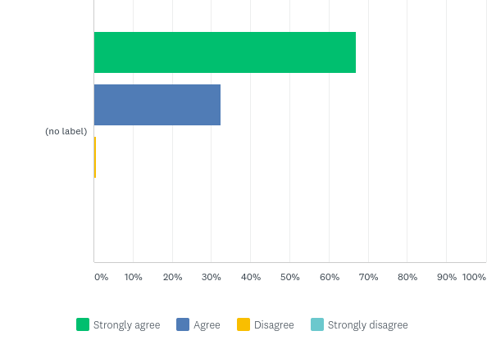
Q5: I feel welcome when I come in to Markeaton Primary School.
Answered: 142 Skipped: 1

Slide 11

Q5: I feel welcome when I come in to Markeaton Primary School.
Answered: 142 Skipped: 1

Slide 12
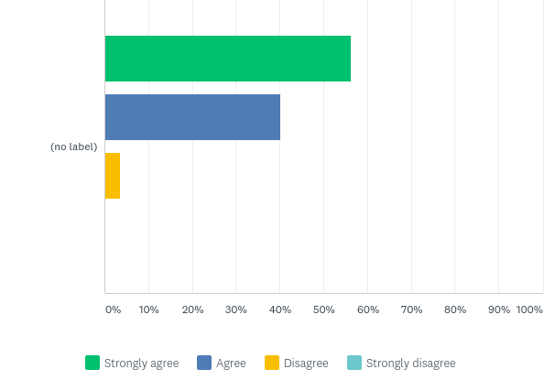
Q6: The outdoor environment is effective at supporting creativity and learning.
Answered: 142 Skipped: 1

Slide 13

Q6: The outdoor environment is effective at supporting creativity and learning.
Answered: 142 Skipped: 1

Slide 14
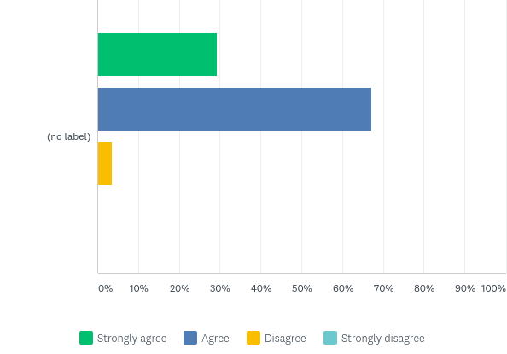
Q7: I am kept well informed about what my child is learning at school.
Answered: 143 Skipped: 0

Slide 15

Q7: I am kept well informed about what my child is learning at school.
Answered: 143 Skipped: 0

Slide 16
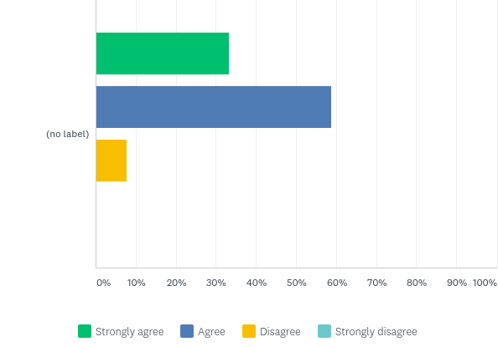
Q8: I am kept well informed about how my child is progressing.
Answered: 141 Skipped: 2

Slide 17

Q8: I am kept well informed about how my child is progressing.
Answered: 141 Skipped: 2

Slide 18
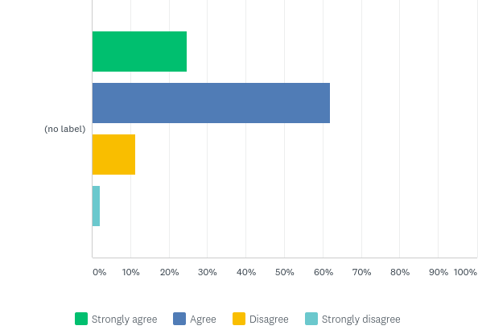
Q9: I think my child gets an appropriate amount of homework.
Answered: 142 Skipped: 1

Slide 19

Q9: I think my child gets an appropriate amount of homework.
Answered: 142 Skipped: 1

Slide 20
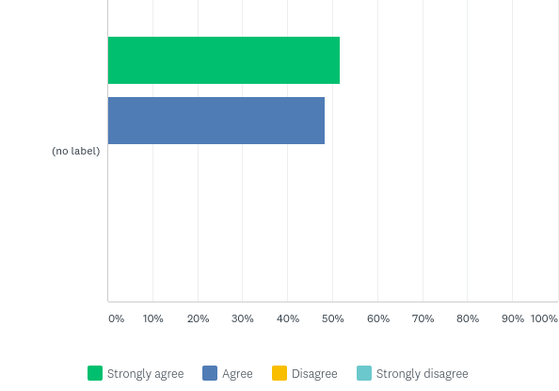
Q10: I think my child is taught well.
Answered: 143 Skipped: 0

Slide 21

Q10: I think my child is taught well.
Answered: 143 Skipped: 0

Slide 22
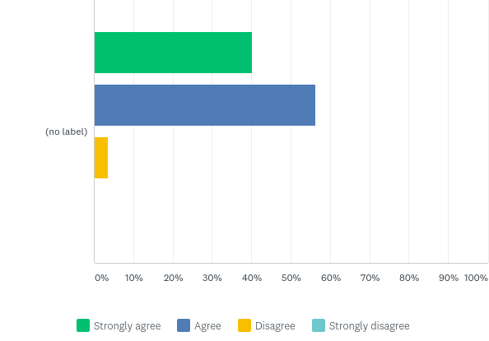
Q11: Markeaton Primary School has high expectations for my child.
Answered: 142 Skipped: 1

Slide 23

Q11: Markeaton Primary School has high expectations for my child.
Answered: 142 Skipped: 1

Slide 24
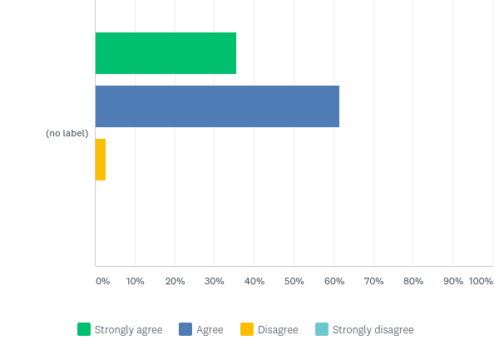
Q12: Markeaton Primary School ensures that my child is able to explore their potential.
Answered: 143 Skipped: 0

Slide 25

Q12: Markeaton Primary School ensures that my child is able to explore their potential.
Answered: 143 Skipped: 0

Slide 26

Q13: The school is led and managed effectively.
Answered: 140 Skipped: 3

Slide 27

Q13: The school is led and managed effectively.
Answered: 140 Skipped: 3

Slide 28
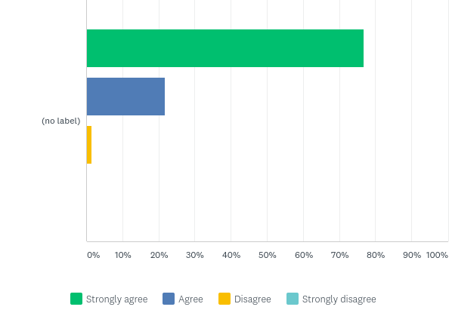
Q14: I would recommend Markeaton Primary School to another family.
Answered: 142 Skipped: 1

Slide 29

Q14: I would recommend Markeaton Primary School to another family.
Answered: 142 Skipped: 1

Slide 30
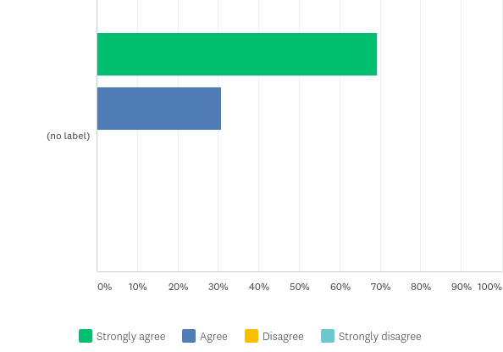
Q15: Markeaton Primary School has a good reputation.
Answered: 143 Skipped: 0

Slide 31

Q15: Markeaton Primary School has a good reputation.
Answered: 143 Skipped: 0

Slide 32
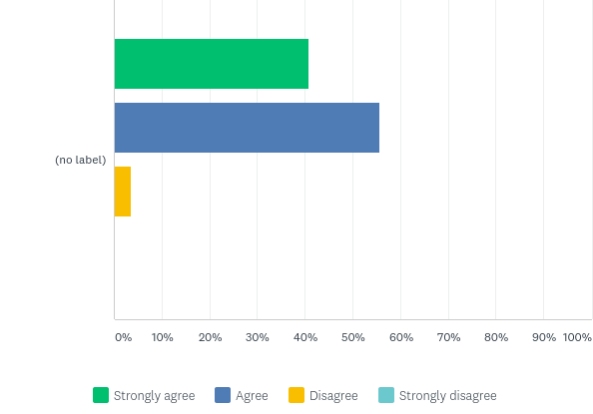
Q16: I understand how my child is assessed at Markeaton Primary and the language that is used.
Answered: 140 Skipped: 3

Slide 33

Q16: I understand how my child is assessed at Markeaton Primary and the language that is used.
Answered: 140 Skipped: 3

Slide 34
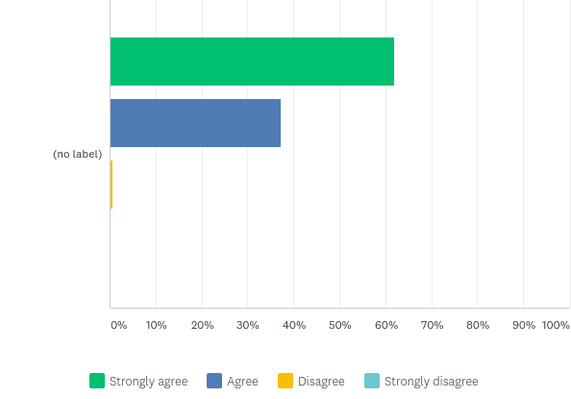
Q17: School trips and visits enhance my child’s learning experience.
Answered: 142 Skipped: 1

Slide 35

Q17: School trips and visits enhance my child’s learning experience.
Answered: 142 Skipped: 1

Slide 36
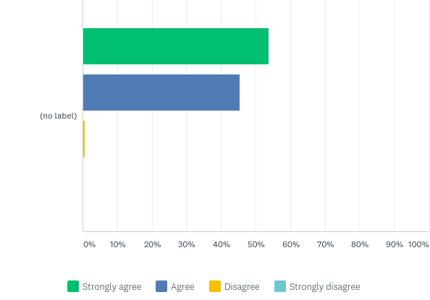
Q18: Markeaton Primary School provides a varied range of enrichment weeks and activities.
Answered: 143 Skipped: 0

Slide 37

Q18: Markeaton Primary School provides a varied range of enrichment weeks and activities.
Answered: 143 Skipped: 0

Slide 38
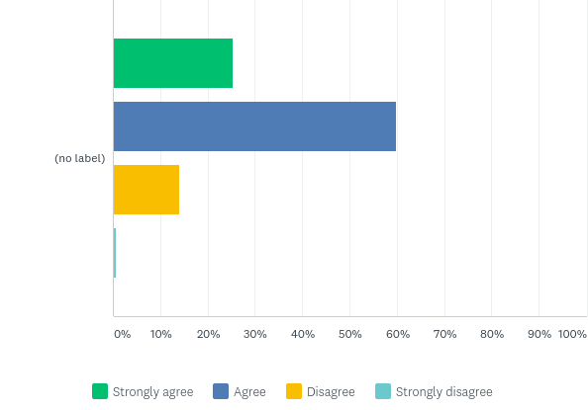
Q19: Markeaton Primary School runs a wide range of after-school clubs.
Answered: 142 Skipped: 1

Slide 39

Q19: Markeaton Primary School runs a wide range of after-school clubs.
Answered: 142 Skipped: 1

Slide 40
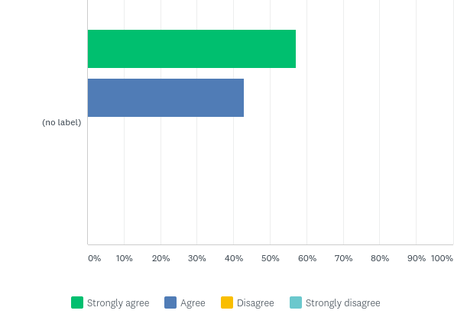
Q20: The school’s values and attitudes have a positive impact on my child (www.markeaton.derby.sch.uk/Vision-and-Values).
Answered: 142 Skipped: 1

Slide 41

Q20: The school’s values and attitudes have a positive impact on my child (www.markeaton.derby.sch.uk/Vision-and-Values).
Answered: 142 Skipped: 1

Slide 42
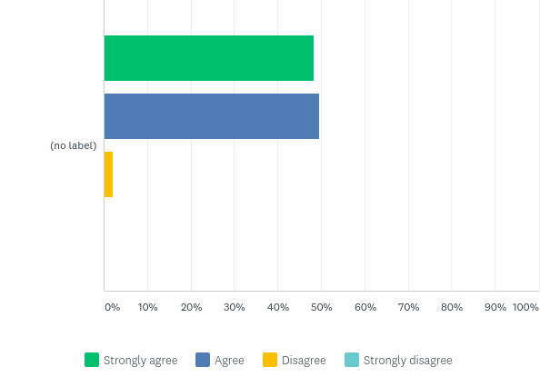
Q21: I think behaviour is good at Markeaton Primary School.
Answered: 143 Skipped: 0

Slide 43

Q21: I think behaviour is good at Markeaton Primary School.
Answered: 143 Skipped: 0

Slide 44

Q22: I think the school deals with any incidents of bullying effectively.
Answered: 138 Skipped: 5

Slide 45

Q22: I think the school deals with any incidents of bullying effectively.
Answered: 138 Skipped: 5

Slide 46

Q23: The school treats my child fairly.
Answered: 143 Skipped: 0

Slide 47

Q23: The school treats my child fairly.
Answered: 143 Skipped: 0

Slide 48
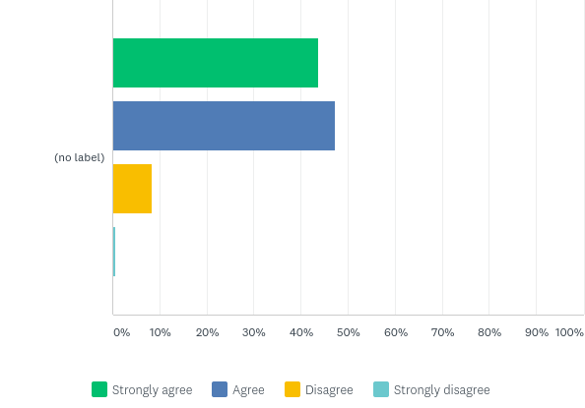
Q24: My child is confident that, should they have a problem, there is someone they can go to in school who will listen to them.
Answered: 142 Skipped: 1

Slide 49

Q24: My child is confident that, should they have a problem, there is someone they can go to in school who will listen to them.
Answered: 142 Skipped: 1

Slide 50
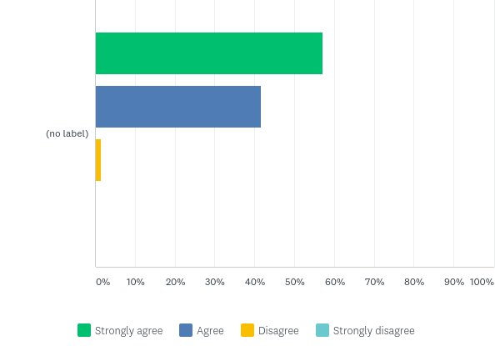
Q25: My child enjoys playtimes and lunchtimes.
Answered: 142 Skipped: 1

Slide 51

Q25: My child enjoys playtimes and lunchtimes.
Answered: 142 Skipped: 1

Slide 52
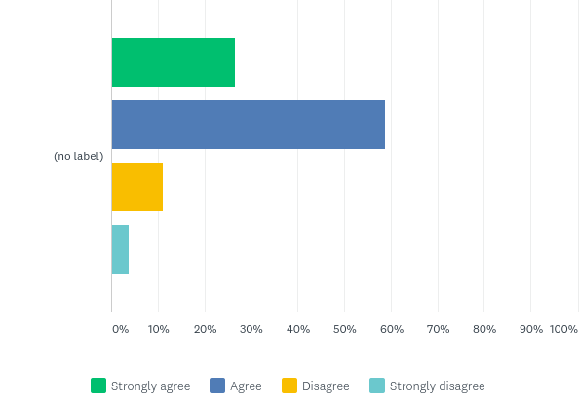
Q26: My child finds school meals enjoyable.
Answered: 136 Skipped: 7

Slide 53

Q26: My child finds school meals enjoyable.
Answered: 136 Skipped: 7

Slide 54

Q27: I think members of staff at Markeaton Primary School are approachable.
Answered: 143 Skipped: 0

Slide 55

Q27: I think members of staff at Markeaton Primary School are approachable.
Answered: 143 Skipped: 0

Slide 56
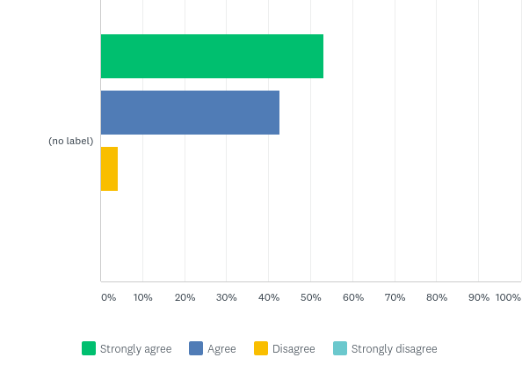
Q28: Parent/Carer Consultation Evenings provide me with the information I require about my child’s progress and achievement.
Answered: 143 Skipped: 0

Slide 57

Q28: Parent/Carer Consultation Evenings provide me with the information I require about my child’s progress and achievement.
Answered: 143 Skipped: 0

Slide 58

Q29: I think the school seeks my views and listens to my concerns.
Answered: 143 Skipped: 0

Slide 59

Q29: I think the school seeks my views and listens to my concerns.
Answered: 143 Skipped: 0

Slide 60
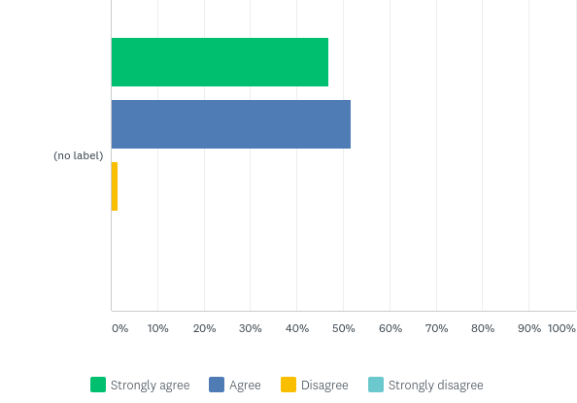
Q30: Markeaton Primary School encourages parents/carers to play an active part in school life.
Answered: 143 Skipped: 0

Slide 61

Q30: Markeaton Primary School encourages parents/carers to play an active part in school life.
Answered: 143 Skipped: 0

Slide 62
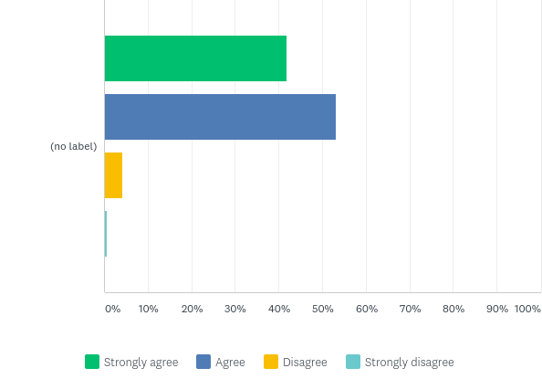
Q31: *New* I feel my child's mental health/well-being is well supported at Markeaton.
Answered: 141 Skipped: 2

Slide 63

Q31: *New* I feel my child's mental health/well-being is well supported at Markeaton.
Answered: 141 Skipped: 2

