Slide 1
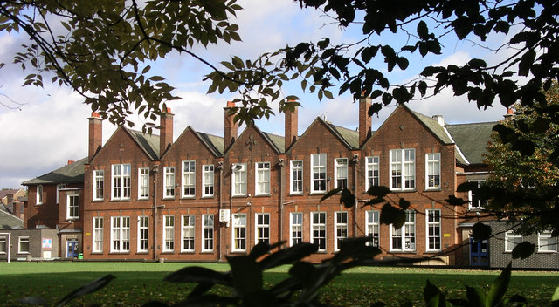
Parent / Carer Questionnaire Results
Markeaton Primary School
Spring 2016

Slide 2
Introduction
In Spring 2016 Questionnaires were given to every pupil for completion by their Parents / Carers
The Questionnaires comprised 27 questions covering the following areas:
  Well Being & Outdoor Environment
  Curriculum
  Enrichment & Extra-curricular Activities
  Behaviour, Pastoral Care & School Meals
  Communication
There was also provision for additional comments to be made where appropriate.
165 completed questionnaires were received back. The responses have been collated, analysed and are summarised in this powerpoint.

Slide 3
Analysis
22 of the questions requested Parents / Carers to select the appropriate option: Strongly Agree / Disagree / Agree / Strongly Agree.
For these questions a score was allocated to each answer:
  Strongly Agree +2
  Agree +1
  Disagree -1
  Strongly Disagree -2
Where an answer indicated ‘Not applicable’, ‘Don’t know’, ‘Neither agree or disagree’, or no answer was given, a value of zero was allocated.
The total score for each question was divided by the number of scoring answers to give an average / factor score.
The average / factor score has then been ranked into order.

Slide 4
Additional Questions
There were 5 additional questions where Parents / Carers were asked for their views / opinions on the following matters:
  Playing on the school field at breaktimes and lunchtimes
  Homework
  Possible provision of ‘wrap-around’ care facility
  Communications
  Parents Teachers & Friends Association

Slide 5
Rankings 1 - 7
Strongly
Agree
Agree

Slide 6
Rankings 8 - 14
Strongly
Agree
Agree

Slide 7
Rankings 15 - 21
Strongly
Agree
Agree

Slide 8
Ranking 22
There was one question where there was an overall negative average / factor score of -0.41:
  Q9 : “I think my child gets too much homework”
This can be viewed as a ‘double negative’ – with the consensus being there is not too much homework.
By reversing the scores for this question to compensate for the ‘double negative’ effect, the revised average / factor score would be +0.41.
However, this would still give this question the lowest ranking of the 22 questions assessed in this manner.

Slide 9
Using field at breaktimes / lunchtimes
84% of respondents said they had no objection to their child playing on the field at breaktimes and lunchtimes - subject to wearing appropriate footwear.

Slide 10
‘Wrap-around’ Care
There was a very positive response to the idea of a ‘wrap-around’ care i.e. a club / group / service which would run before and after school - for a nominal fee.

Slide 11
Communications
Q25a : Do you read the weekly newsletter?

Slide 12
Communications
Q25b : Would you prefer to have a more current and immediate way to access school dates and events happening in school?

Slide 13
Communications
Q25c : Which method of communication do you currently find most effective?

Slide 14
PTFA
Thank you to all the parents / carers who expressed an interested in helping the PTFA, providing extra support and ideas for the future.
Over a third of respondents said they were interested.

Slide 15
Thank you
Thank you to everyone who completed the Parent / Carer Questionnaire.
Your feedback and comments are very much appreciated and will be factored into the school’s vision for the future.
Mr I.Johnson
Headteacher

