Slide 1
Growth mindset
How can we help each other?

Slide 2
So, what do we know? Here are a few numbers to help you make sense of Growth Mindset…
Children who were praised for their intelligence were more likely to choose future tasks that they thought would make them look smart. Children who had been praised for their effort tended to choose tasks that would help them learn new things. What does this mean?
Children praised for their intelligence said they enjoyed the task less when compared to the children who had been praised for their effort. What does this mean?
Children praised for their intelligence were less likely to persist on tasks than the children who had been praised for their effort. What does this mean?
Children who had been praised for their intelligence performed worse in future tasks. The children who had been praised for their effort performed better in future tasks. What does this mean?
The majority (86%) of children praised for their intelligence asked for information about how their peers did on the same task. Only 23% of children who had been praised for effort asked for this type of feedback – most of them asked for feedback about how they could do better. What does this mean?
A significant proportion (38%) of children praised for their ability lied about the number of problems they solved in the task. Only 13% of the children praised for effort did the same. What does this mean?

Slide 3
And here is how you might be more ‘Growth Mindset’
ask the teacher to demonstrate a new way to answer a question (or maybe even try a new way yourself)
volunteer answers in class even when unsure
ask a question even if might seem basic
seek out problems that will push you, rather than problems that stay safely within your comfort zone – what is a comfort zone?

Slide 4
But, how else can we help ourselves and each other?
Types of Praise – praise somebody else’s effort and individual development over the end result, encourage each other to ask for and act on feedback from a teacher, encourage a sense of curiosity
Level of Expectation – have high, challenging but realistic expectations of your own performance. ‘Rome wasn’t built in a day!’
Positive Group Norms – create a growth culture amongst your friends that values learning, education and development. Saying things like ‘I am so much more clever than you’ doesn’t help you or the other person!
Helpful Self-Talk - talk to yourself and to do so in a positive, helpful and energised way. Try to force any negativity out of your head, especially that fear of failure and thoughts like ‘what will happen if I get it wrong?’

Slide 5
Let’s recap…
https://www.youtube.com/watch?v=0Q6a_rD85X0 - animations

Slide 6
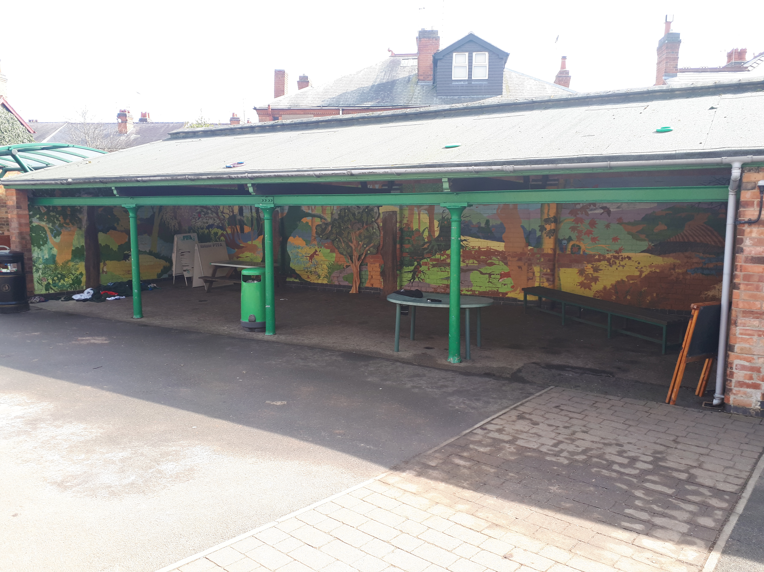
Competition
Growth Mindset quote for the entrance and the website. All entries by the end of this week please…In next Monday’s assembly the winners of this competition and the logo competition will be announced. Good luck!
Lining Up KS2
New community space – what could it be used for?

