Slide 1
How do we challenge ourselves?
Another philosophical question for the children of Markeaton…

Slide 2
…what is challenge?

Slide 3
…how does challenge make us feel?

Slide 4
…who challenges us and why is it important?

Slide 5
Famous people who have challenged themselves…
JK Rowling, author of Harry Potter, had her book rejected 12 times
Albert Einstein didn’t speak until he was four years old
Richard Branson has Dyslexia
Walt Disney was fired from his first job for having ‘no imagination’
Thomas Edison created 1000 lightbulbs before finally making one work
Vincent Van Gogh only sold one painting when he was alive

Slide 6
…challenge – I need three volunteers

Slide 7
Fold this piece of paper in half as many times as possible. Whoever folds it the most wins…

Slide 8
Who won? What did you notice about the three people who took part?

Slide 9
Challenge for you… Next time you are in the classroom and you feel that a piece of work has been too easy or you feel that you have ‘finished it’ I want you to challenge yourself. But how do we do this? Any ideas…?

Slide 10
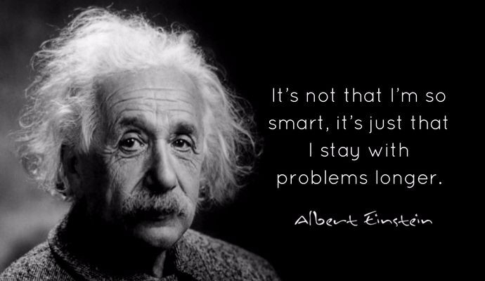

Slide 11
Competition Time
Here is a sneak preview of some artwork we are having done in school (corridor by community room, main entrance and serving hatch). If you would like a small logo of yours including in the final piece of work then please come and see me for an application form. The design must be one item only and must represent the school. So it could be a stag, it could be something to do with the outdoors or something personal to you.
The winners will be announced in the last week of this half term…good luck!

Slide 12
Examples might be…

