Slide 1

Children’s Mental Health Week
3-9 February 2020

Slide 2
Slide 2

Slide 3
Slide 2
Being brave can mean facing a situation when you’re unsure about something and having a go anyway.
Sometimes big and uncomfortable feelings or emotions can get in the way of being brave.
*Being brave IS NOT taking unsafe risks!*

Slide 4
Slide 3

Slide 5
Slide 3
Might make a fool of myself or be embarrassed
People might laugh at me or look at me
Might make things worse
Sometimes big and
uncomfortable feelings or
emotions can get in the
way of being brave.
I will get something wrong
I might hurt myself

Slide 6
Slide 4

Slide 7
Slide 4
Bravery comes in all shapes and sizes and what feels brave for one person might not feel brave to another.
Taking even small brave steps can help you feel good about yourself and more confident to face future challenges.
It’s important to know that not feeling brave is OK too and that there are times where it may be more difficult to Find your Brave.

Slide 8
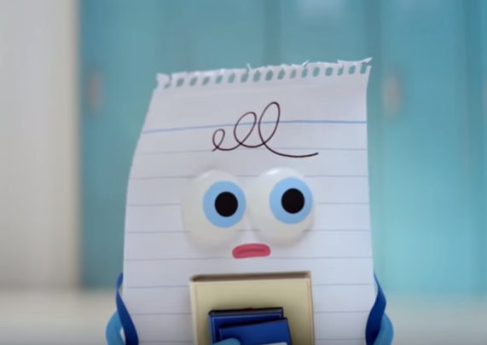
Slide 5
https://www.youtube.com/watch?v=0Cz6drXxrMI

Slide 9

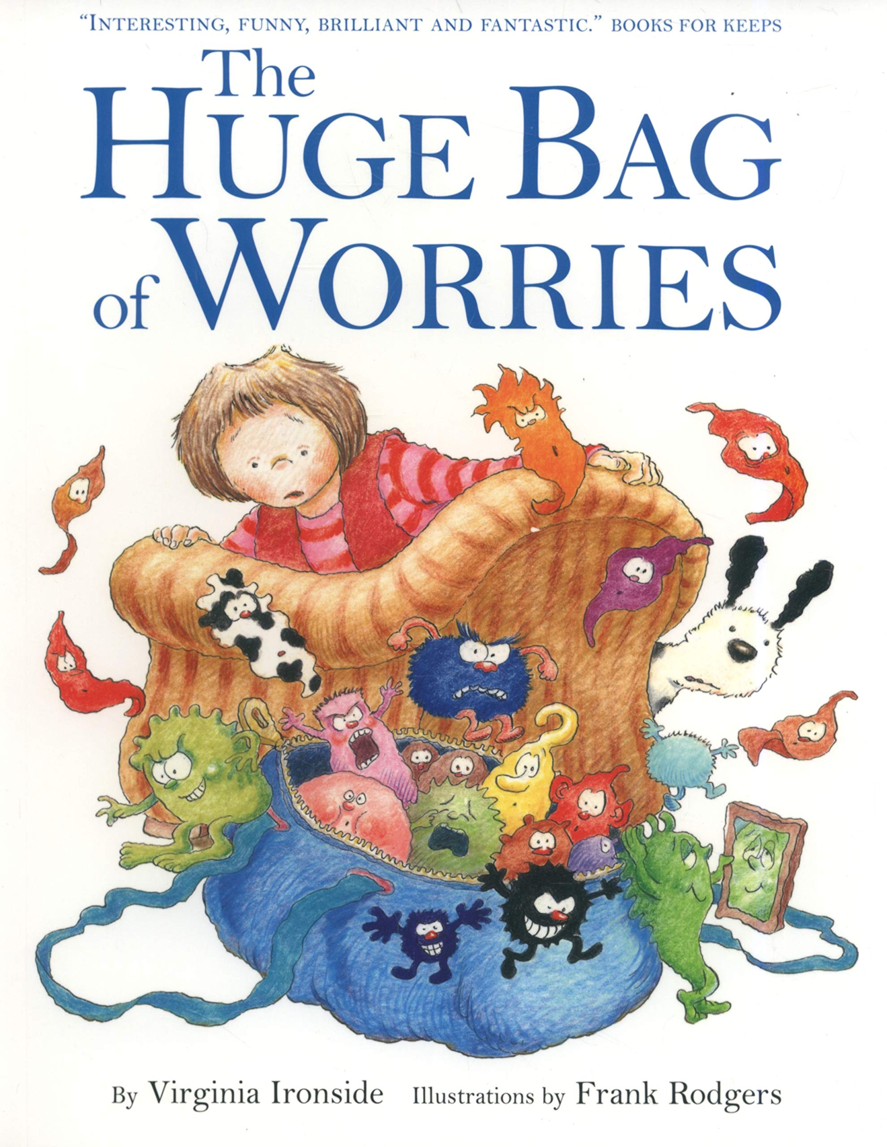
Slide 6
Child Survey-
We want to know
what YOU think!
Add thumbnail of the Show and Tell pack/poster etc

Slide 10
Slide 7
If you have worries or are unsure about something you can always talk to:
a member of school staff
an adult you trust
Childline
0800 1111
a teacher

