Slide 1
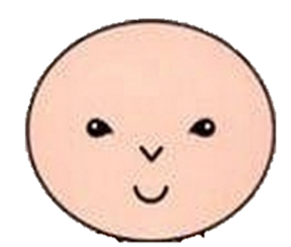
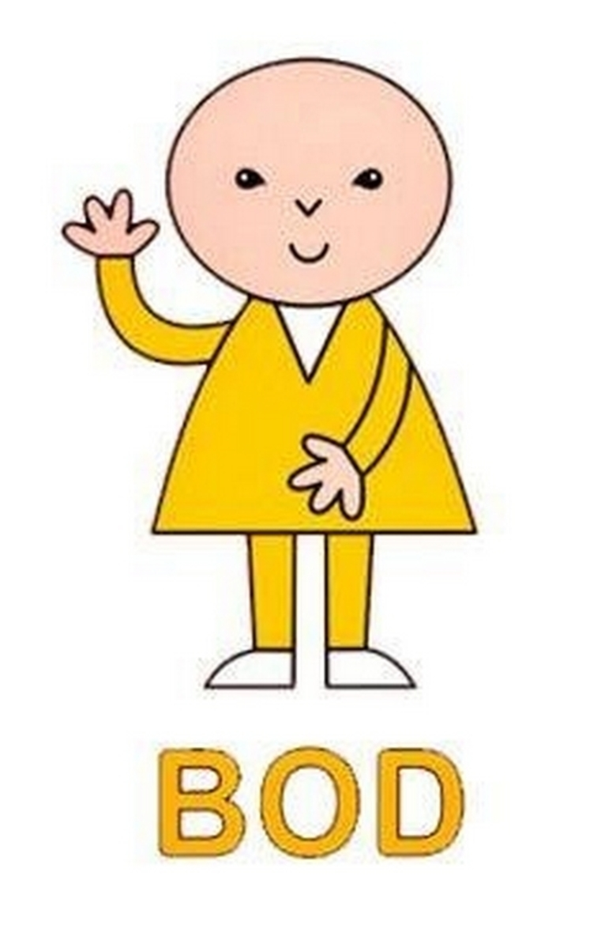
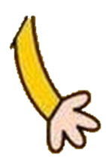
This is BOD.
He is going to start at Markeaton Primary School!
What does BOD need to know about being a great pupil at Markeaton?
BOD needs to use his…

Slide 2
Can you tell BOD what the Markeaton MINDS skills are?

Slide 3
BOD wants to know what people do when they use their Markeaton MINDS…

Slide 4
More than just me…(Reciprocity)
Listening to other people’s ideas
Making sure everyone is part of a group
Letting other people have their turn
Encouraging and helping others to do well
Being grateful and saying please and thank you
WHAT ELSE COULD YOU TELL BOD?

Slide 5
I can do it…(Resilience)
Working hard at things even if they are hard
Having a positive attitude to lessons
Learning from any mistakes
Answering questions in class and joining in
WHAT ELSE COULD YOU TELL BOD?

Slide 6
Now what…(Reflectiveness)
Improving work and editing it
Being curious about things and wanting to find out more
Thinking about what is needed to be done to make it even better
Working with others to find strengths and development points
WHAT ELSE COULD YOU TELL BOD?

Slide 7
Doing it myself…(Responsibility)
Getting on with work and concentrating
Finishing work on time
Making sure things are the very best they can be
Working with others well
Completing reading and homework tasks
WHAT ELSE COULD YOU TELL BOD?

Slide 8
Solving problems…(Resourcefulness)
Looking for ways to solve difficult questions
Using skills to complete tasks
Showing initiative and thinking for yourself
Choose the best method to complete a task
WHAT ELSE COULD YOU TELL BOD?

Slide 9
Thanks everyone!

