Slide 1
KS2 Assembly
24.1.2022

Slide 2
Democracy
Rule of law
Individual liberty
Mutual respect
Tolerance
What are these?

Slide 4
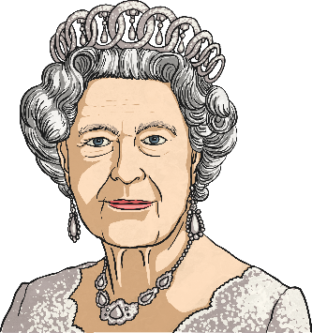
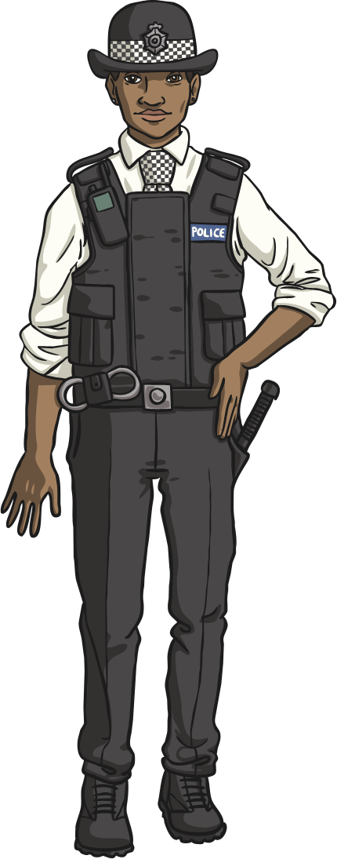
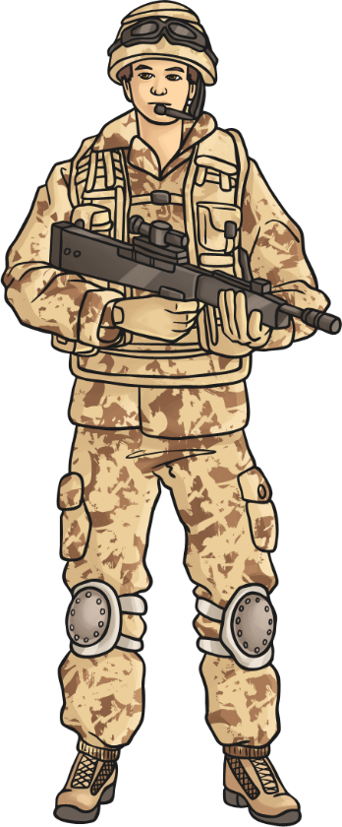
Who Rules Britain?
The Queen?
The Police?
The Army?
The People?

Slide 5
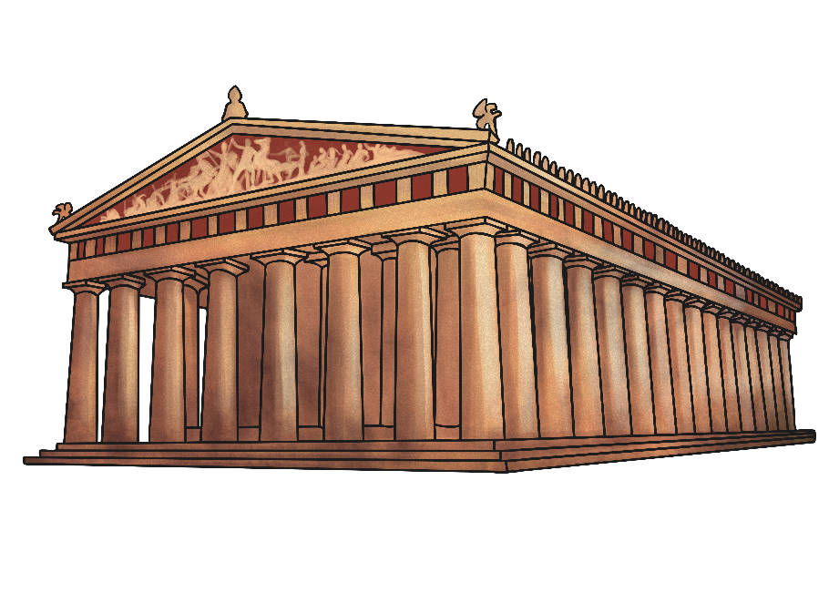
What Does Democracy Mean?
We have a system of government called democracy.
Democracy means ‘rule by the people’. It comes from the Greek words Dêmos, which means people, and krátos which means rule or strength.
This is because the idea of democracy developed in Greece in about 507 BC.
Watch this video on democracy:
Video

Slide 6
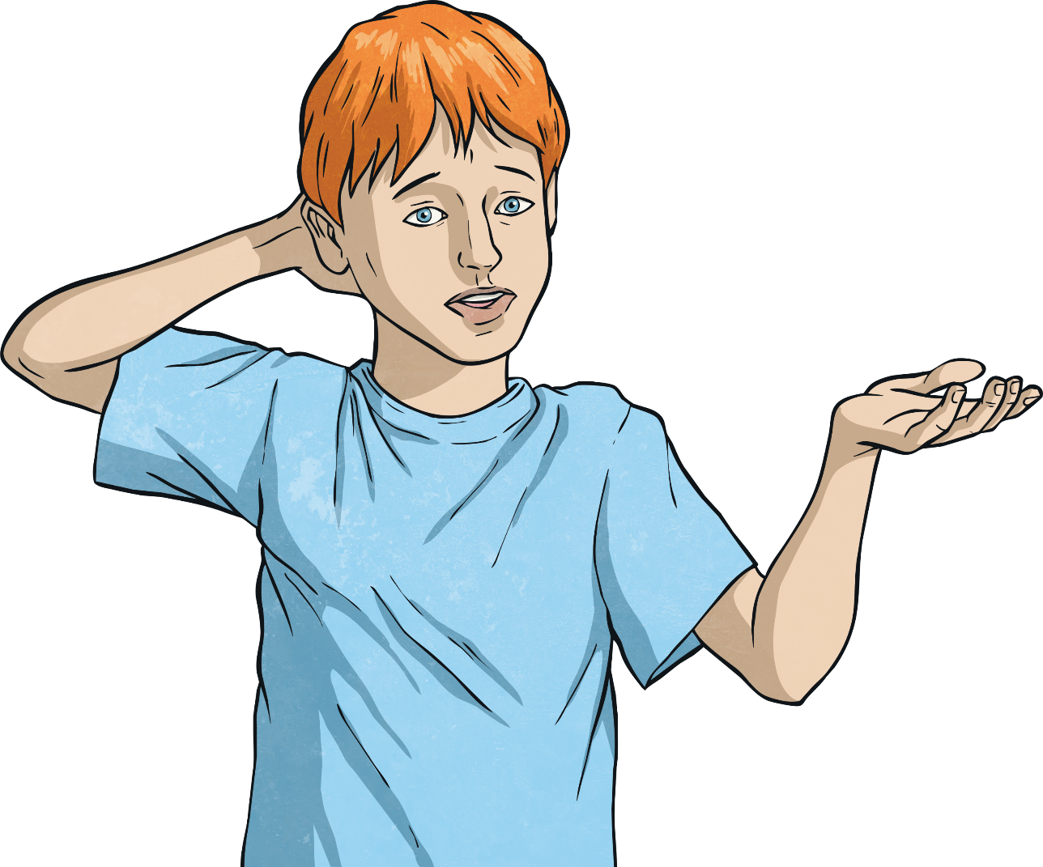
Ruled by the People?
What do we think this means?

Slide 7
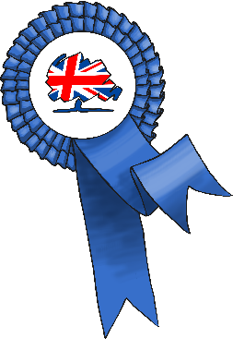
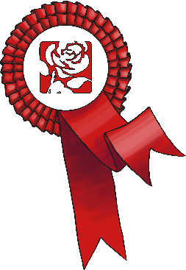
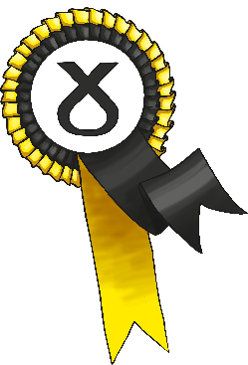
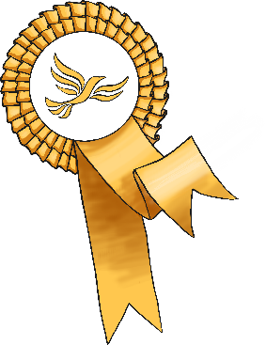
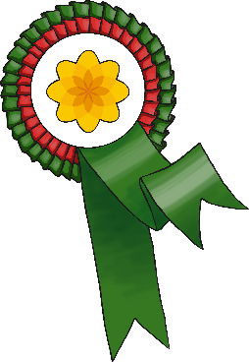
What Does Democracy Mean?
We hold an election to choose someone to represent us.
Most candidates who ’stand’ for election belong to a political party – a group of people who share similar beliefs.
Together, people who belong to the party agree on changes they will make if they are elected. These are called policies.
Can you name any political parties or their leaders?

Slide 8
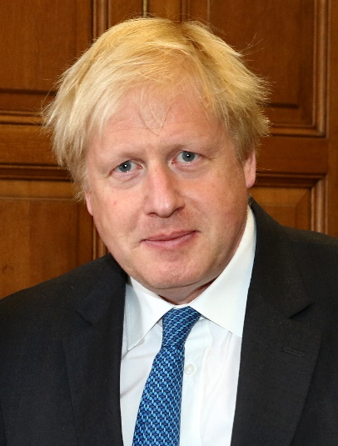
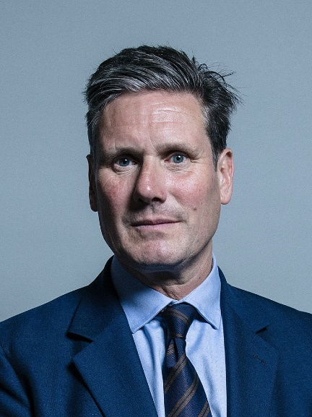
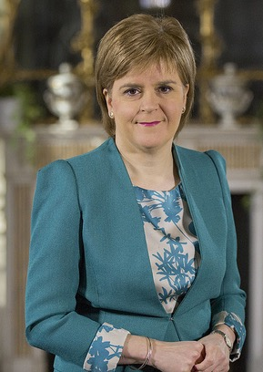
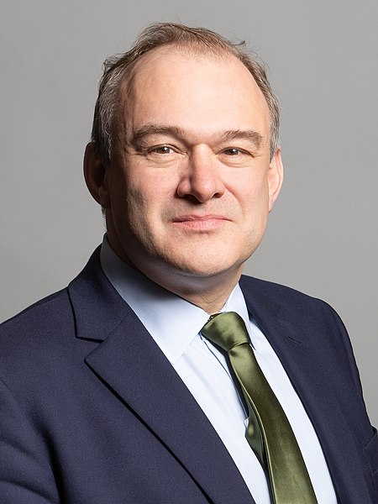
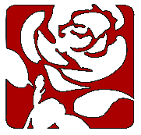
Main Political Party Leaders
“Official portrait of Keir Starmer, taken June 2017” by Chris McAndrew is licensed under CC BY 3.0
“Official portrait of Rt Hon Sir Edward Davey MP” by Richard Townshend is licensed under CC BY 3.0
“Official portrait of Nicola Sturgeon, 5th First Minister of Scotland” by Scottish Government is licensed under OGL v1.0
Boris Johnson
Conservatives
Sir Keir Starmer
Labour
Nicola Sturgeon
SNP
Sir Ed Davey
Liberal Democrats

Slide 9
Our democracy is a system of government with four special features:
Allows people a way of choosing and replacing their representatives through free and fair elections.
Protects the human rights of all citizens.
Depends on laws, which apply equally to all citizens.
Encourages citizens to participate in politics and community life.

Slide 10
Voting
Every citizen should listen to the views of the different parties and candidates and then make his or her own decision on whom to support.
People must be 18 or over in order to take part in an election.
Each person (voter) votes (‘casts a ballot’) for the candidate of his or her choice. S/he does this by putting a cross beside the person’s name on the ballot paper.
People cast their ballots in a booth so that no one can see who they are voting for. This is called a ‘secret ballot’.
At the end of the election day, the votes are added up and the candidate with the highest number of votes (the majority) is declared the winner.

Slide 11
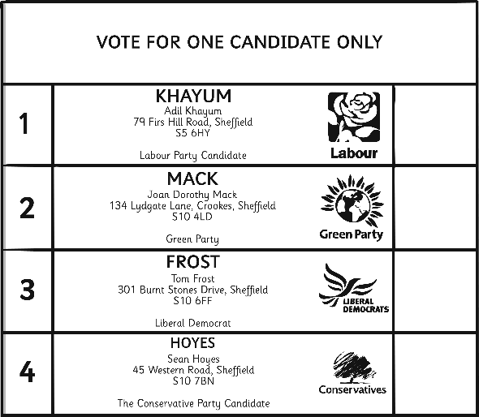
Why Do You Think Voting Is Necessary?
Do you think 18 is the right age to allow people to vote? Why?
If not, what age do you think people should be allowed to vote?

Slide 12
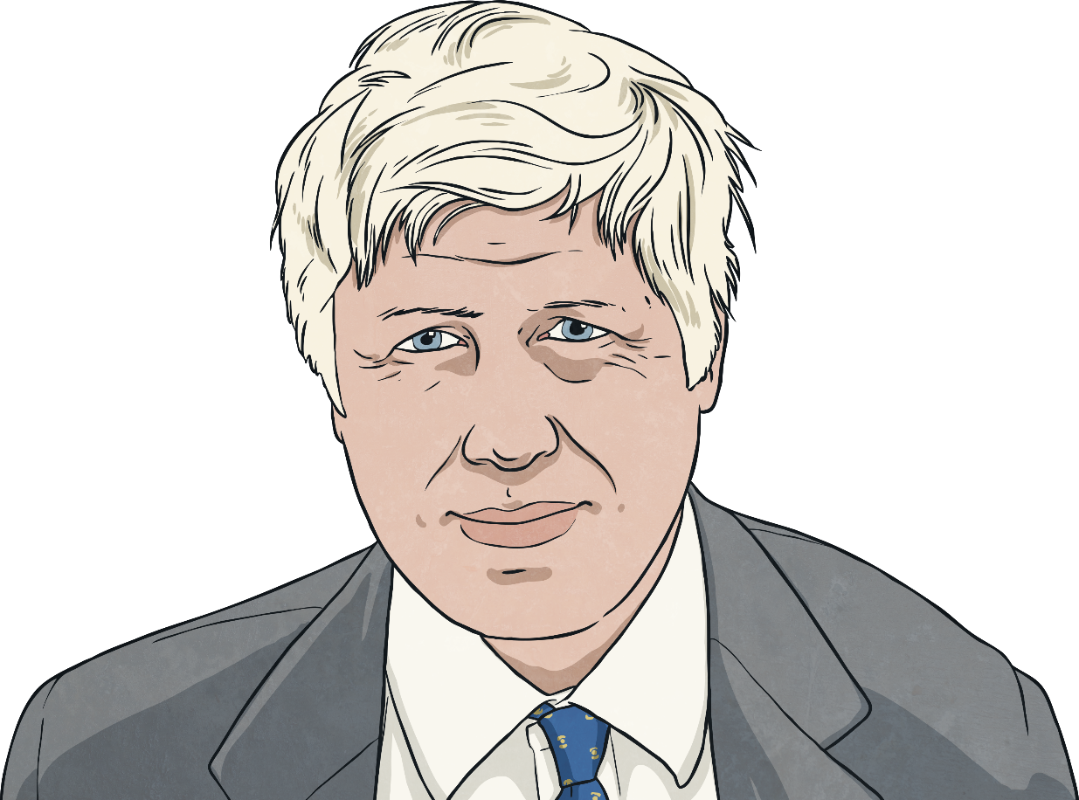
Who Makes The Decisions?
The Prime Minister appoints a ‘cabinet’ of about 20 ministers.
Each minister is put in charge of an area of government, e.g. children’s issues. One of the most important posts is that of the Chancellor of the Exchequer, who decides how the money collected through taxes will be spent.
The cabinet meets with the Prime Minister once a week at his home in 10 Downing Street.

Slide 13
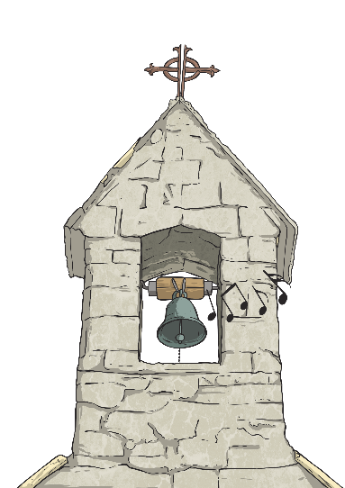
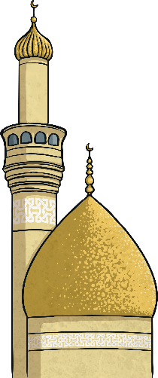
In Our Democracy, Every Citizen Has Certain Basic Rights
No one can tell you what you must think, believe, say or not say.
Everyone is free to choose their own religion and to worship and practice their religion as they want to.
Every individual has the right to enjoy their own culture, along with other members of their group, even if their group is a minority.

Slide 14
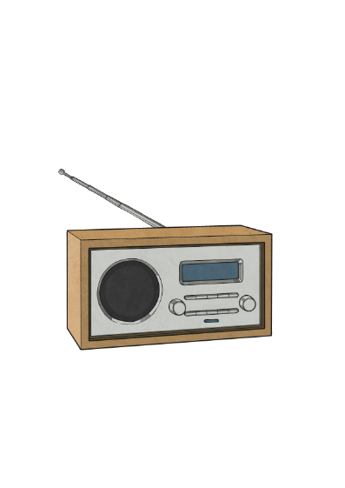
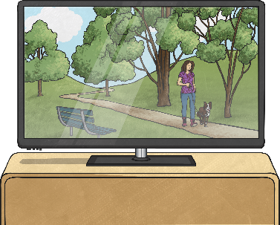
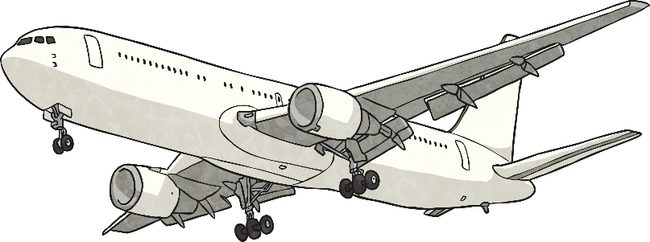
…Continued
You can read, listen to and watch all kinds of news and opinion in the newspapers, on the radio and on television.
You have the right to join organisations, including trade unions.
You are free to travel around the country and to go abroad if you want to.
You have the right to gather with other people and to protest about what the government is doing.
However, everyone must exercise these rights peacefully, with respect for the law and the rights of others.

Slide 15
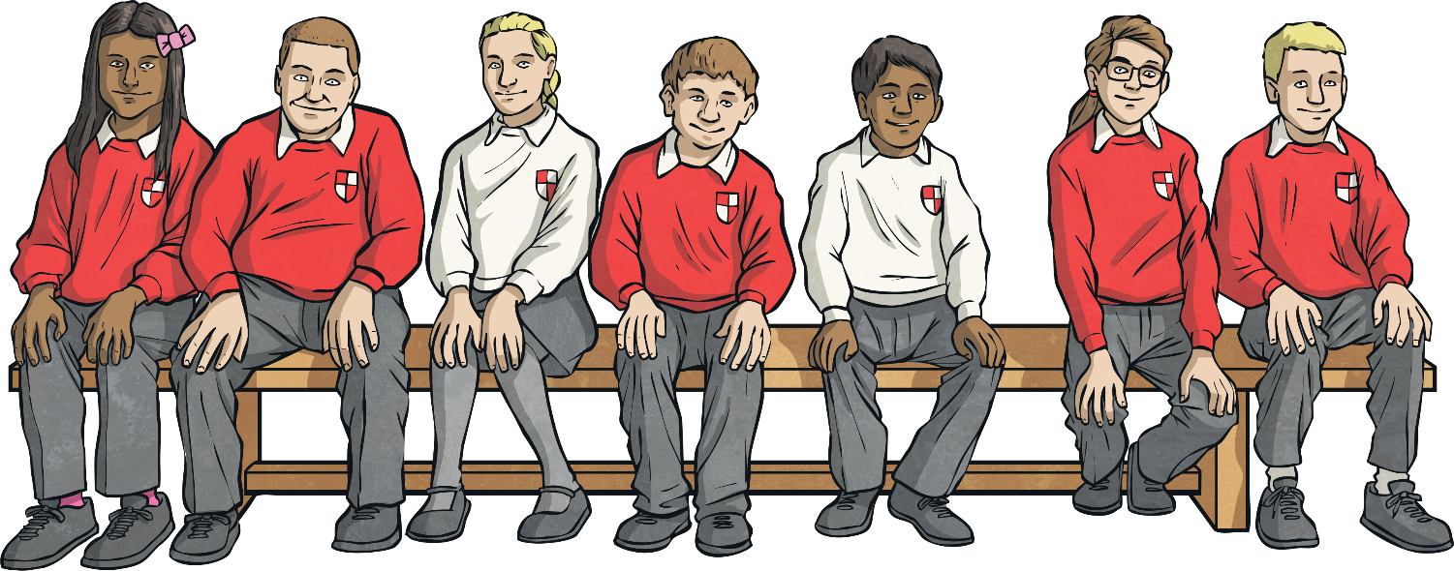
School Council and Democracy
All pupils in the school are involved in the school council.
It is pupil-led.
The staff and the children believe that it plays an important role.
It deals with significant issues.
It makes a difference.

Slide 16
Children and Democracy
What Can You Do?
Stand as a candidate and vote in your school council election.
Lobby your councillor and/or MP about local and national issues.
Find out about your rights and responsibilities.
Learn to see the difference between choices that affect you personally and those that affect others.
Improve your skills, for example public speaking.
Keep informed - watch and read the news regularly.

