Slide 1
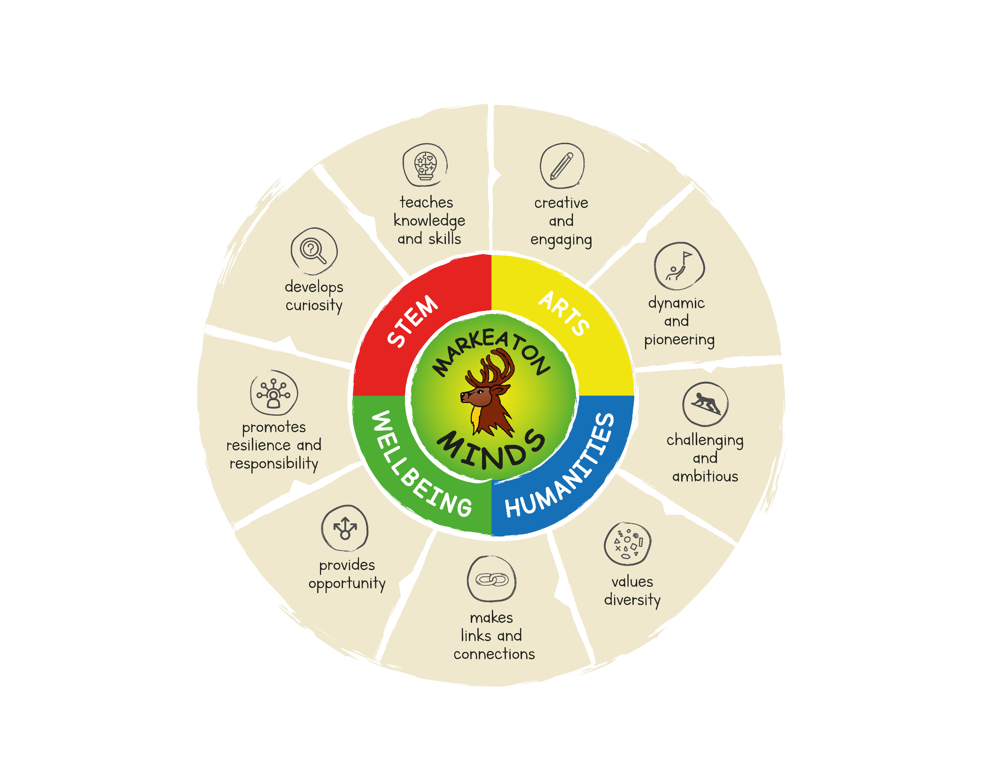
The ‘Markeaton’ Curriculum
How it is shaped and why…

Slide 2
The graphic on the previous slide is an illustration of our curriculum at Markeaton.
In the centre we see our school, the children, our focus.
We see them surrounded by our MINDS skills.
From here we see 4 sections, representing the 4 curriculum families.
On the outside we see our ambitions for the curriculum we provide at Markeaton.
This year, we have been undergoing a curriculum review but the principles driving our curriculum are still the things that we have always seen as essential to the Markeaton Curriculum we provide for our pupils.

Slide 3
Curriculum Families
These have been in place for a number of years but due to a variety of reasons, never really showed their potential until this year.
They are still in their infancy but have already demonstrated their importance in the development of our curriculum.
They involve members of the teaching staff from all departments to ensure a whole school eye on a subject, its development and coverage.
They ensure professional dialogue around curriculum subjects.
They help to support less experienced curriculum leads to lead their subject effectively.
They help prevent pockets of good practise pooling in certain departments.
Science
Design Technology
Maths
Computing
Art
Music
Writing
Reading
Phonics
History
Geography
RE
MFL
PE
PSHE and Wellbeing
Forest Schools
SEND

Slide 4
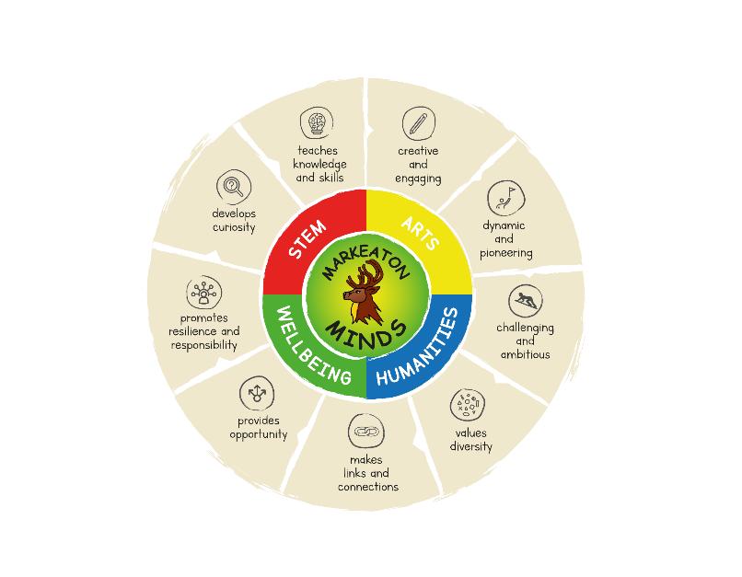
Curriculum intent.
Our curriculum is being reviewed.
As part of this review, we are looking at the subjects in a different way.
Previously, we had adopted our curriculum from Focus Education and it was split into what we call ‘Small Steps’. However, these felt more like a set of activities for children to undertake than a progressive map for the development of and revisiting of skills in subjects.
To address this, we have been looking at ‘themes’ that run through each subject and how these themes are planned for, in each department, to ensure the progression of skills.
Let’s take art as an example. How are we going to make our children Artists?
Art and Design National Curriculum KS1 Children will be taught:
To use a range of materials creatively to design and make products.
To use drawing, painting and sculpture to develop and and share their ideas, experiences and imagination
To develop a wide range of art and design techniques in using colour, pattern, texture, line, shape, form and space
About the work of a range of artists, craft makers and designers, describing the differences and similarities between different practices and disciplines, and making links to their own work.

Slide 5
We want to continue to work in ‘topics’ over the terms.
Each department has it’s own topics - they have a science, history or geography bias. This allows us to create learning that is cohesive to the children and ensure they build ‘schemas’ of knowledge over the term, to create one big picture where learning from all the subjects interweaves.
It was important that we had an overview of the main art and design product and the artists that were to be studied and used as inspiration for the children’s own work to ensure coverage and not cross over.
You can see the ‘Making focus’ for each – although there are other processes involved. ‘Making’ is one of the major themes for art. It is studied in great depth in the topic outlined above but will also feature in other topics (e.g. The printed landscape in Knock, Knock also includes collage techniques.)
These ‘Making’ elements are revisited across the year groups but with a progressive expectation as the children travel through Markeaton.

Slide 6
We have chosen 4 points to measure learning at: end of EYFS, end of Y2, end of Y4 and end of Y6.
These ‘Making’ expectations are for the end of Y2 and will be built upon in year 3/4 and then year 5/6 but will remain the elements within the theme of ‘Making’.

Slide 7
As well as the theme, ‘Making’ we have also decided on:
Generating ideas
Evaluating ideas
(Which run regardless of the ‘Making’ theme.)
These are skills that are revisited every term. (We don’t just want to fill knowledge gaps if we are saying our curriculum is about skills)
Also…

Slide 8
Communication and Vocabulary
 | primary / secondary colours | hatching
 | Block colours | smudging
 | Pattern | blending
 | Repeating pattern | scumbling
 | shape | dark
 | print | light
 | collage | zoom
 | roll / rolling | focus
 | rub / rubbing | scale
 | stamp / stamping | sketch
 | Acrylic paint | observational
 | Layers | tone
 | Motif | texture
 | perspective | effect
Cross curricular Art opportunities | Lit – Drawing an alarm machine for Grandma’s house.
 | Geog - Painting pics of nearby buildings and shops
 | RE – drawing wedding cakes
 | Hist – collage of old and new items in a house
This bit is still being made…
We also want to show progression in the vocabulary we are using with the children and ensure that words are introduced at the right times and then built upon over subsequent topics and years.
Art isn’t just for a couple of weeks each topic. We want to make sure there are other artistic opportunities running throughout the topic to help bring learning to life and establish cross curricular links.

Slide 9
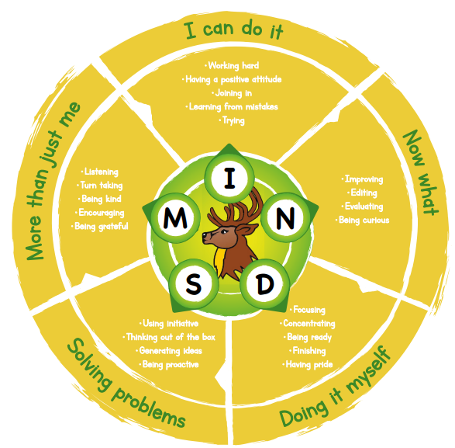
These curriculum maps will look similar across all subjects. They run on the same principles.
They will all have themes that may break down into elements or run throughout.
They will all have vocabulary and cross curricular sections.
But that is not all we do at Markeaton! All of our learning also goes through our Markeaton MINDS lenses.
(This graphic is not quite the finished article yet.)
At Markeaton as well as wanting children to be increasingly excellent artists / historians / mathematicians and so on, we also want them to be increasingly excellent people – citizens of the future.
Our Markeaton MINDS are designed to help achieve this.

Slide 10
Each lesson has subject content and learning but it will also encourage the children to use one, some or all of the Markeaton MINDS skills too…
This is planned for by teachers and is made clear to pupils alongside the subject content they are going to be studying in the session.
Let’s see it in the planning and on a SMART sheet example…

Slide 11
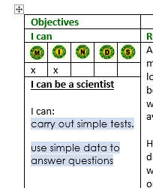
Planned for…
Shared with pupils…
(Plenaries often have opportunities for the children to consider how well they used their MINDS skills as well as showcase any knowledge and learning they have acquired.)

Slide 12
And hopefully, that is where things come full circle because the aspirations we have for our curriculum are also the aspirations we have for our pupils at Markeaton.
We seek to provide a curriculum that follows the principles outlined on that first graphic I shared but equally, we seek to inspire children to grow into, value and uphold the same principles as citizens of the future.
Our curriculum content and Markeaton MINDS are the ways we hope to achieve this.
A person who is
A person who has
A person who has
A person who is
A person who has
A person who is
A person who has and uses
A person who
A person who

