Slide 1
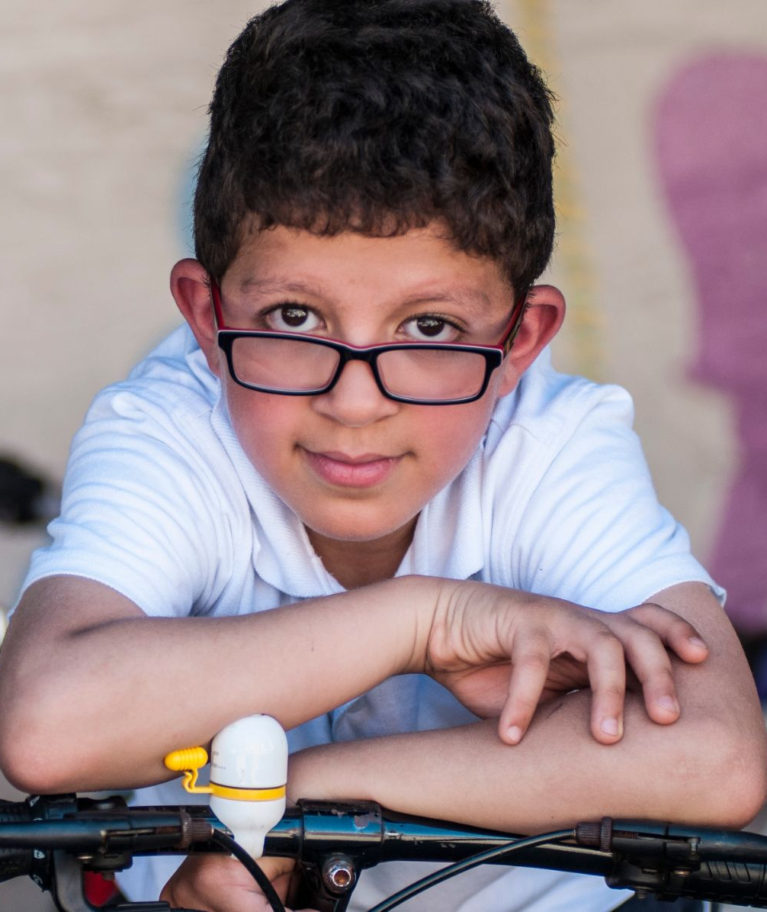
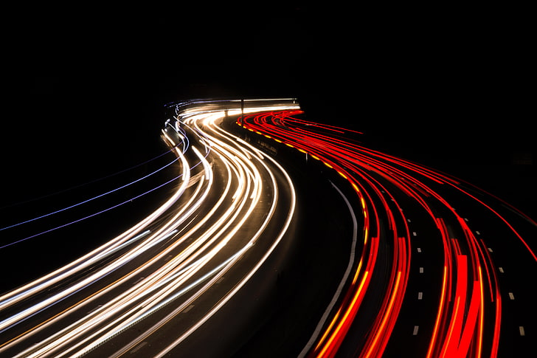


Be Bright, Be Seen

Slide 2
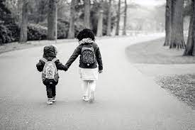
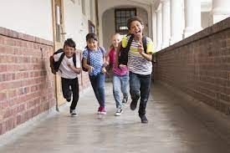
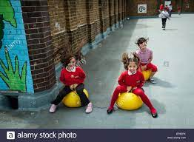
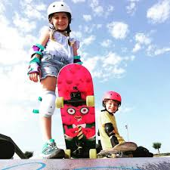
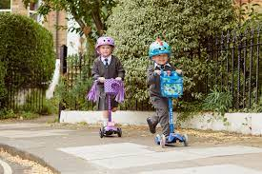
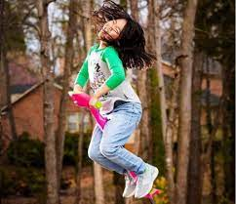
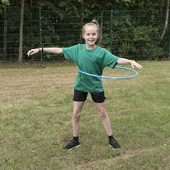
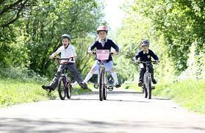
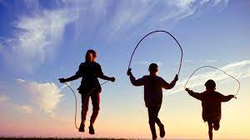
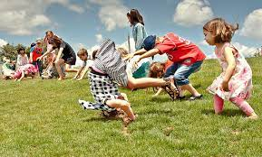
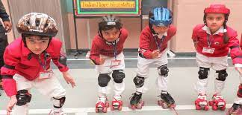
So what is, Active Travel?

Slide 3




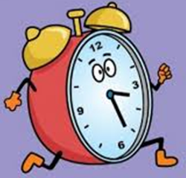
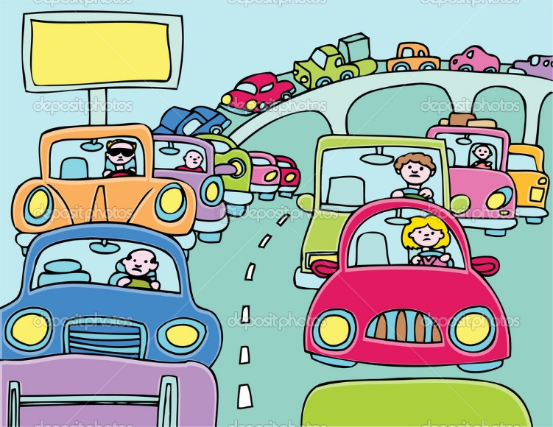
Why is being active so great?
Notes:
In the winter, rain, cold and darkness make cycling more hazardous
It’s still impotant to stay active, so we need to be bright to be seen
Animals are pretty smart, and some of them make themselves very bright to be seen
Can you think of any brightly coloured animals?

Slide 4
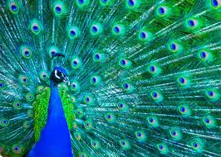
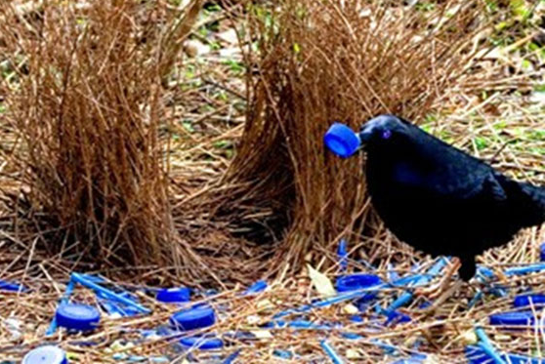
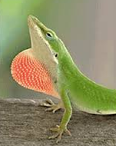
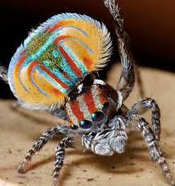
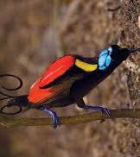
Document title | 12 November 2021
Notes:
As it is getting darker before and after school its really important to wear bright, reflective clothing when walking, cycling or scooting.
In nature many animals are brightly coloured to help them be seen – here are a few examples.
Peacock, Bowerbird, Green anole lizard, Wilson's bird-of-paradise, and Maratus volans (peacock spider)

Slide 5
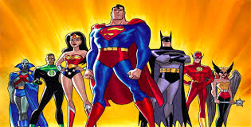

Who do you want to be?
Be Bright, Be Seen| 12 November 2021
Notes:
Another example of being well seen are superheroes, they dress in bright colours and the baddies are in dark colours
WHAT HEROES CAN YOU THINK OF IN EVERYDAY LIFE WHO WEAR BRIGHT CLOTHES??

Slide 6
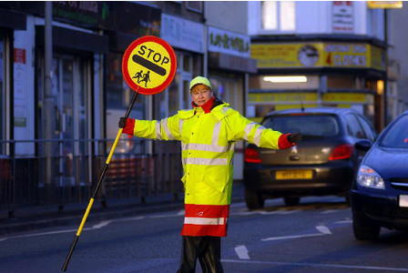
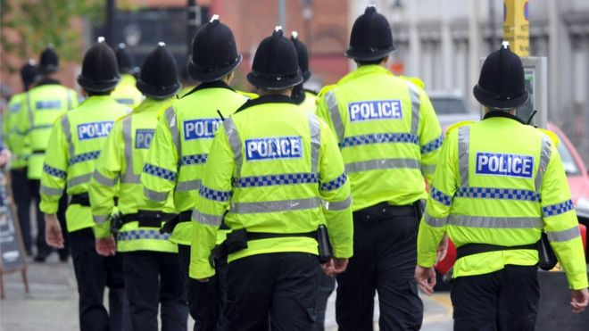
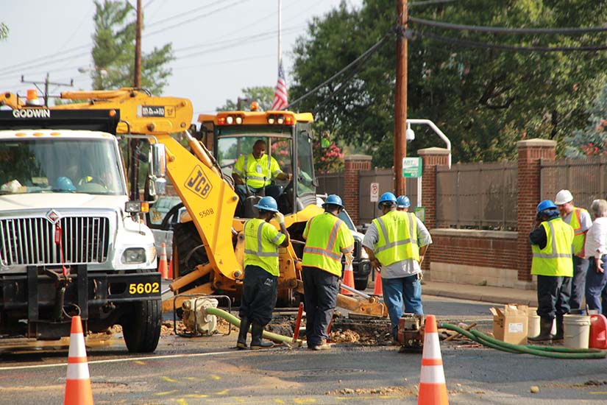
Why do these people wear reflective clothes?
Notes:
Its not just about bright clothing, it also needs to be reflective – when a light is shined on it it glows.
Why do these people wear bright, reflective clothes?
work on or near the road
so that cars can clearly see them
it keeps them safe

Slide 7
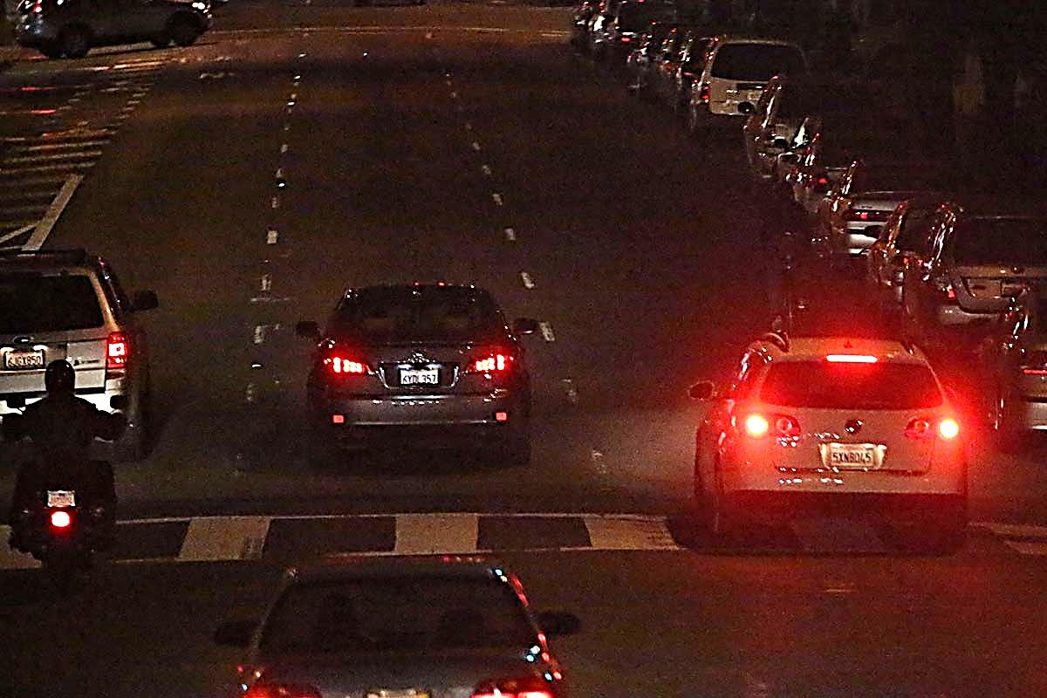
Can you spot the cyclist?
Document title | 12 November 2021
Notes:
Can you see the cyclist?
Its in-front of the white car? (circle appears to show location)
Why can’t we see this cyclist?

Slide 8
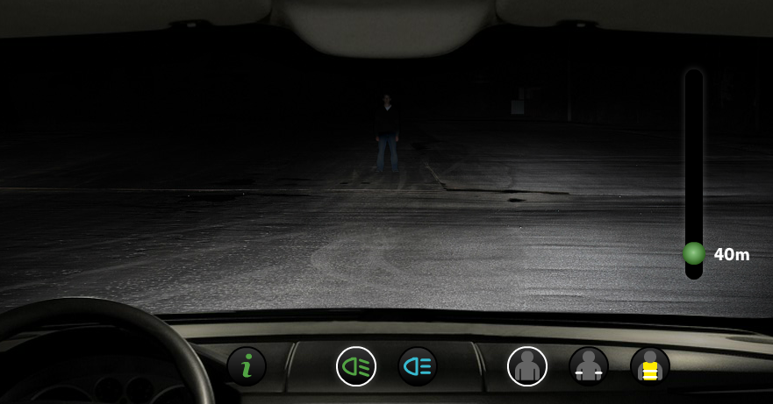
What a driver sees
Document title | 12 November 2021
Notes:
Can you see the person walking in front of the car?
When it is dark and this is what the driver sees if the person is not wearing reflective clothing.

Slide 9
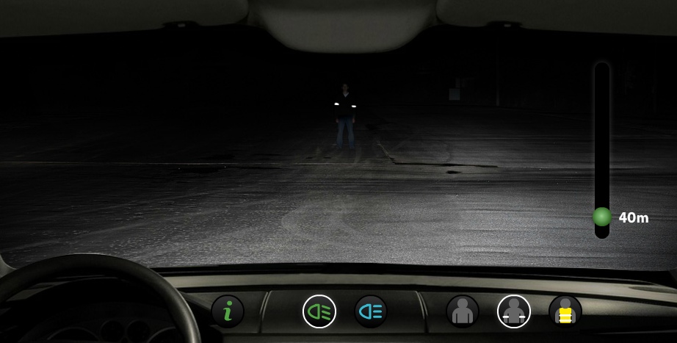
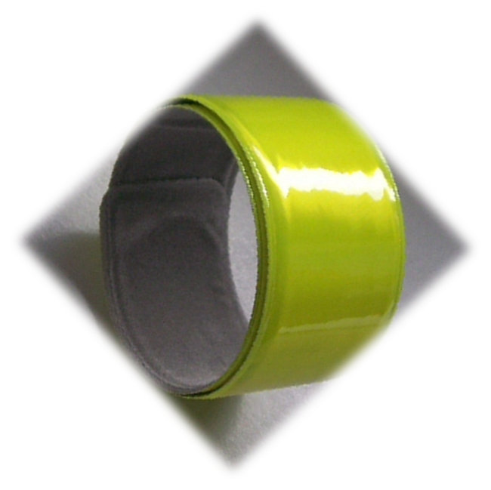
What a driver sees
Document title | 12 November 2021
Notes:
Put on some reflective arm bands…
Can we see him now?

Slide 10
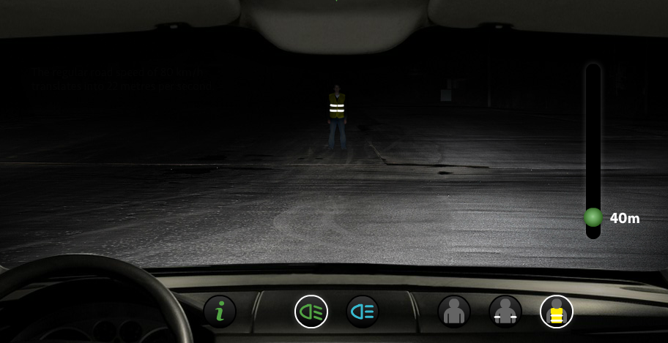
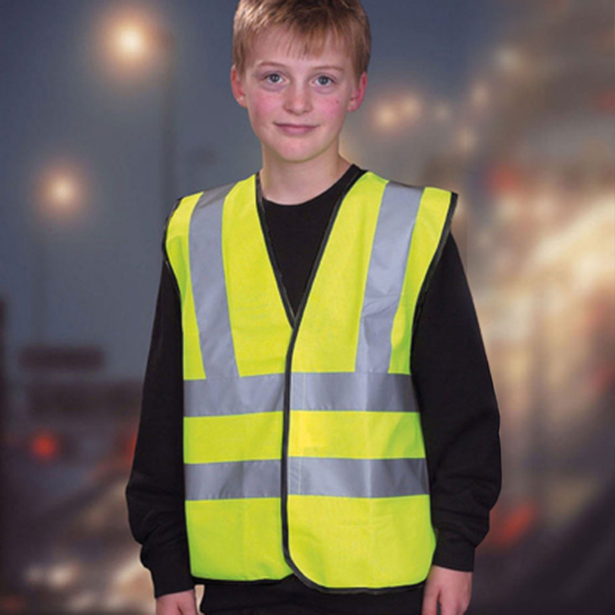
What a driver sees
Document title | 12 November 2021
Notes:
The pedestrian has put on fluorescent waist coat with reflective stripes
Much more visible / easier for the driver to see.

Slide 11
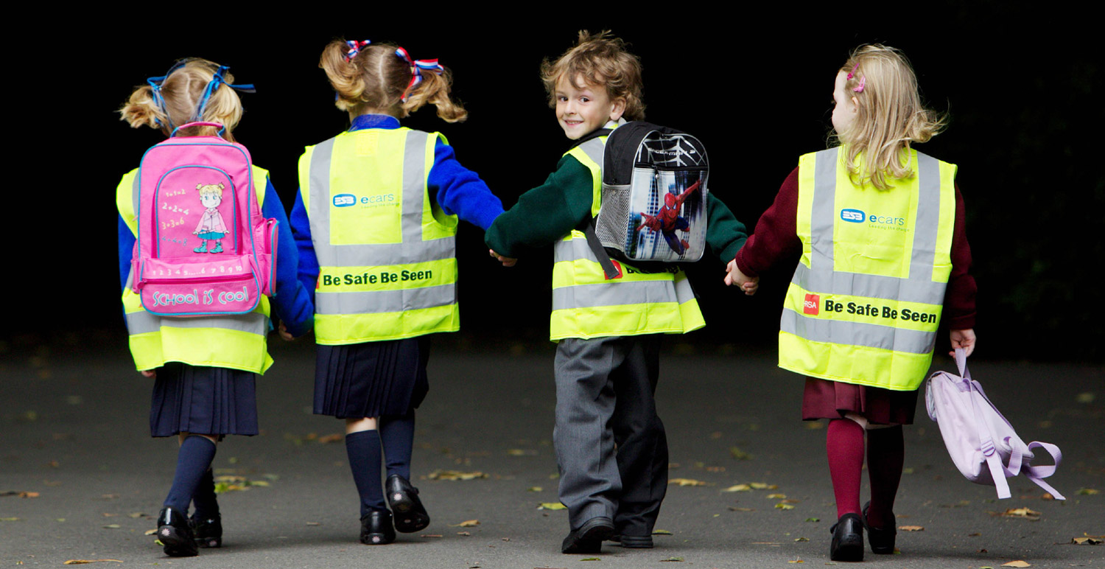
What could you wear?
Document title | 12 November 2021
Notes:
Dark : Reflective, light clothes
Daytime : Bright, colourful clothes

Slide 12
What could you do to your bike so it can be seen more clearly?

Slide 13
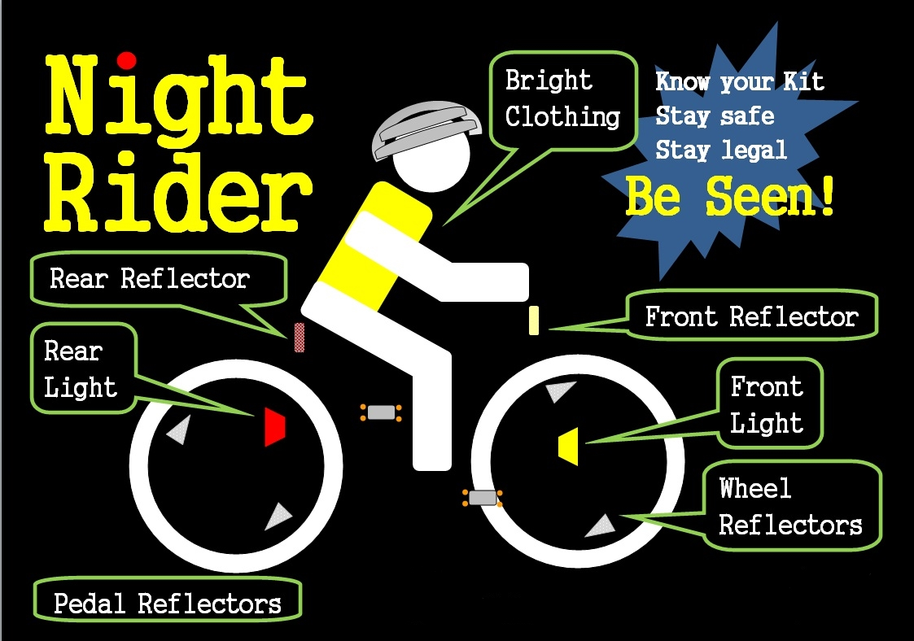
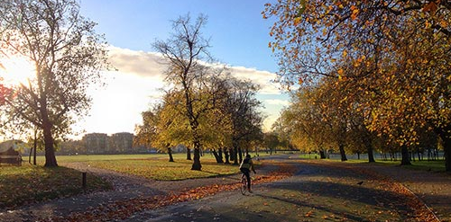
Autumn and winter
Document title | 12 November 2021
Notes:
What other things should you think about when cycling, walking or scooting in the autumn / winter?
Wet leaves = slip during braking, turning.
Leaves or slush on side of road = loss of cycle lanes.
Low sun = zero visibility at times.
Heavy cloud or fog = low visibility.
Windy = loss of control.
Frost, ice or snow = loss of control.

Slide 14
The
Really Bright
Game Show

Slide 15
Question 1: What type of colour is best for being seen?
A. Pastels
B. Fluorescent
C. Blue
D. Dark

Slide 16
b) Fluorescent

Slide 17
Question 2: When should I wear bright clothes?
A. Never
B. Winter and night time
C. My birthday
D. Only August

Slide 18
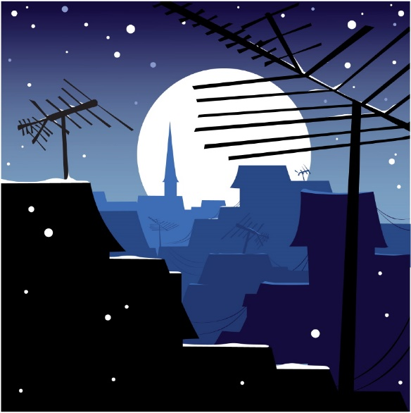
b) Winter and night time

Slide 19
Question 3: What colour is the front and back light on a bicycle?
A. Front: red, Back: white
B. Front: blue, Back: red
C. Front: white, Back: red
D. Front: green, Back: red

Slide 20
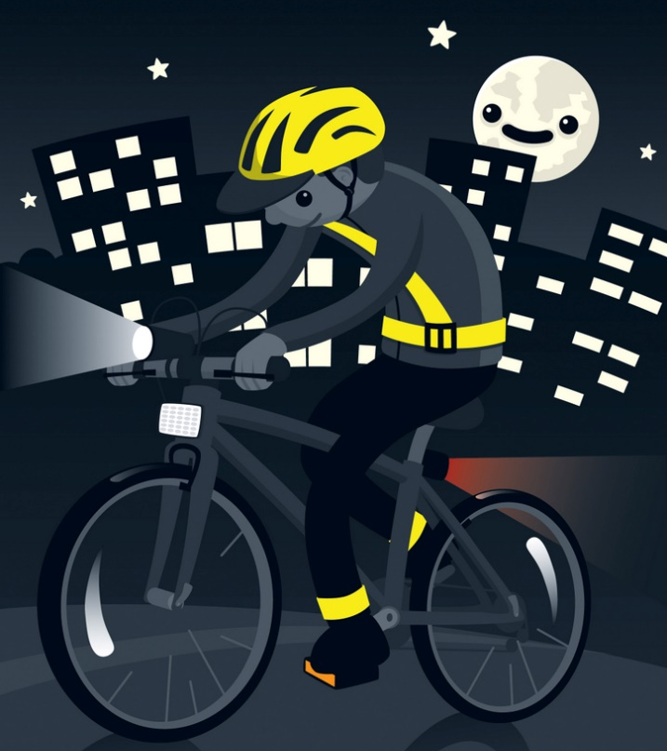
c) Front: white, Back: red

Slide 21
Question 4: What can stop a car from seeing you at night on a bicycle?
A. Dirty reflectors
B. No lights
C. Dark clothes
D. All of the above

Slide 22
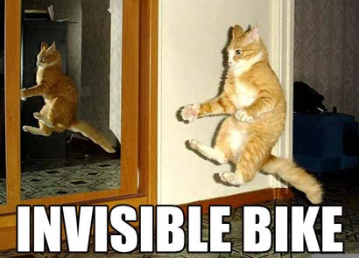
d) All of the above

Slide 23
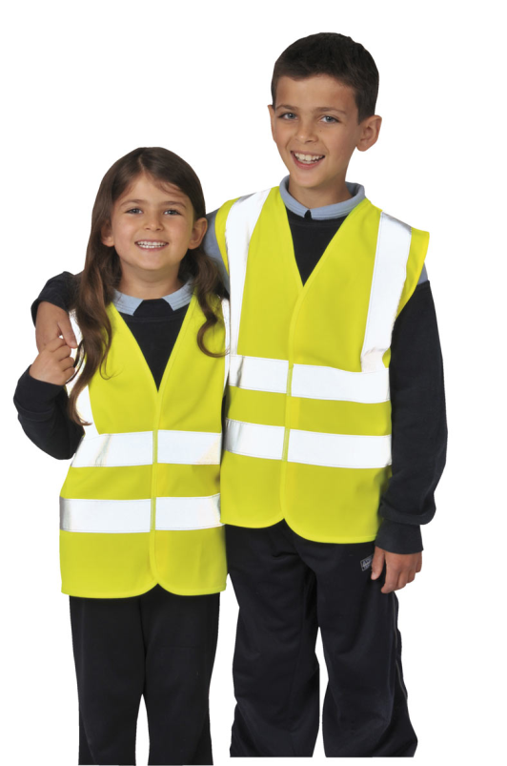
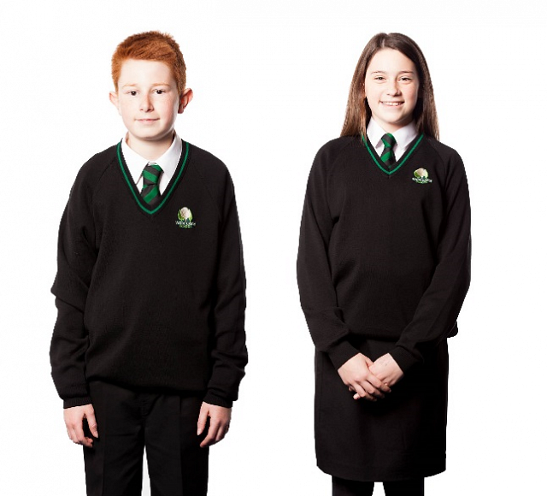
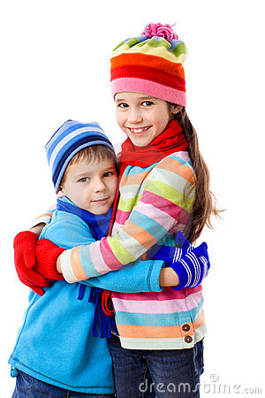
How bright is Mark?
On a scale from 1 to 10
Notes:
GAME
Ask for three volunteers and give them each a bag of clothes.
Give them three minutes to put on everything they can in their bag:
one bag contains only black clothes (t shirt, scarf, hat, gloves),
one contains colourful clothes (nothing reflective) and
one contains clothes with reflective and fluorescent qualities (high vis jacket, lights, slap bands).
Once they are dressed, ask questions and get the school to put their hands up to agree.
Who is the best dressed to go out in the day?
Who is the best dressed to go out at night?
What properties does the third volunteer’s clothes have?
Many pupils think the bright clothes are good for dark nights (they actually don’t make much difference) so if the hall can be made really dark you can shine a light across the volunteers to highlight the role of reflective materials. At the end, put a couple of reflective things onto the pupil in black to show you can wear your normal clothes with the addition of a reflective strip or high visibility jacket. Also, encourage pupils to look at their own winter jackets and backpacks as many of them have a subtle bit of reflective trim somewhere on them

Slide 24
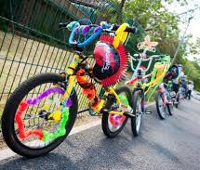
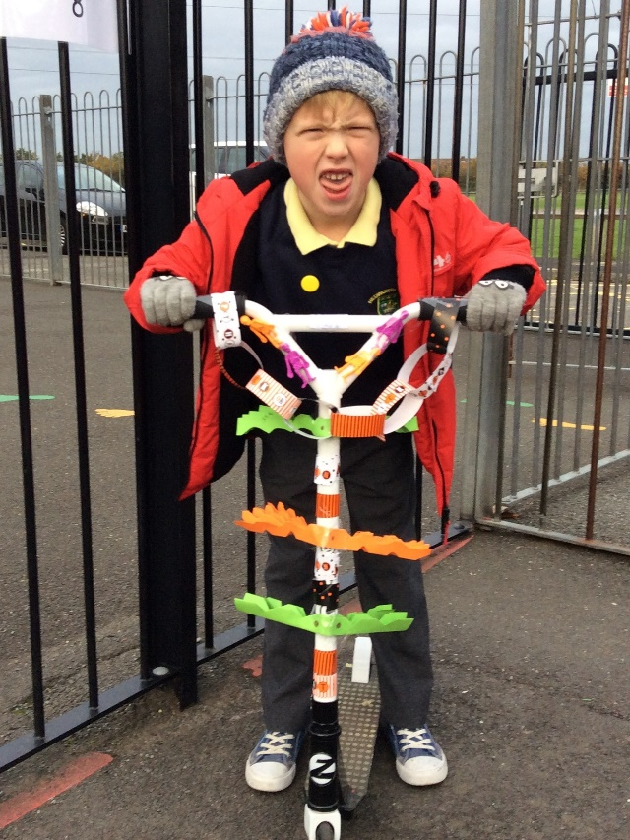
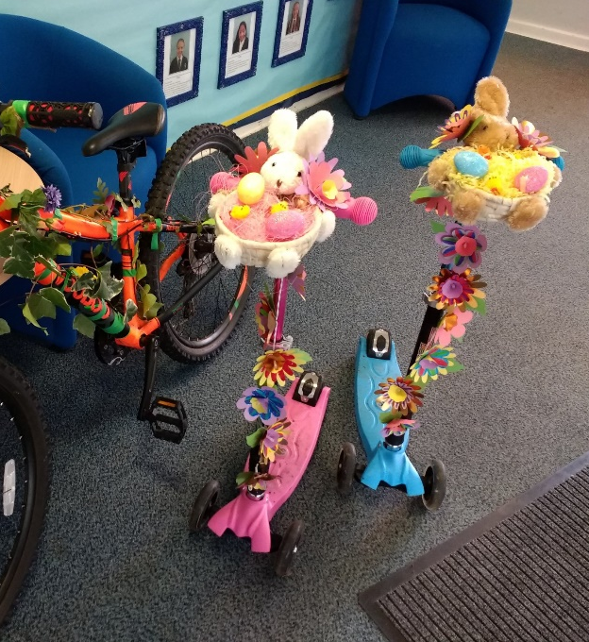
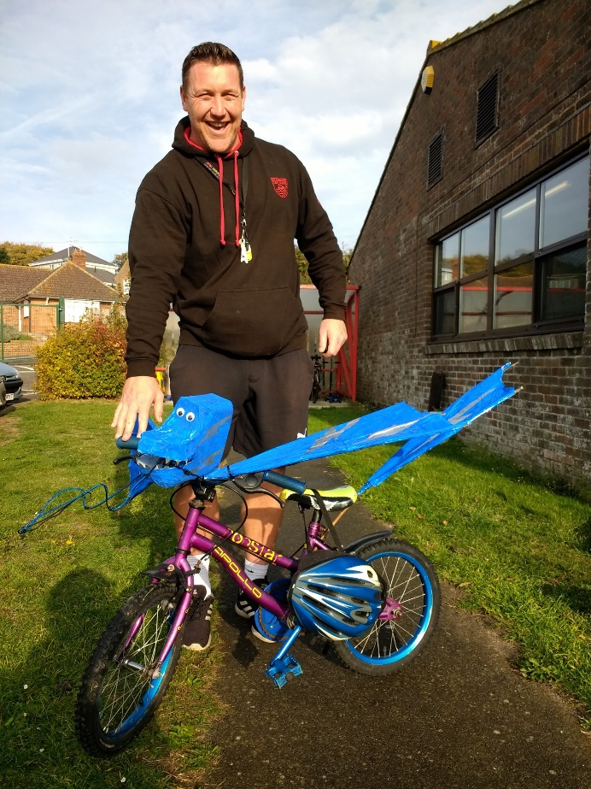
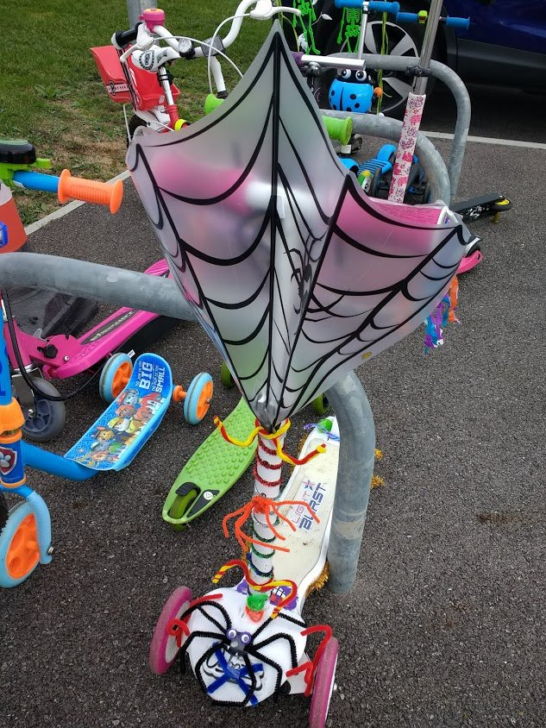
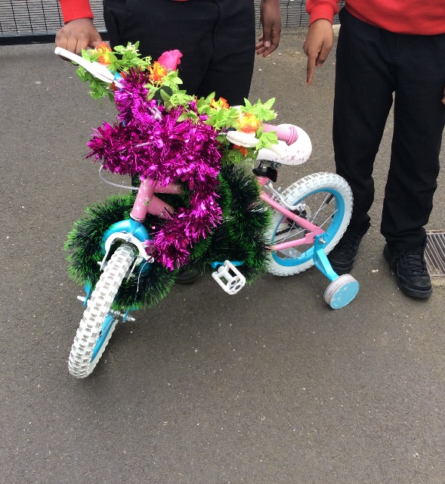
BLING YOUR BIKE / SCOOTER
Document title | 12 November 2021

