Slide 1
Questionnaire Results Summer 2018

Slide 2
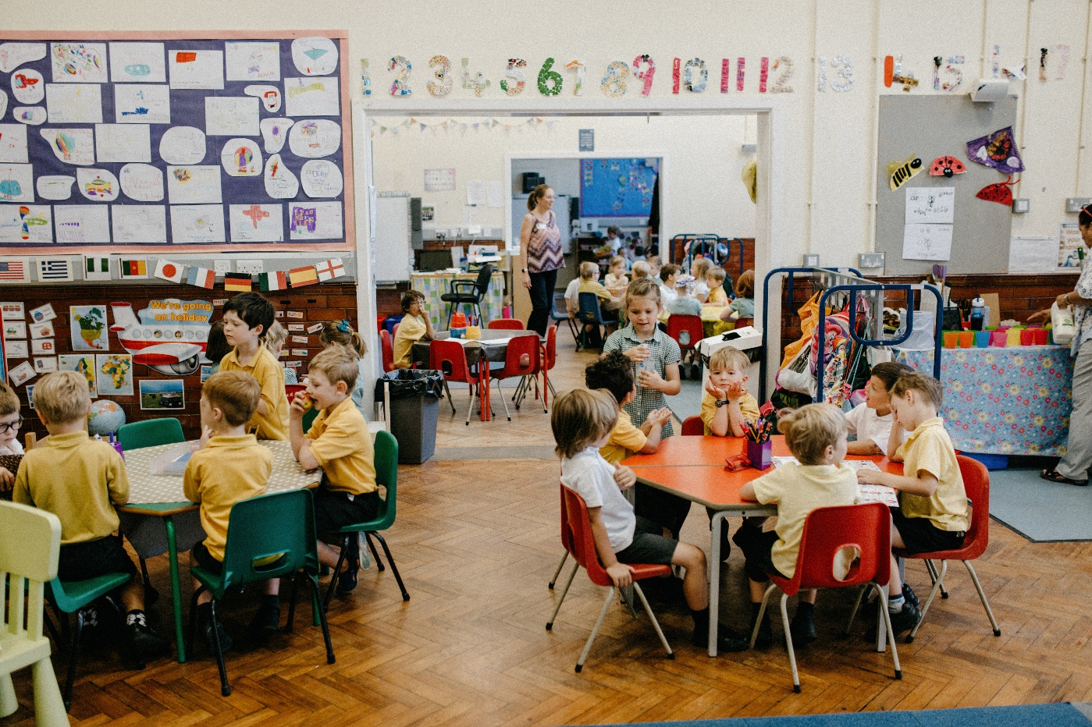
Parent/Carer Questionnaire Results
Summer 2018

Slide 3
To all Parents/Carers,
A huge thank you to everyone who took the time to fill out our annual school questionnaire. The results are presented in the next few slides and we are delighted with the positive feedback. As always there are areas to develop but on the whole, I hope you’ll agree, there is lots to celebrate (the second highest answer of 1.83 is ‘my child is happy at school’ which is amazing!).
What we will do with these results now is taker a closer look at some of the comments that have been made, alongside the scores, and see where we need to go next in order to improve. For example, one result in particular stands out, and that is after school clubs. We are already looking at how best to improve our provision and we will, of course, keep you up to date with our progress.
Many thanks again for your continued support,
Mr I. Johnson

Slide 4
Analysis
28 of the questions requested Parents/Carers to select the appropriate option : Strongly Agree, Disagree, Agree or Strongly Agree.
For these questions a score was allocated to each answer:
Strongly Agree +2
Agree +1
Disagree -1
Strongly Disagree -2
Where an answer indicated ‘Not applicable’, ‘Don’t know’, ‘Neither agree or disagree’, or no answer was given, a value of zero was allocated.
The total score for each question was divided by the number of scoring answers to give an average/ factor score.
The average / factor score has then been ranked into order.
This year we received 153 completed questionnaires (12 fewer than last year)

Slide 5
Response Percentages (including previous years)
 | Spring 2016 | Summer 2016 | Summer 2017 | Summer 2018
Strongly Agree | 38.1% | 52.3% | 55.1% | 58.0%
Agree | 45.9% | 38.1% | 36.6% | 38.1%
Disagree | 8.3% | 5.1% | 4.7% | 1.9%
Strongly Disagree | 0.6% | 0.4% | 0.6% | 0.2%
Other/No answer | 7.1% | 4.1% | 3.0% | 1.9%

Slide 6
Well Being & Outdoor Environment
No. | Question | Spring 2016 | Summer 2016 | Summer 2017 | Summer 2018 | Variance
Q1 | My child is happy at Markeaton Primary School. | 1.62 | 1.73 | 1.74 | 1.83 | 0.09
Q2 | There is a positive atmosphere at Markeaton Primary School. | 1.53 | 1.73 | 1.78 | 1.85 | 0.07
Q3 | I feel welcome when I come in to Markeaton Primary School. | 1.44 | 1.77 | 1.73 | 1.77 | 0.04
Q4 | The outdoor environment is effective at supporting creativity and learning. | 1.27 | 1.42 | 1.75 | 1.80 | 0.05

Slide 7
Curriculum & Leadership
No. | Question | Spring 2016 | Summer 2016 | Summer 2017 | Summer 2018 | Variance
Q5 | I am kept well informed about what my child is learning at school. | 0.89 | 1.21 | 1.29 | 1.29 | 0
Q6 | I am kept well informed about how my child is progressing. | 0.86 | 1.25 | 1.16 | 1.23 | 0.07
Q7 | I think my child gets an appropriate amount of homework. | -0.41 | -0.64 | -0.62 | 1.29 | N/A
Q8 | I think my child is taught well. | N/A | 1.63 | 1.63 | 1.69 | 0.06
Q9 | Markeaton Primary School has high expectations for my child. | 1.01 | 1.40 | 1.41 | 1.55 | 0.14
Q10 | Markeaton Primary School ensures that my child is able to explore their potential. | 1.04 | 1.29 | 1.40 | 1.49 | 0.09
Q11 | The school is led and managed effectively. | N/A | 1.60 | 1.63 | 1.72 | 0.09
Q12 | I would recommend Markeaton Primary School to another family. | N/A | 1.75 | 1.77 | 1.80 | 0.03
Q13 | Markeaton Primary School has a good reputation. | 1.47 | 1.69 | 1.75 | 1.74 | -0.01
Q14 | I understand how my child is assessed at Markeaton Primary and the language that is used. | N/A | N/A | 1.37 | 1.52 | 0.15

Slide 8
Enrichment
No. | Question | Spring 2016 | Summer 2016 | Summer 2017 | Summer 2018 | Variance
Q15 | School trips and visits enhance my child’s learning experience. | 1.59 | 1.68 | 1.73 | 1.65 | -0.08
Q16 | Markeaton Primary School provides a varied range of enrichment weeks and activities. | 1.44 | 1.62 | 1.64 | 1.61 | -0.03
Q17 | Markeaton Primary School runs a wide range of after-school clubs. | 1.13 | 1.47 | 1.18 | 0.99 | -0.19

Slide 9
Behaviour, Pastoral Care and Meals
No. | Question | Spring 2016 | Summer 2016 | Summer 2017 | Summer 2018 | Variance
Q19 | The school’s values and attitudes have a positive effect on my child. | 1.44 | 1.64 | 1.63 | 1.59 | -0.04
Q20 | I think behaviour is good at Markeaton Primary School. | N/A | 1.47 | 1.51 | 1.52 | 0.01
Q21 | I think the school deals with any incidents of bullying effectively. | N/A | 1.28 | 1.38 | 1.46 | 0.08
Q22 | The school treats my child fairly. | 1.40 | 1.47 | 1.50 | 1.56 | 0.06
Q23 | My child is confident that, should they have a problem, there is someone they can go to in school who will listen to them. | 1.29 | 1.32 | 1.43 | 1.43 | 0
Q24 | My child enjoys playtimes and lunchtimes. | 1.43 | 1.63 | 1.60 | 1.53 | -0.07
Q25 | My child finds school meals enjoyable. | 1.08 | 1.08 | 1.14 | 1.28 | 0.14

Slide 10
Communication
No. | Question | Spring 2016 | Summer 2016 | Summer 2017 | Summer 2018 | Variance
Q26 | I think members of staff at Markeaton Primary School are approachable. | 1.47 | 1.59 | 1.60 | 1.59 | -0.01
Q27 | Parent/Carer consultation evenings provide me with the information I require about my child’s progress & achievement. | 1.12 | 1.37 | 1.44 | 1.51 | 0.07
Q28 | I think the school seeks my views and listens to my concerns. | N/A | 1.35 | 1.44 | 1.48 | 0.04
Q30 | Markeaton Primary School encourages parents/carers to play an active part in school life. | 1.26 | 1.58 | 1.59 | 1.51 | -0.08

