Slide 1
Parent/Carer Forum 22nd November 2017

Slide 2
Agenda
Review of last Summer’s Parent/Carer Questionnaires (including a comparison with the year before)
Whole School Priorities and how they are chosen
Review of last year’s Priorities
This year’s Priorities
Any questions

Slide 3
Parent/Carer Questionnaire Results
Summer 2017

Slide 4
Analysis
28 of the questions requested Parents / Carers to select the appropriate option : Strongly Agree / Disagree / Agree / Strongly Agree.
For these questions a score was allocated to each answer:
Strongly Agree +2
Agree +1
Disagree -1
Strongly Disagree -2
Where an answer indicated ‘Not applicable’, ‘Don’t know’, ‘Neither agree or disagree’, or no answer was given, a value of zero was allocated.
The total score for each question was divided by the number of scoring answers to give an average / factor score.
The average / factor score has then been ranked into order.

Slide 5
Response Percentages

Slide 6
Well Being & Outdoor Environment
No. | Question | Spring 2016 | Summer 2016 | Summer 2017 | Variance
Q1 | My child is happy at Markeaton Primary School. | 1.62 | 1.73 | 1.74 | 0.01
Q2 | There is a positive atmosphere at Markeaton Primary School. | 1.53 | 1.73 | 1.78 | 0.04
Q3 | I feel welcome when I come in to Markeaton Primary School. | 1.44 | 1.77 | 1.73 | -0.04
Q4 | The outdoor environment is effective at supporting creativity and learning. | 1.27 | 1.42 | 1.75 | 0.33

Slide 7
Curriculum & Leadership
No. | Question | Spring 2016 | Summer 2016 | Summer 2017 | Variance
Q5 | I am kept well informed about what my child is learning at school. | 0.89 | 1.21 | 1.29 | 0.09
Q6 | I am kept well informed about how my child is progressing. | 0.86 | 1.25 | 1.16 | -0.08
Q7 | I think my child gets too much homework. | -0.41 | -0.64 | -0.62 | 0.02
Q8 | I think my child is taught well. | N/A | 1.63 | 1.63 | 0.00
Q9 | Markeaton Primary School has high expectations for my child. | 1.01 | 1.40 | 1.41 | 0.01
Q10 | Markeaton Primary School ensures that my child is able to explore their potential. | 1.04 | 1.29 | 1.40 | 0.11
Q11 | The school is led and managed effectively. | N/A | 1.60 | 1.63 | 0.03
Q12 | I would recommend Markeaton Primary School to another family. | N/A | 1.75 | 1.77 | 0.01
Q13 | Markeaton Primary School has a good reputation. | 1.47 | 1.69 | 1.75 | 0.06
Q14 | I understand how my child is assessed at Markeaton Primary and the language that is used. | N/A | N/A | 1.37 | N/A

Slide 8
Enrichment
No. | Question | Spring 2016 | Summer 2016 | Summer 2017 | Variance
Q15 | School trips and visits enhance my child’s learning experience. | 1.59 | 1.68 | 1.73 | 0.05
Q16 | Markeaton Primary School provides a varied range of enrichment weeks and activities. | 1.44 | 1.62 | 1.64 | 0.02
Q17 | Markeaton Primary School runs a wide range of after-school clubs. | 1.13 | 1.47 | 1.18 | -0.29

Slide 9
Behaviour, Pastoral Care and Meals
No. | Question | Spring 2016 | Summer 2016 | Summer 2017 | Variance
Q19 | The school’s values and attitudes have a positive effect on my child. | 1.44 | 1.64 | 1.63 | -0.01
Q20 | I think behaviour is good at Markeaton Primary School. | N/A | 1.47 | 1.51 | 0.04
Q21 | I think the school deals with any incidents of bullying effectively. | N/A | 1.28 | 1.38 | 0.10
Q22 | The school treats my child fairly. | 1.40 | 1.47 | 1.50 | 0.03
Q23 | My child is confident that, should they have a problem, there is someone they can go to in school who will listen to them. | 1.29 | 1.32 | 1.43 | 0.11
Q24 | My child enjoys playtimes and lunchtimes. | 1.43 | 1.63 | 1.60 | -0.03
Q25 | My child finds school meals enjoyable. | 1.08 | 1.08 | 1.14 | 0.05

Slide 10
Communication
No. | Question | Spring 2016 | Summer 2016 | Summer 2017 | Variance
Q26 | I think members of staff at Markeaton Primary School are approachable. | 1.47 | 1.59 | 1.60 | 0.01
Q27 | Parent/Carer consultation evenings provide me with the information I require about my child’s progress & achievement. | 1.12 | 1.37 | 1.44 | 0.07
Q28 | I think the school seeks my views and listens to my concerns. | N/A | 1.35 | 1.44 | 0.09
Q30 | Markeaton Primary School encourages parents/carers to play an active part in school life. | 1.26 | 1.58 | 1.59 | 0.01

Slide 11
School Development Priorities (1)
Whole school targets:
These are the main targets for the school. They are shared with the Governing Board and are uploaded to the website for the school community to see. They form part of the school’s self evaluation report and, if Ofsted were to visit, are what they look at and hold you to account on.
In order to show that the school is fully aware of their strengths and areas to develop it is very important that these targets are relevant, underpinned by evidence and measurable. Evidence might include: questionnaires, data, advice from the local authority, pupil voice or teaching and learning observations by staff.

Slide 12
School Development Priorities (2)
Subject targets:
These are specific to each subject but also make clear links to the whole school targets (should they be relevant).
E.g. Last year’s English targets made clear links to the whole school target about improving Spelling, Punctuation and Grammar.

Slide 13
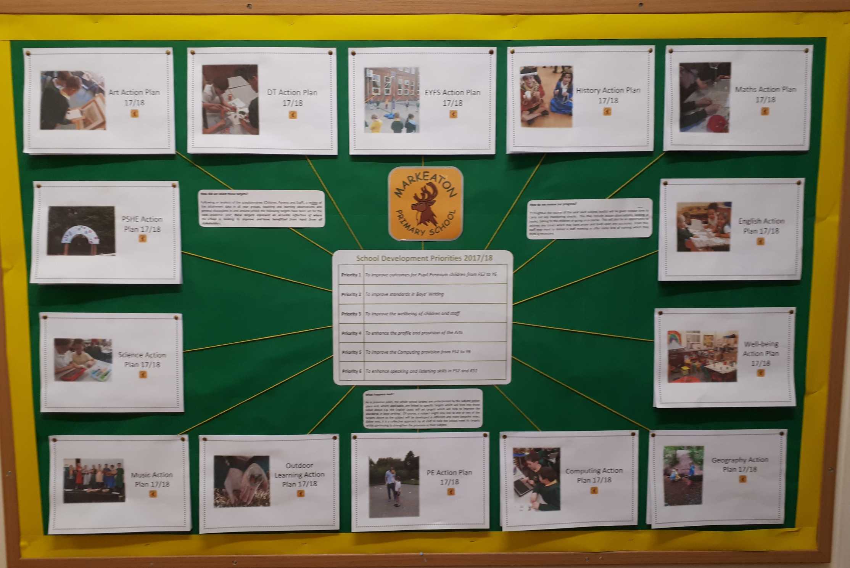

Slide 14
School Development Priorities 16/17
Priority 1 | To close the attainment gap between disadvantaged pupils (Pupil Premium) and non-disadvantaged pupils | Ongoing
Priority 2 | To develop a Growth Mindset philosophy across the school involving pupils, staff and parents | Target Met
Priority 3 | To introduce and develop new strategies and teaching methods to improve mathematical standards across the school | Target Met
Priority 4 | To further raise attainment in SPaG with a particular emphasis on spelling | Target Met
Priority 5 | To enhance the profile and provision of outdoor learning | Target Met

Slide 15
School Development Priorities 17/18
Priority 1 | To improve outcomes for Pupil Premium children from FS2 to Y6
Priority 2 | To improve standards in Boys’ Writing
Priority 3 | To improve the wellbeing of children and staff
Priority 4 | To enhance the profile and provision of the Arts
Priority 5 | To improve the Computing provision from FS2 to Y6
Priority 6 | To enhance speaking and listening skills in FS2 and KS1

