Slide 1
Markeaton Midnight Snowdon Challenge
19th May 2018

Slide 2
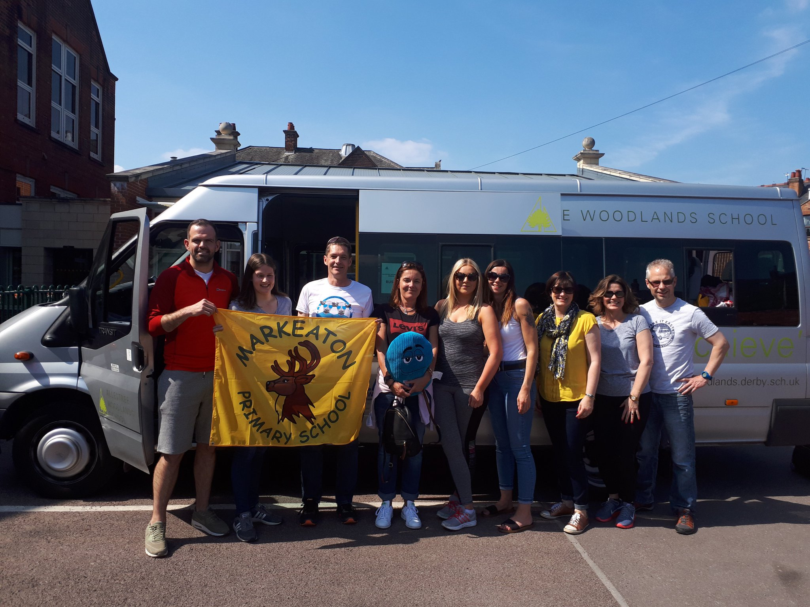
Setting off…

Slide 3
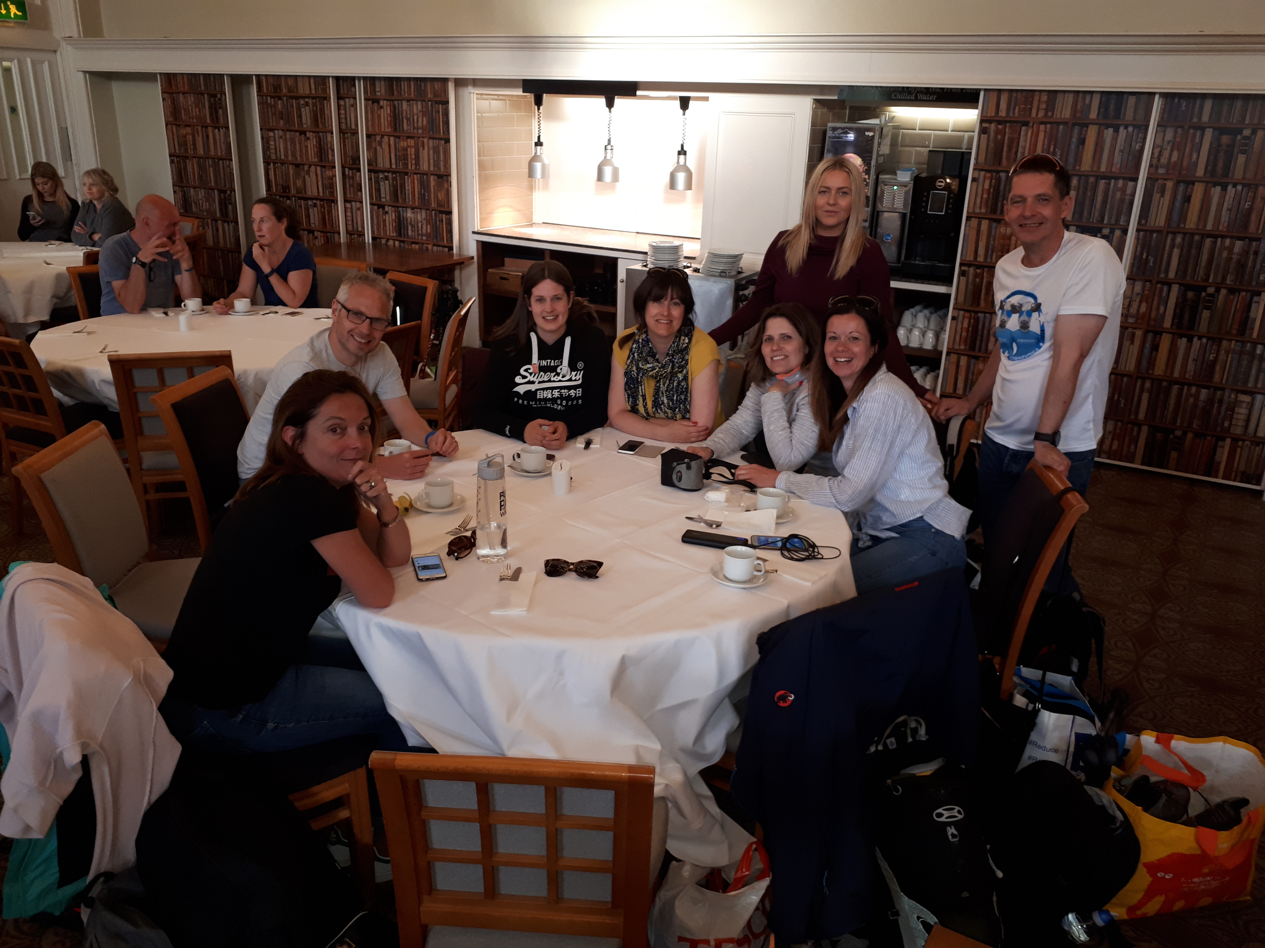
Pre-climb meal (lots of carbohydrates)…

Slide 4
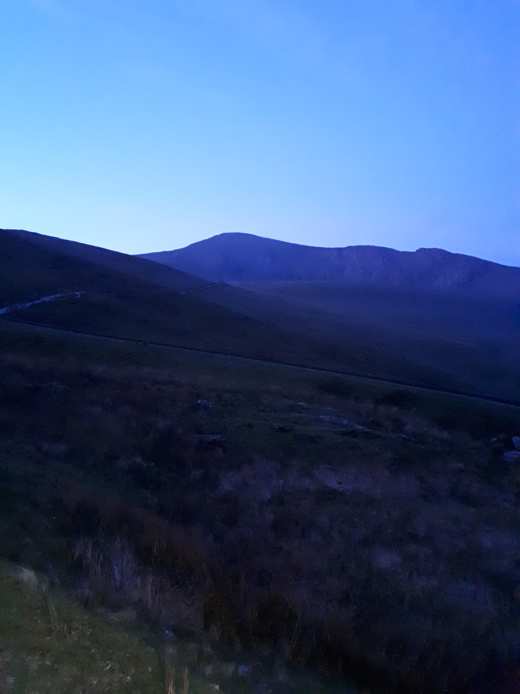
The climb…

Slide 5
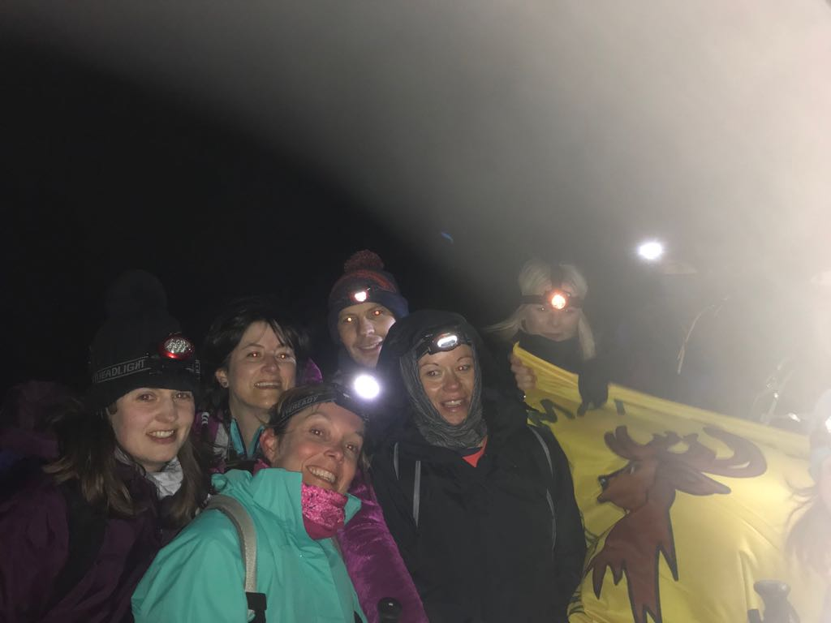
At the top (it was a bit windy and very dark!)…
Mr Rowcroft
Miss Gaskin
Mr Johnson
Mrs Beddington
Mr Johnston
Miss Yeoman
Mrs Wilbur
Miss Ball

Slide 6
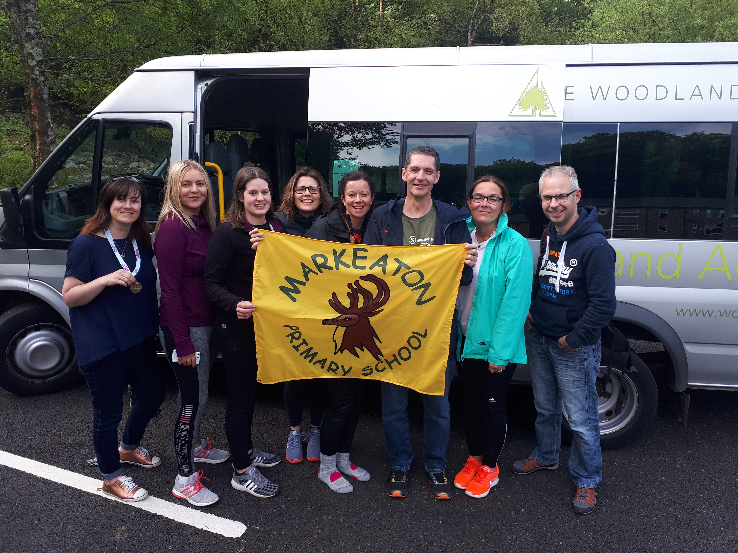
At the bottom just before we set off for home…

Slide 7
A huge thank you to everyone for all your support and donations!

