Slide 1
Children’s Mental Health Week
5 – 11 February 2018
Assembly slides for Primary Schools
Being Ourselves

Slide 2
Reflect
Listen to the music;
Think of three qualities that you really like about yourself;
Why do you like those qualities?

Slide 3
Bingo
Who thinks they have a nice smile?

Slide 4
Bingo
Who thinks they are funny?

Slide 5
Bingo
Who thinks they are kind?

Slide 6
Bingo
Who thinks they think of others before themselves?

Slide 7
Bingo
Who thinks they are respectful?

Slide 8
Bingo
Who thinks they don’t give up easily?

Slide 9
Bingo
Who thinks they always see the best in people?

Slide 10
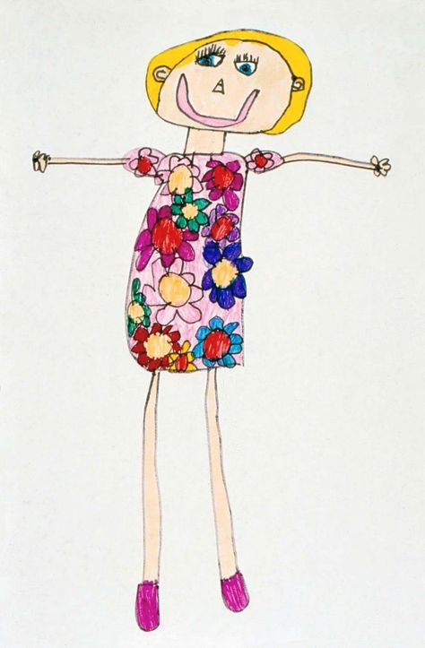
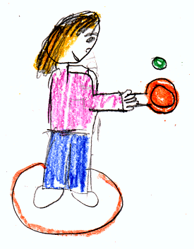
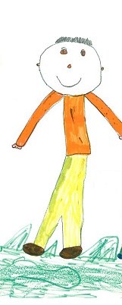
Draw your own selfie…make sure it tells the world what a special person you are…
Competition
Slide 2

