Slide 1
Children’s Mental Health Week
4 – 10 February 2019
Healthy: Inside and Out
Assembly slides for Primary Schools

Slide 2
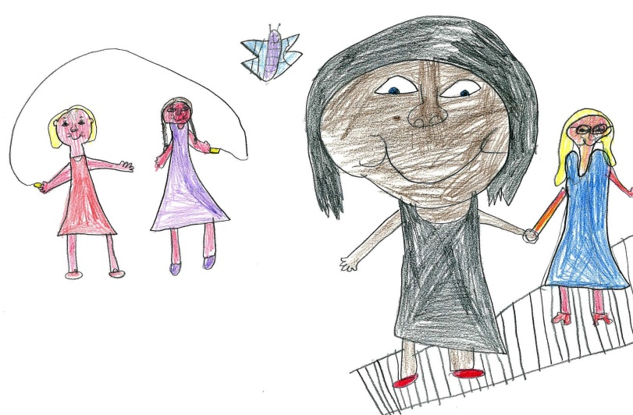
Being healthy
How do we stay healthy?
Food
Being active
Sleep

Slide 3
Being healthy
How do we stay ‘food healthy’…
…and what does this mean?

Slide 4
Being healthy
How do we stay ‘active healthy’…
or sometimes ‘not
active healthy’ at all…?

Slide 5
Being healthy
Being able to let go…it’s a skill you know
https://www.youtube.com/watch?v=c1Ndym-IsQg

Slide 6
Being healthy
How do we stay ‘sleep healthy’…
…surely we just close our eyes?

Slide 7
Being healthy
…or is there more to it?
https://www.youtube.com/watch?v=wyj8l9miy4w

Slide 8
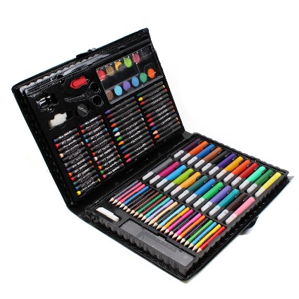
Competition
Come and get one of Markeaton’s very own Mindfulneess colouring sheets. The best entry will be put on the website, Twitter and in the school entrance. They will also receive some brand new art equipment to help them carry on with their excellent designs in the future! One winner for KS1, LKS2 and UKS2.
On Friday, we will be coming together as a school and hearing all about your Mental health work throughout the week!
I am meeting with Chellaston Academies very own Mental Health Council this afternoon. If you are in Y4-6 and this is something you would be interested in being a part of then please let me know at lunchtime.

